Slide 1

PRODUCT TOUR
Before an important
conversation.
Understand yourself. Prepare for the conversation.
Turn insight into everyday action.
01
Notes:
[Sources]
- Official Empatyzer logotype supplied by the user: EMPATYZER (1).svg.
[/Sources]

Slide 2
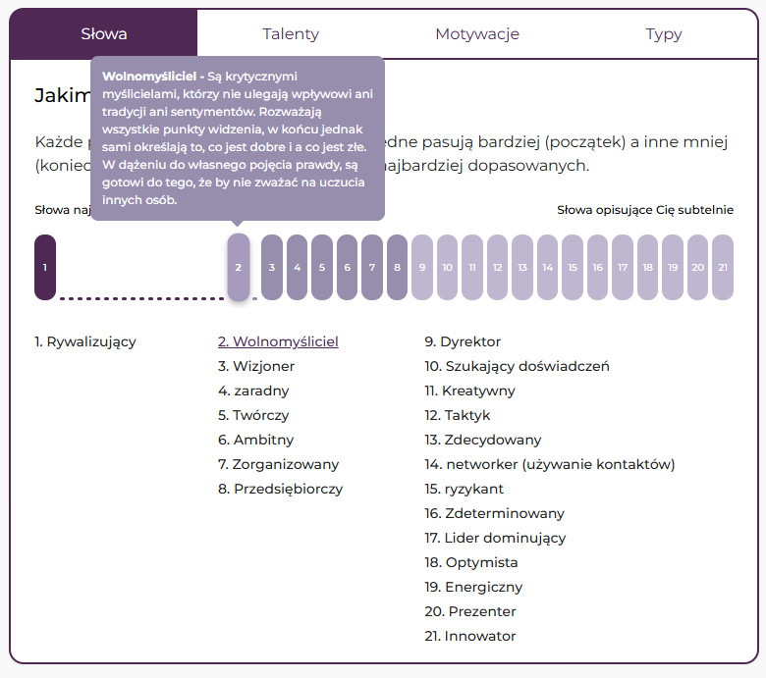
HOW THE PLATFORM WORKS
Empatyzer brings three elements together.
01
YOUR ASSESSMENT
Understand your profile, strengths and internal tensions.
02
CONVERSATIONS
Choose a person or group, see tailored guidance and ask Em.
03
MICROLEARNING
Turn insight into action through short, practical lessons.
02
Notes:
[Sources]
- Three product mechanisms from the user-provided Empatyzer master: diagnosis, Ask Em and personalized micro-lessons.
[/Sources]

Slide 3

HOW THE PLATFORM WORKS
Three pillars of Empatyzer.
01 YOUR ASSESSMENT
Understand yourself.
02 CONVERSATIONS
ABOUT YOU
personal development
PERSON
advice · comparison · remember · how they help
GROUP
team · project group · department
03 MICROLEARNING
Turn insight into action.
03
Notes:
[Sources]
- Symbol M supplied by the user: Vector.svg; embedded as a compatible transparent PNG.
[/Sources]

Slide 4
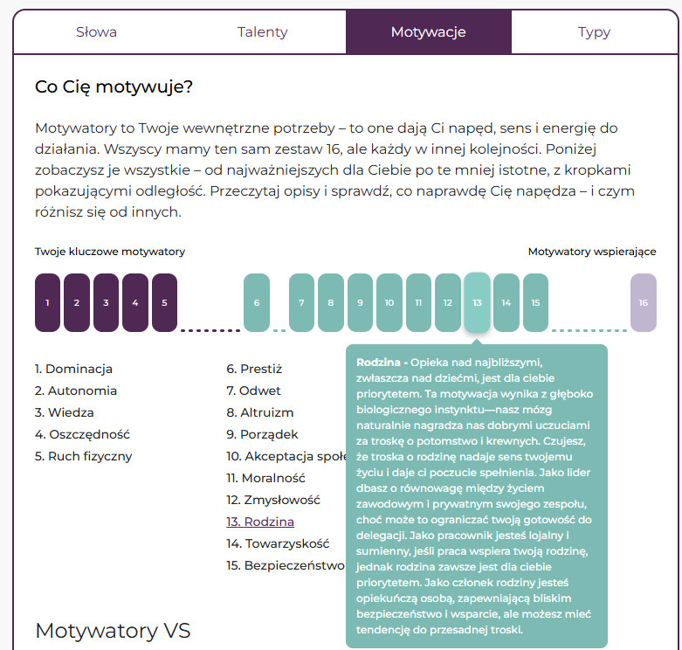
01
SECTION 01
First, understand yourself.
YOUR ASSESSMENT
04
Notes:
[Sources]
- User-provided Empatyzer master: section structure and brand system.
[/Sources]

Slide 5
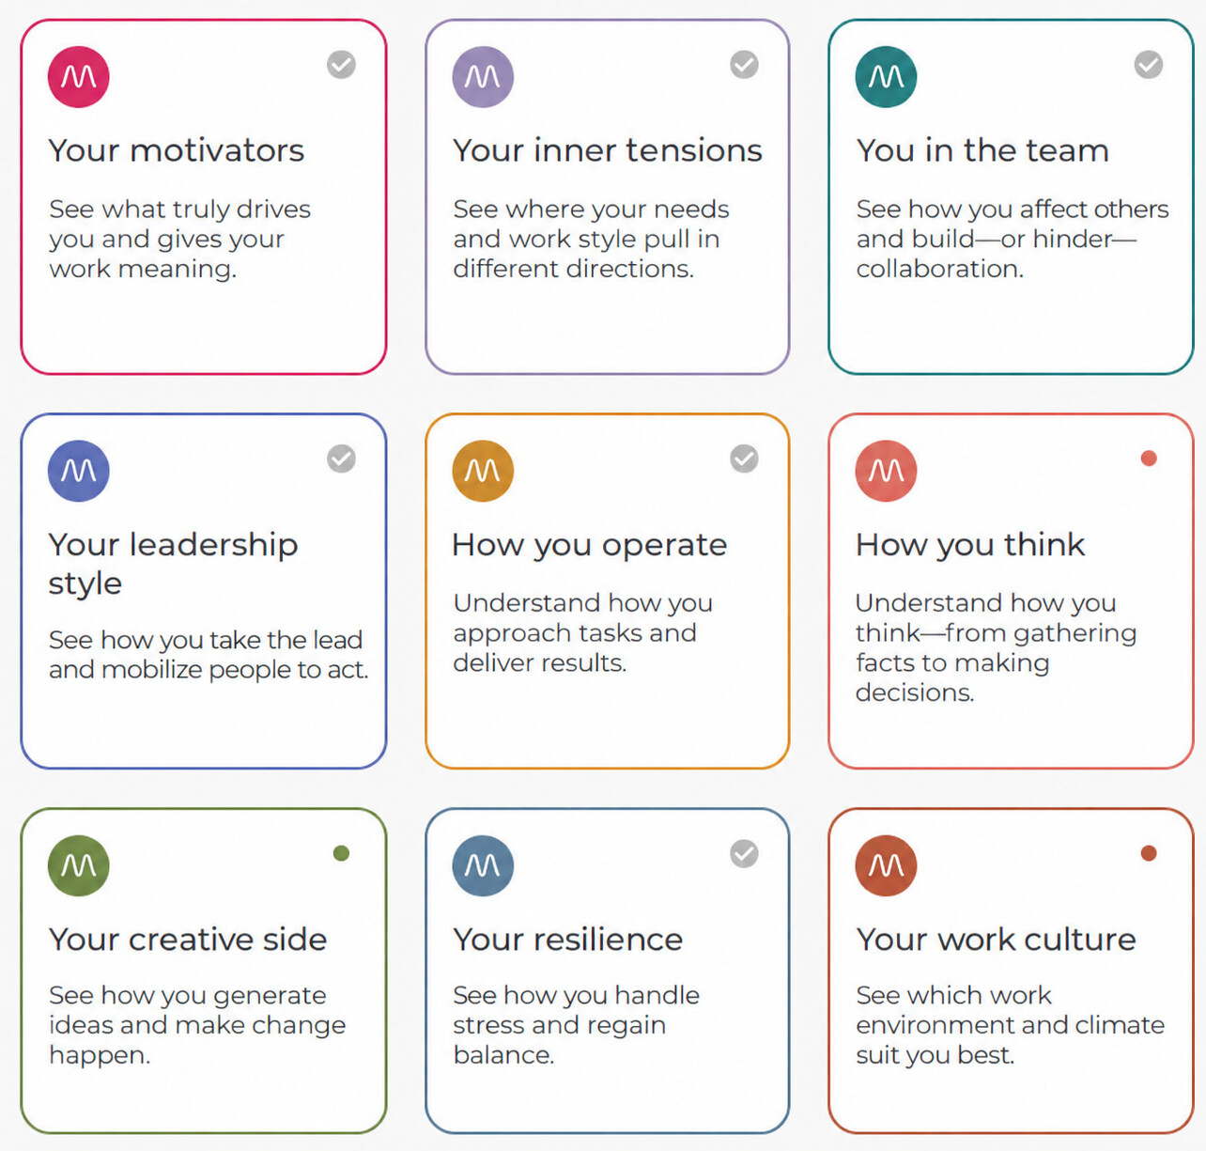
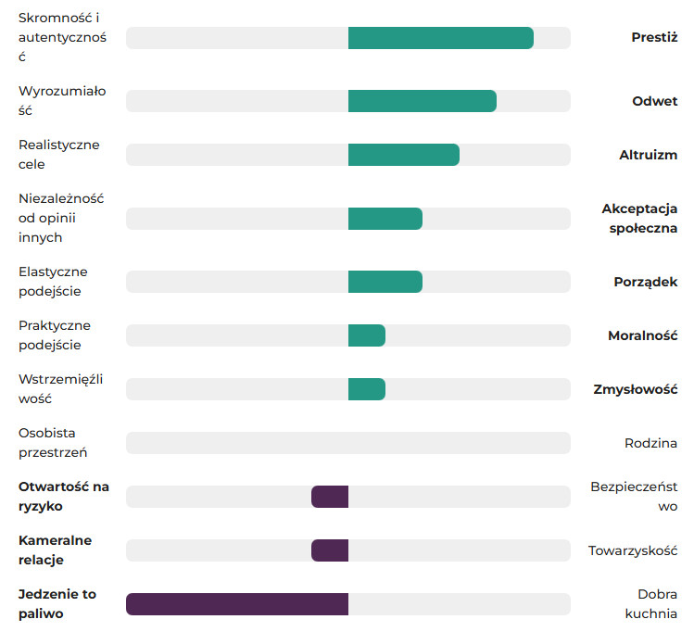
ASSESSMENT · AREAS
Choose an area of your profile.
Nine perspectives show how you operate from different angles.
05
Notes:
[Sources]
- English interface reconstruction based on the user-provided Empatyzer product screenshot.
[/Sources]

Slide 6
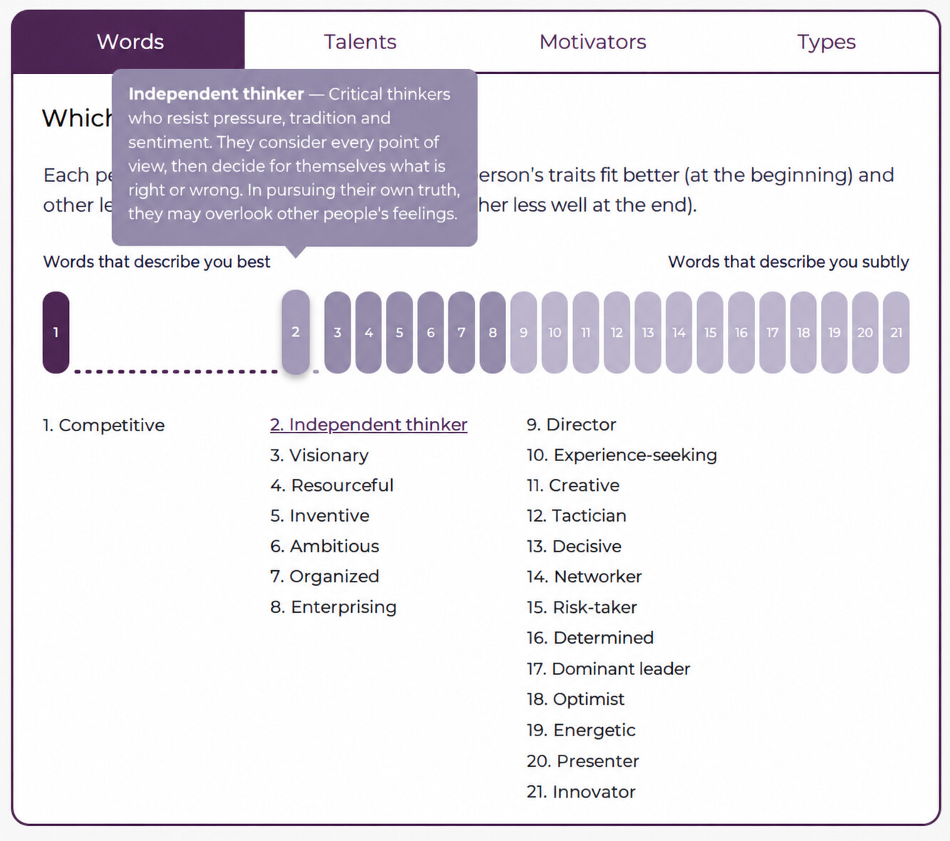
ASSESSMENT · WORDS
Your words show how you naturally operate.
The ranking highlights subtle differences in how you approach work.
06
Notes:
[Sources]
- English interface reconstruction based on the user-provided Empatyzer product screenshot.
[/Sources]

Slide 7
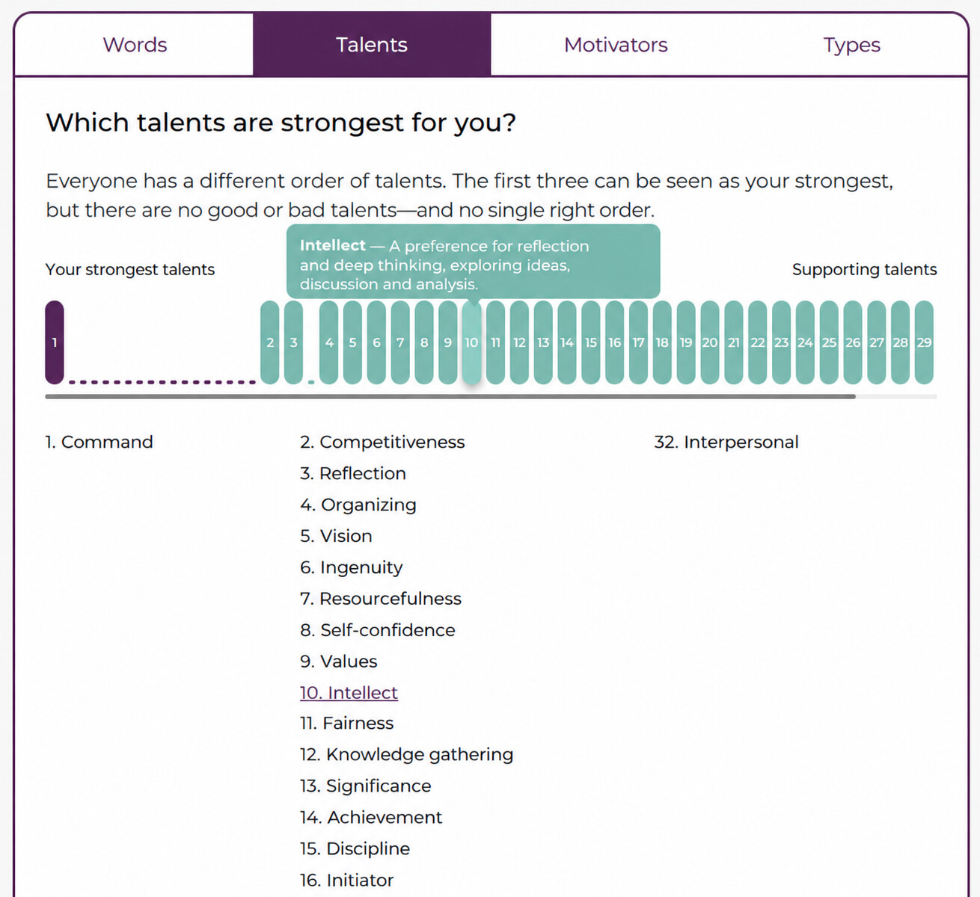
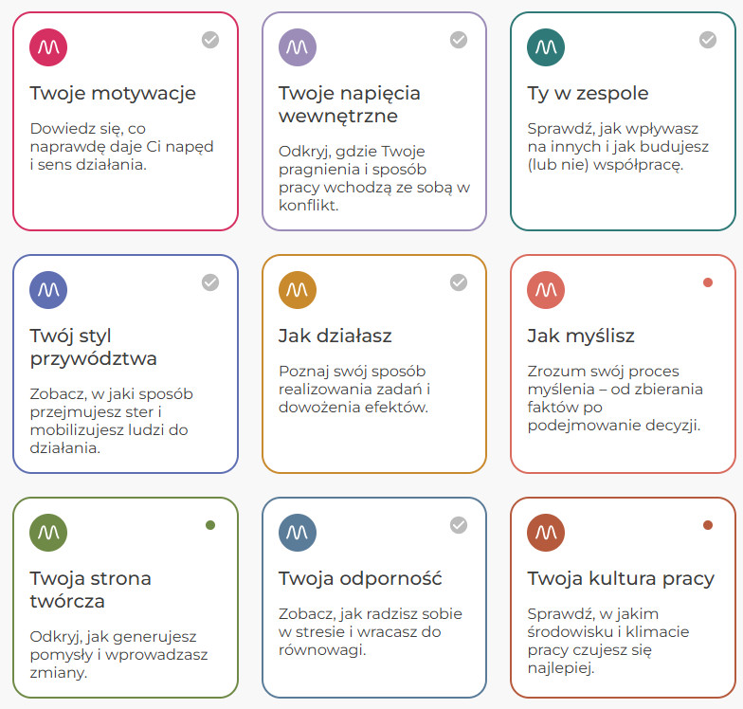
ASSESSMENT · TALENTS
Talents show what you reach for first.
The results distinguish dominant talents from supporting ones.
07
Notes:
[Sources]
- English interface reconstruction based on the user-provided Empatyzer product screenshot.
[/Sources]

Slide 8
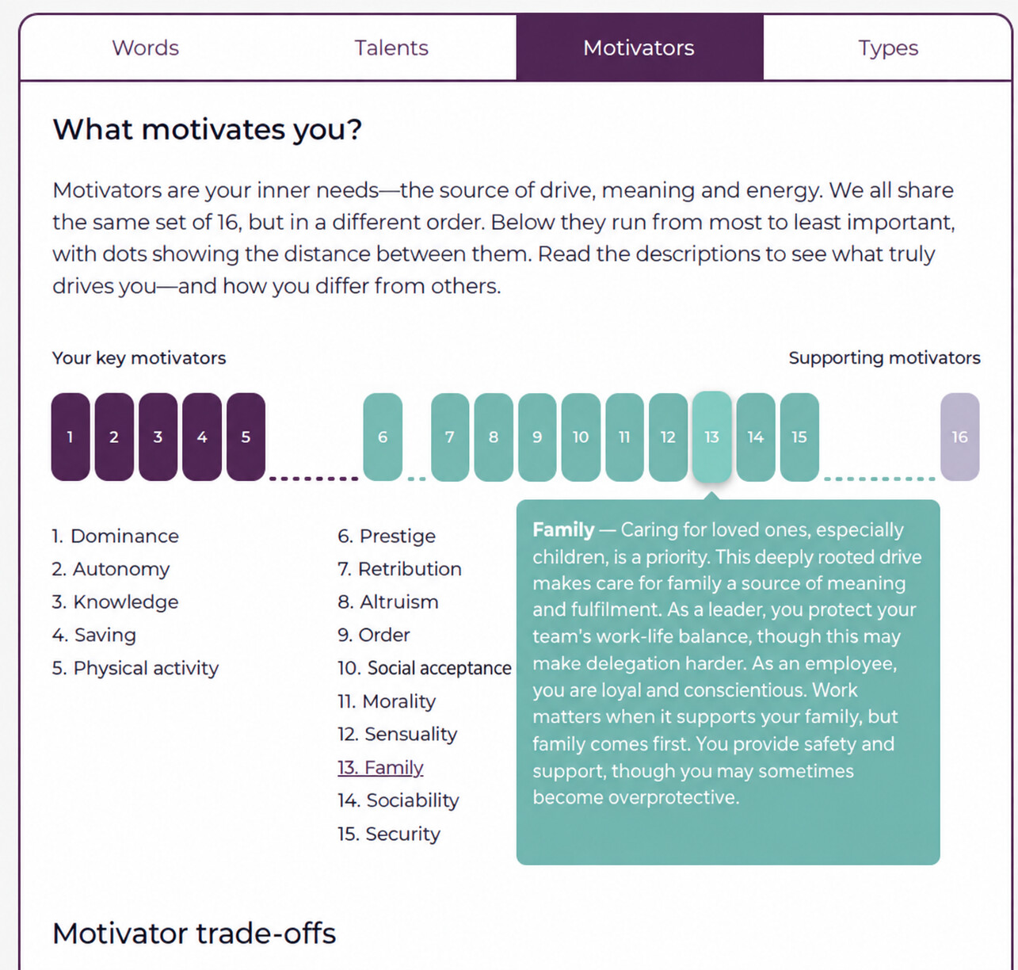
ASSESSMENT · MOTIVATORS
Motivators show what gives you energy.
The profile shows what gives you drive, meaning and energy to act.
08
Notes:
[Sources]
- English interface reconstruction based on the user-provided Empatyzer product screenshot.
[/Sources]

Slide 9
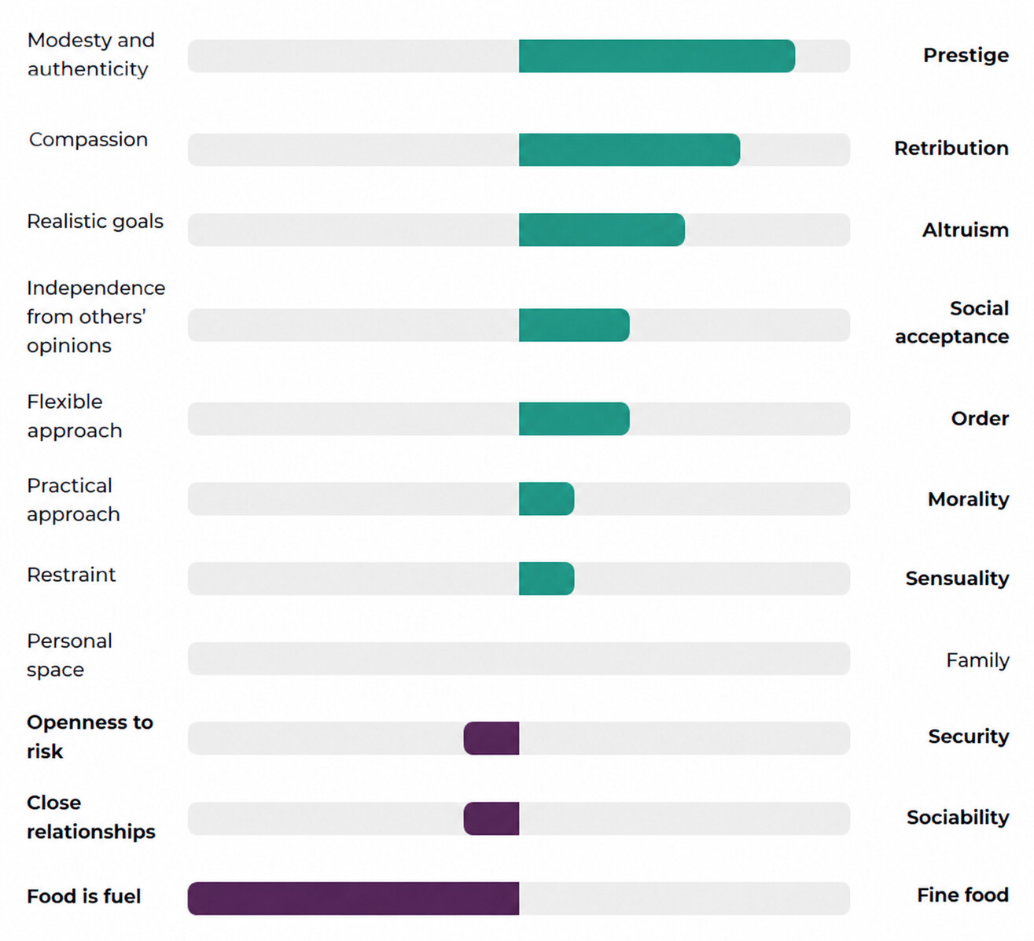
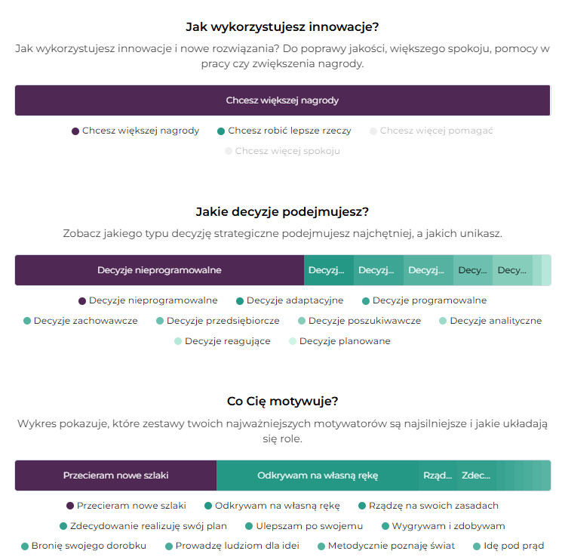
ASSESSMENT · TENSIONS
Internal tensions matter as much as strengths.
Paired scales reveal internal tensions, not only the highest results.
09
Notes:
[Sources]
- English interface reconstruction based on the user-provided Empatyzer product screenshot.
[/Sources]

Slide 10
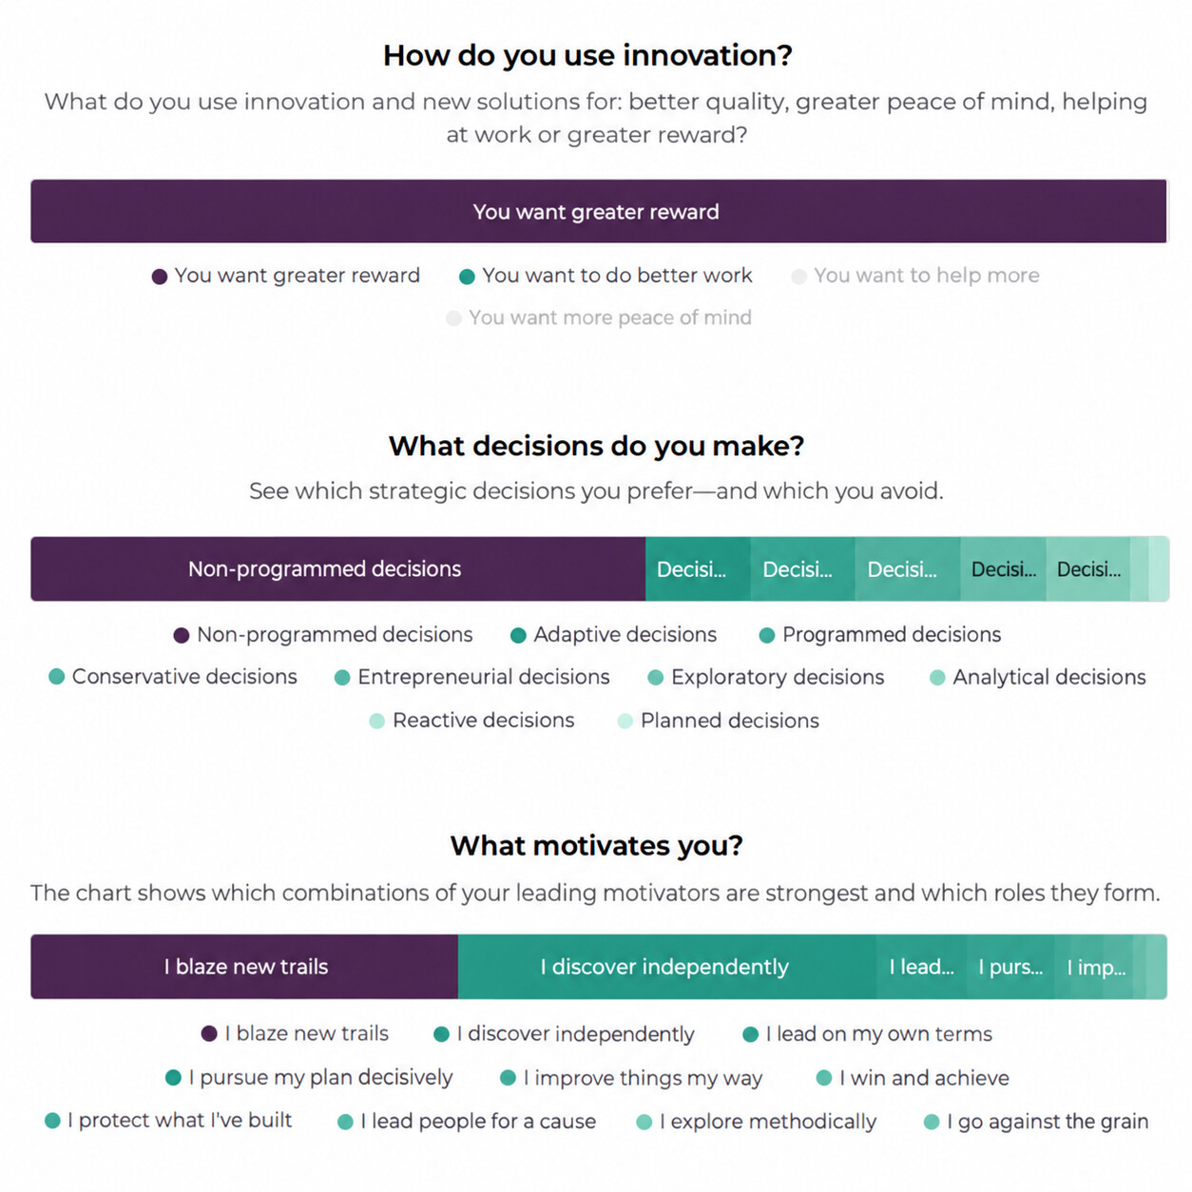
ASSESSMENT · PATTERNS
One profile connects traits, decisions and motivations.
Different perspectives create a practical picture of how you operate.
10
Notes:
[Sources]
- English interface reconstruction based on the user-provided Empatyzer product screenshot.
[/Sources]

Slide 11
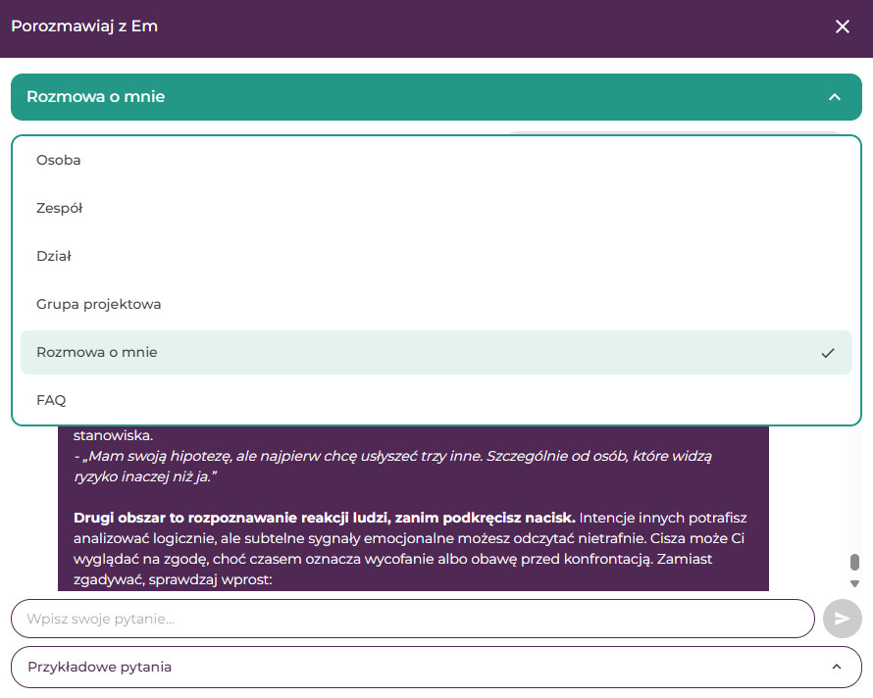
02
SECTION 02
Choose a person or group.
Prepare the conversation.
CONVERSATIONS
11
Notes:
[Sources]
- User-provided Empatyzer master: section structure and brand system.
[/Sources]

Slide 12

CONVERSATION WITH EM · CONTEXT
First, choose who your question is about.
You can ask Em about yourself, a selected person, a team, a project group or a department.
12
Notes:
[Sources]
- English interface reconstruction based on the user-provided Empatyzer product screenshot.
[/Sources]

Slide 13
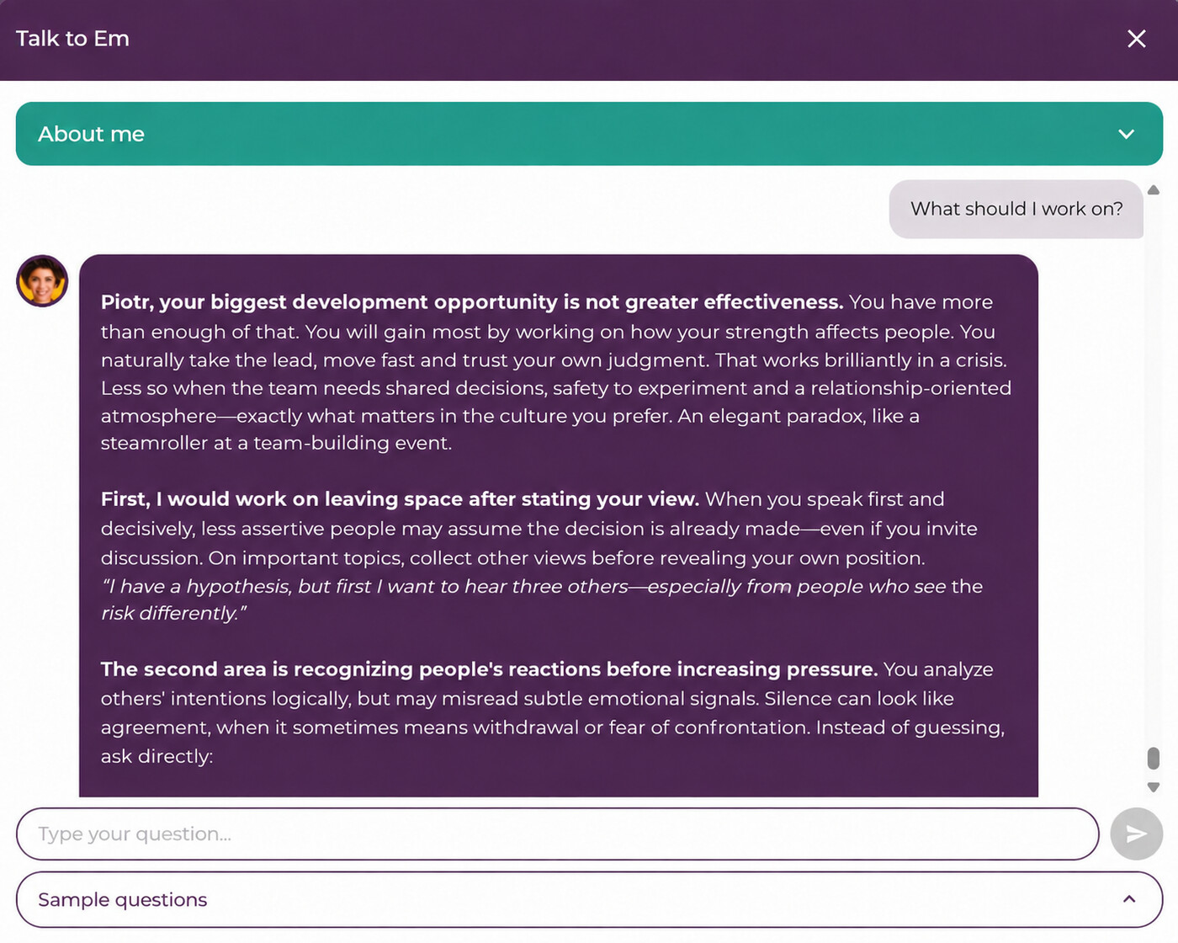
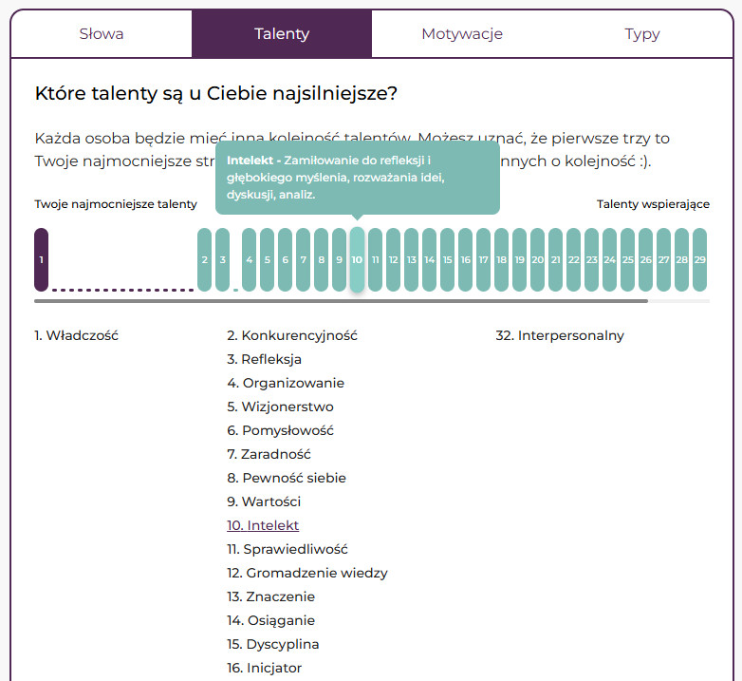
CONVERSATION WITH EM · DEVELOPMENT
Ask Em about your own development.
Alex, your biggest development
Em tailors guidance to the results of your assessment.
13
Notes:
[Sources]
- English interface reconstruction based on the user-provided Empatyzer product screenshot.
[/Sources]

Slide 14
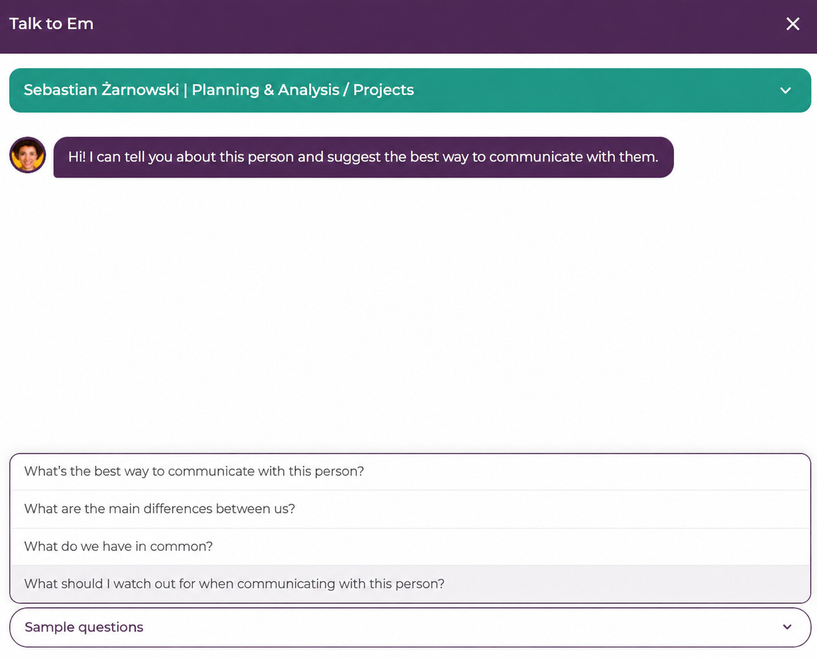
CONVERSATION WITH EM · SELECTED PERSON
Ask Em about a selected person.
Daniel Novak | Strategy & Operations / Projects
Prepare for feedback, a 1:1 conversation or a difficult meeting.
14
Notes:
[Sources]
- English interface reconstruction based on the user-provided Empatyzer product screenshot.
[/Sources]

Slide 15
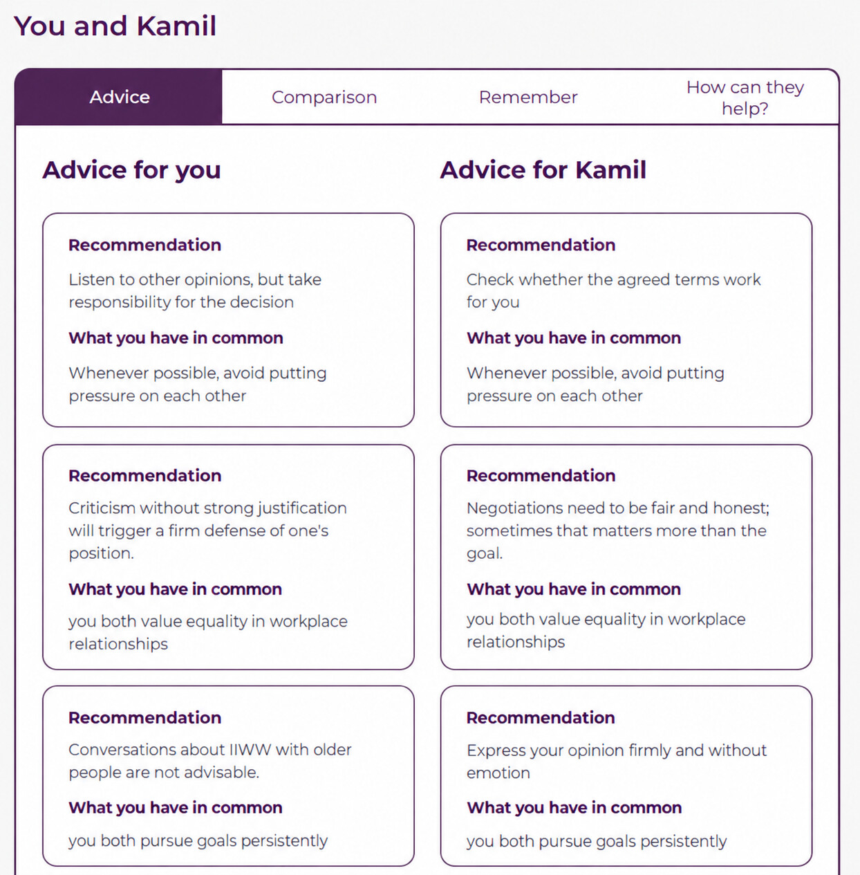
SELECTED PERSON · ADVICE
See guidance for both sides.
You and Adam
Advice for Adam
Advice shows what can make your conversation and collaboration easier.
15
Notes:
[Sources]
- English interface reconstruction based on the user-provided Empatyzer product screenshot.
[/Sources]

Slide 16
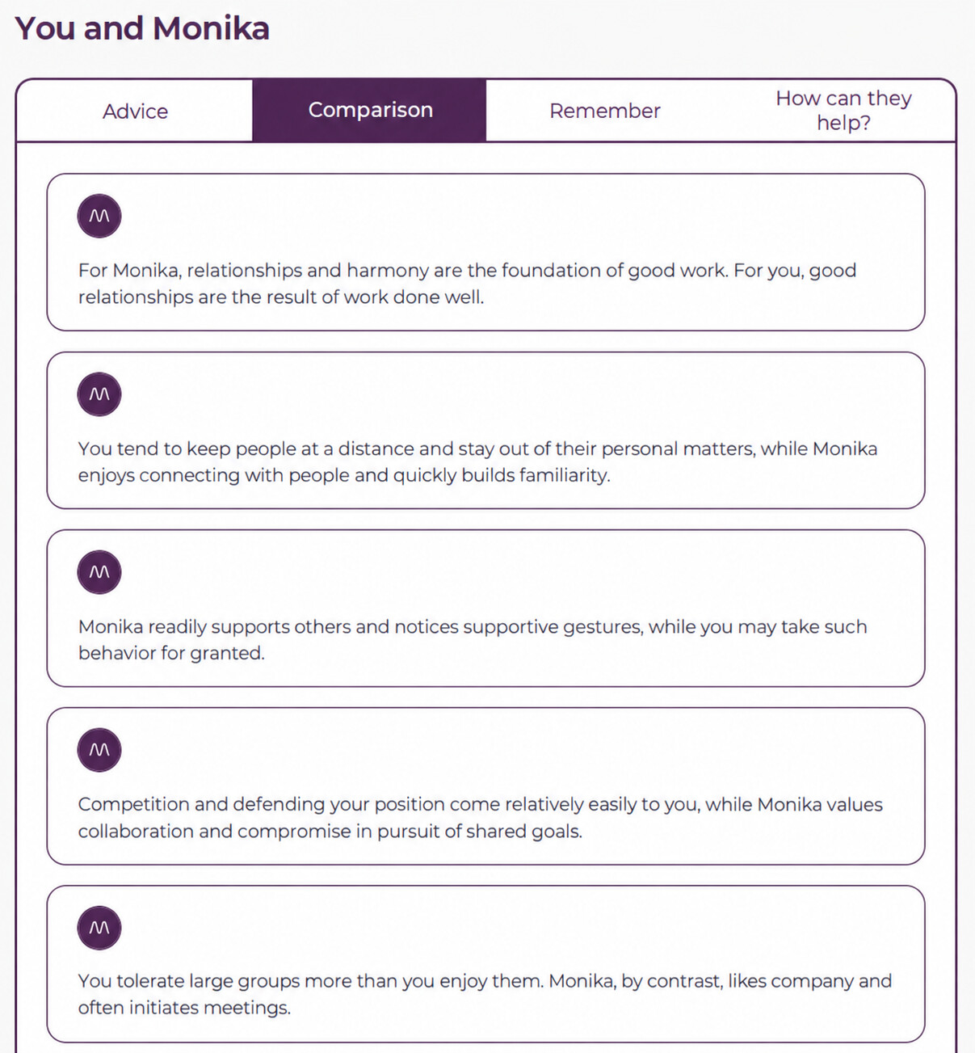
SELECTED PERSON · COMPARISON
See what you share and where you differ.
You and Anna
Anna,
Anna
Anna
Anna
Anna,
Comparison highlights differences that matter for communication and collaboration.
16
Notes:
[Sources]
- English interface reconstruction based on the user-provided Empatyzer product screenshot.
[/Sources]

Slide 17
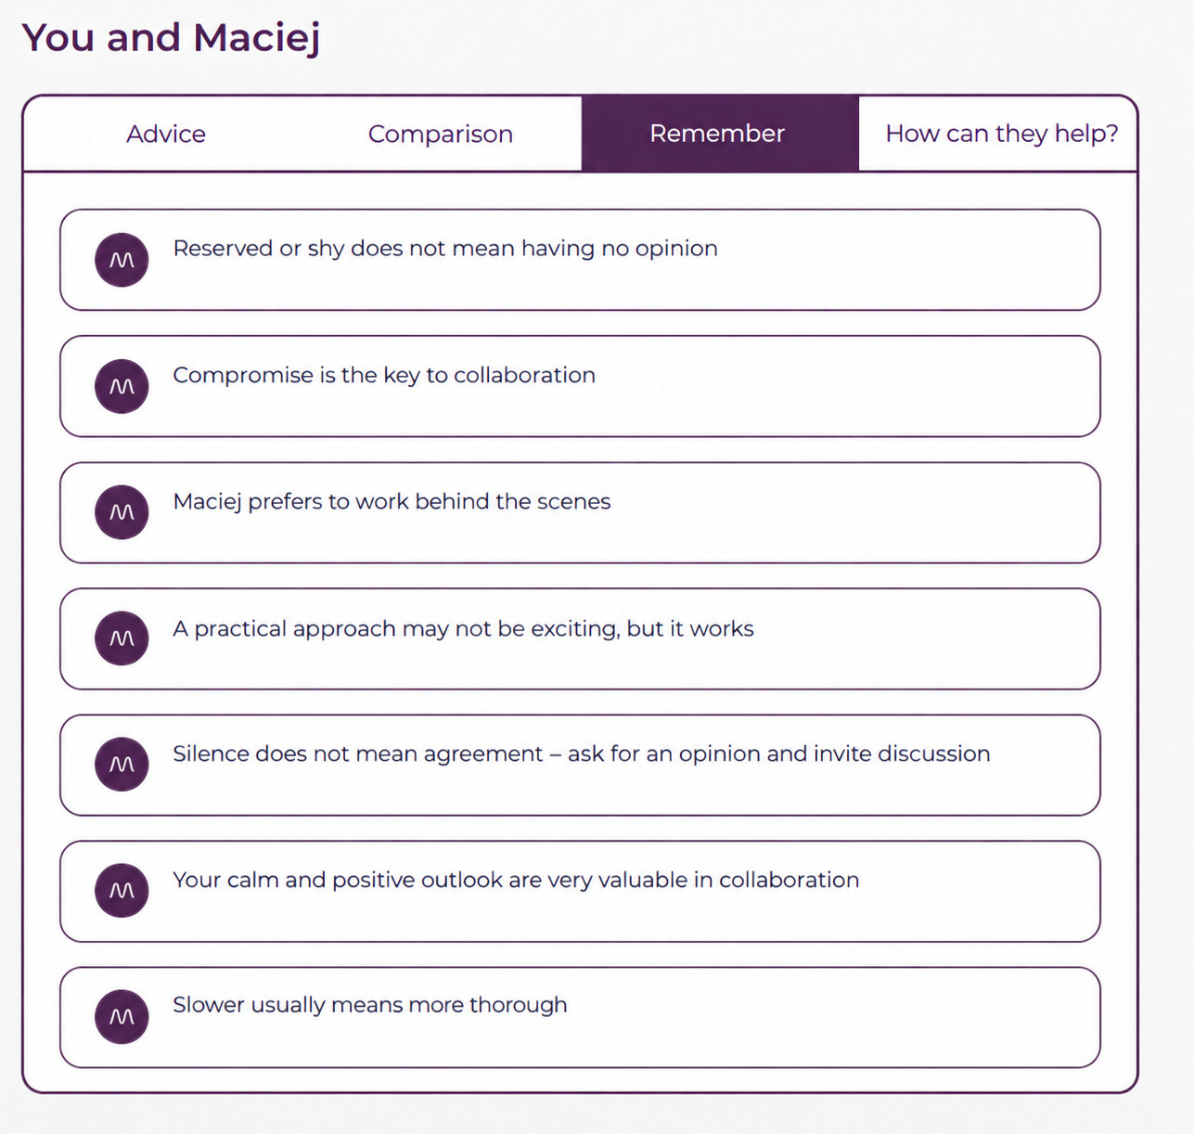
SELECTED PERSON · REMEMBER
See what is worth remembering.
You and Mark
Mark prefers to work
Keep the most important guidance at hand before the conversation.
17
Notes:
[Sources]
- English interface reconstruction based on the user-provided Empatyzer product screenshot.
[/Sources]

Slide 18
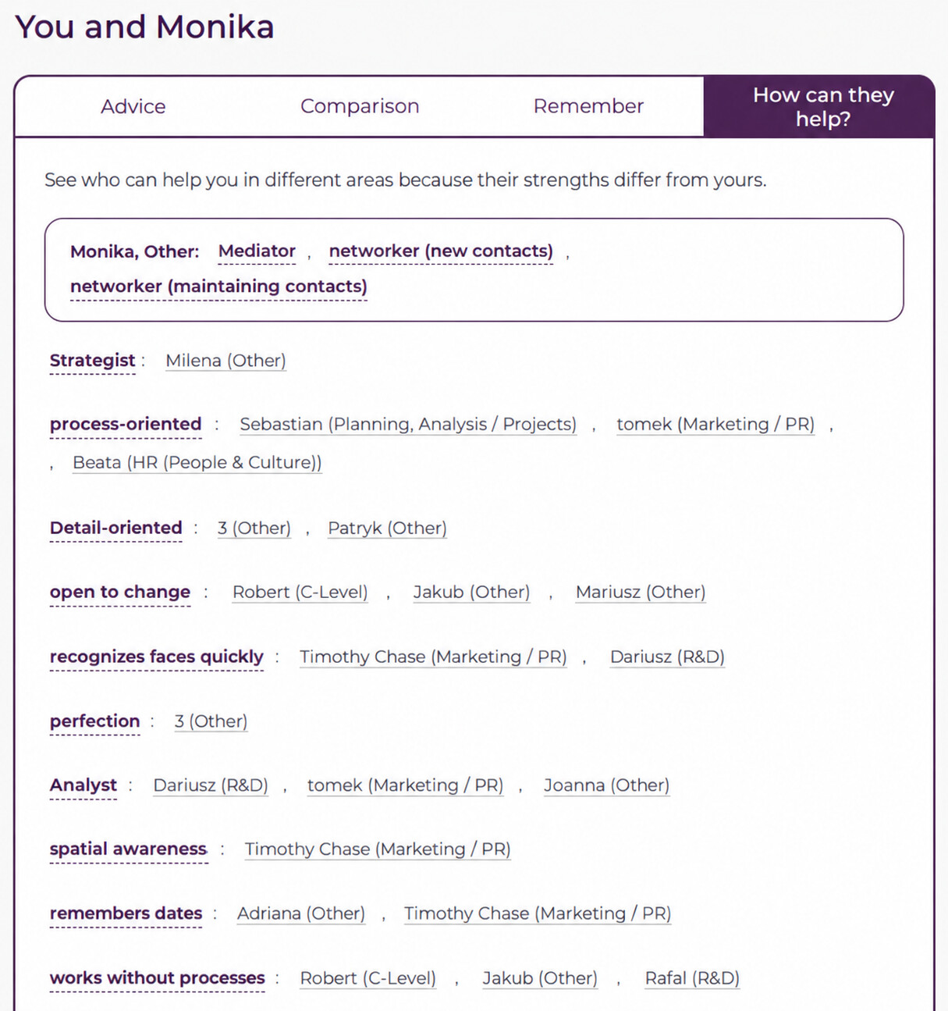
SELECTED PERSON · HOW THEY HELP
See how this person can help you.
You and Anna
Anna, Customer Success: mediator, networker (new contacts),
networker (maintaining contacts)
Strategist
Julia Martin (Finance)
process-oriented
Daniel Novak (Strategy & Operations / Projects), Adam Reed (Marketing / PR),
Anna Lewis (People & Culture)
Detail-oriented
Chris Taylor (Technology), Mia Clark (Finance)
open to change
Lucas King (Executive Team), Mark Evans (Sales), Noah Martin (Customer Success)
recognizes faces quickly
Liam Scott (Marketing / PR), Sophie Davis (R&D)
perfection
Mia Clark (Finance)
Analyst
Sophie Davis (R&D), Adam Reed (Marketing / PR), Julia Martin (Finance)
spatial awareness
Liam Scott (Marketing / PR)
remembers dates
Nina Walker (Administration), Liam Scott (Marketing / PR)
works without processes
Lucas King (Executive Team), Mark Evans (Sales), Emma Lewis (R&D)
Their talents can complement yours in specific tasks.
18
Notes:
[Sources]
- English interface reconstruction based on the user-provided Empatyzer product screenshot.
[/Sources]

Slide 19
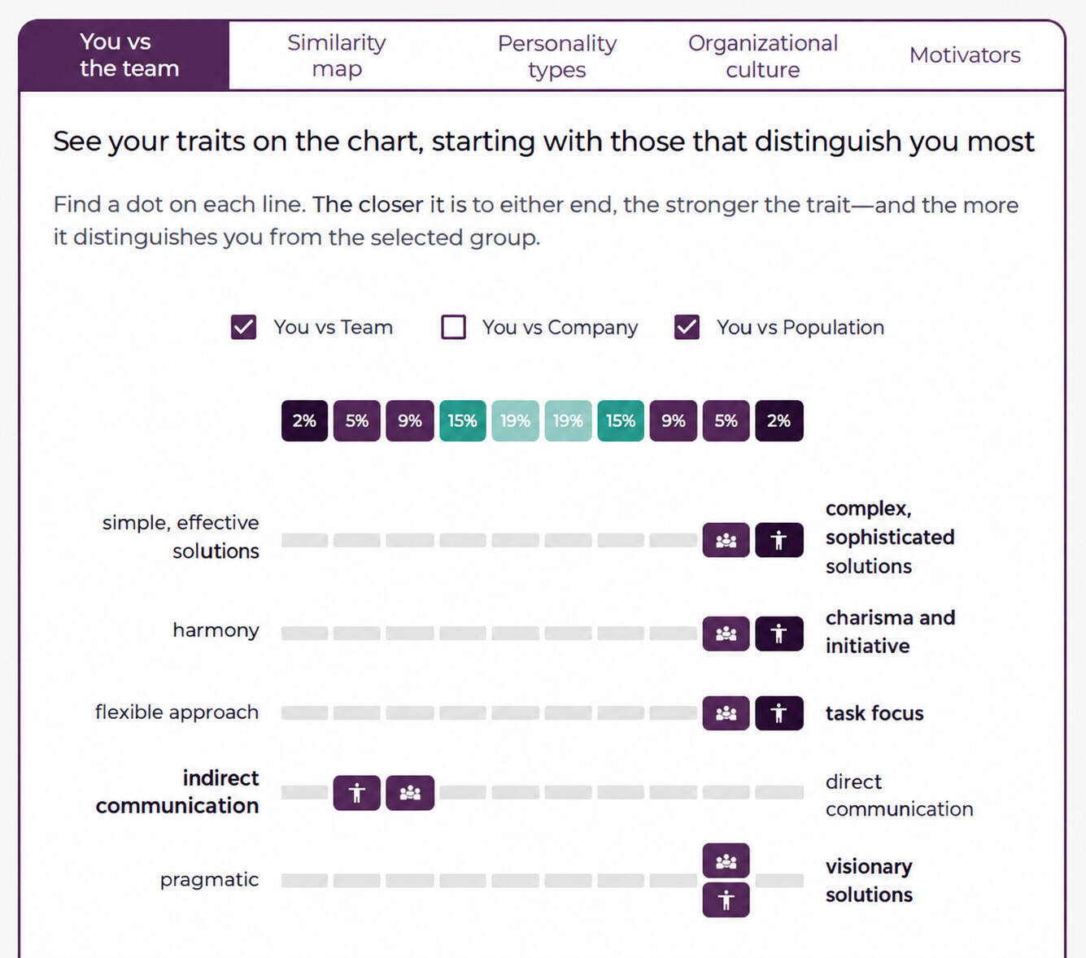
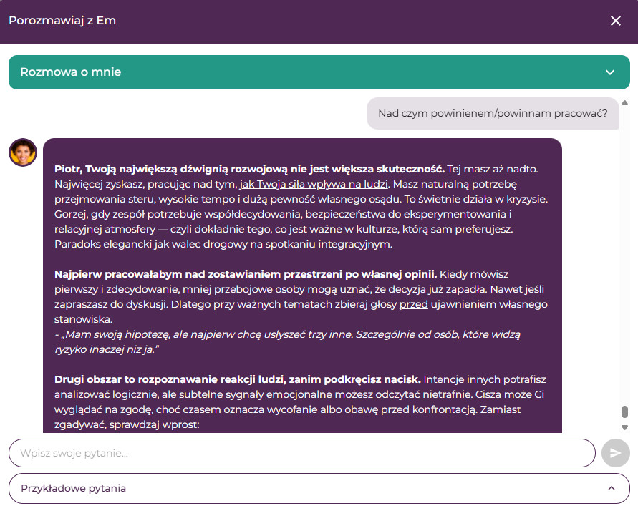
CONVERSATIONS · GROUP
See yourself in the context of a selected group.
Choose a team, project group or department and see your own profile in context.
19
Notes:
[Sources]
- English interface reconstruction based on the user-provided Empatyzer product screenshot.
[/Sources]

Slide 20
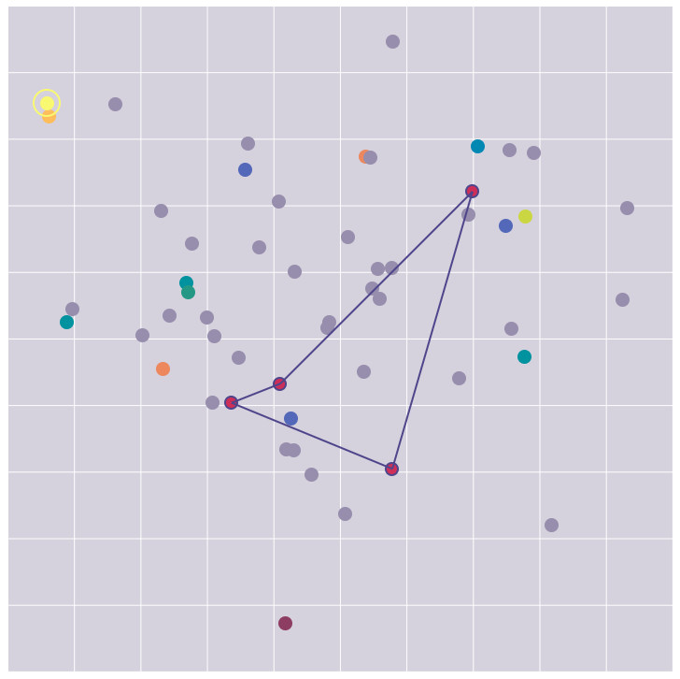
CONVERSATIONS · SIMILARITY MAP
See where you sit on the group map.
The map shows similarities and differences without revealing anyone else's assessment.
20
Notes:
[Sources]
- English interface reconstruction based on the user-provided Empatyzer product screenshot.
[/Sources]

Slide 21
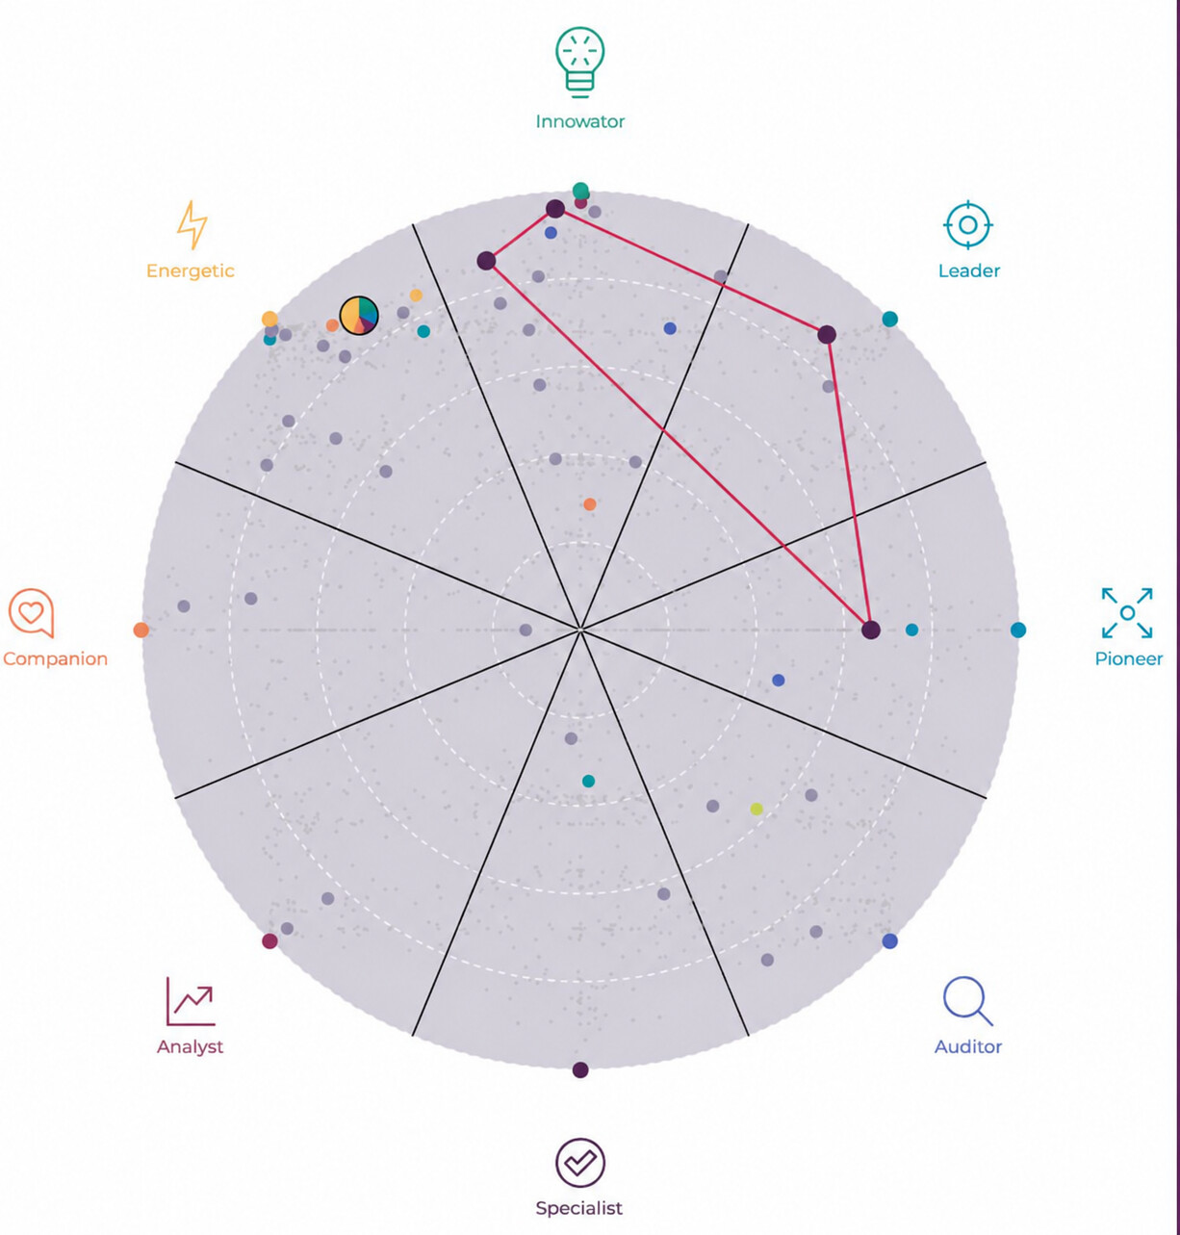
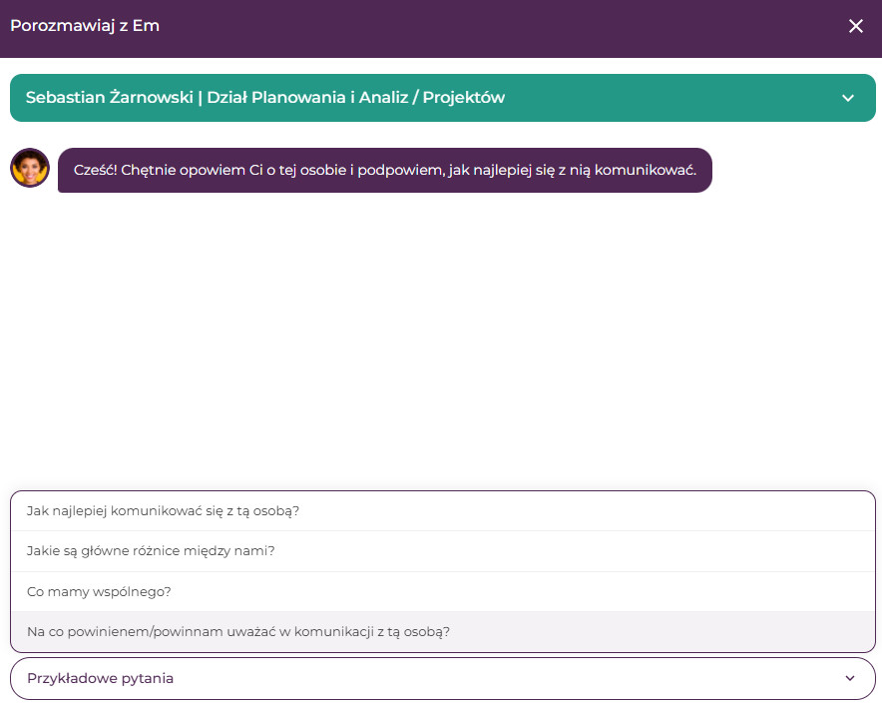
CONVERSATIONS · CAPABILITY MAP
See what you bring to the group.
See which perspectives you contribute and how your profile compares with the group.
21
Notes:
[Sources]
- English interface reconstruction based on the user-provided Empatyzer product screenshot.
[/Sources]

Slide 22
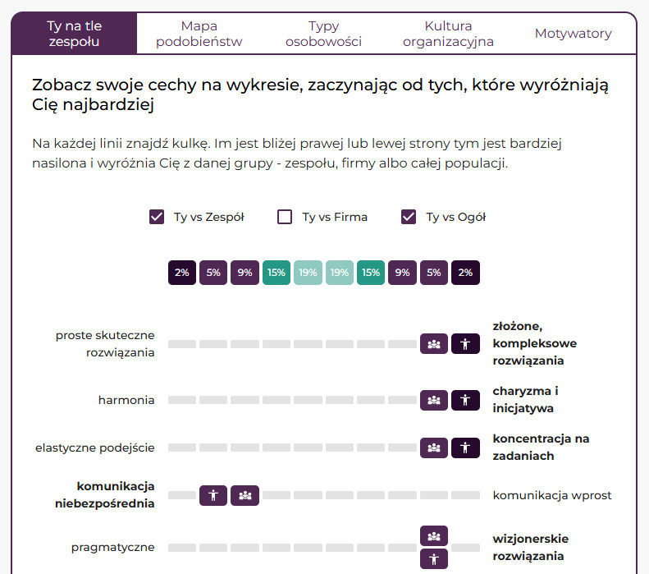
03
SECTION 03
Turn insight into action, step by step.
MICROLEARNING
22
Notes:
[Sources]
- User-provided Empatyzer master: section structure and brand system.
[/Sources]

Slide 23
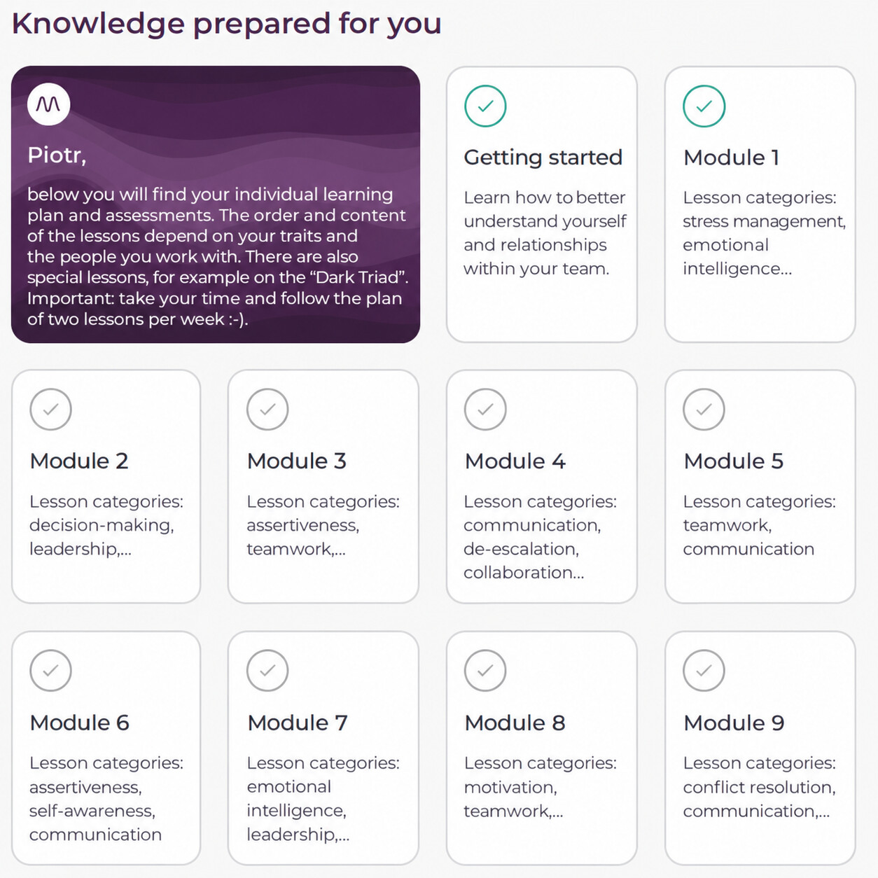
MICROLEARNING · PLAN
Your learning plan adapts to you.
Alex,
The sequence and content reflect your profile and the people you work with.
23
Notes:
[Sources]
- English interface reconstruction based on the user-provided Empatyzer product screenshot.
[/Sources]

Slide 24
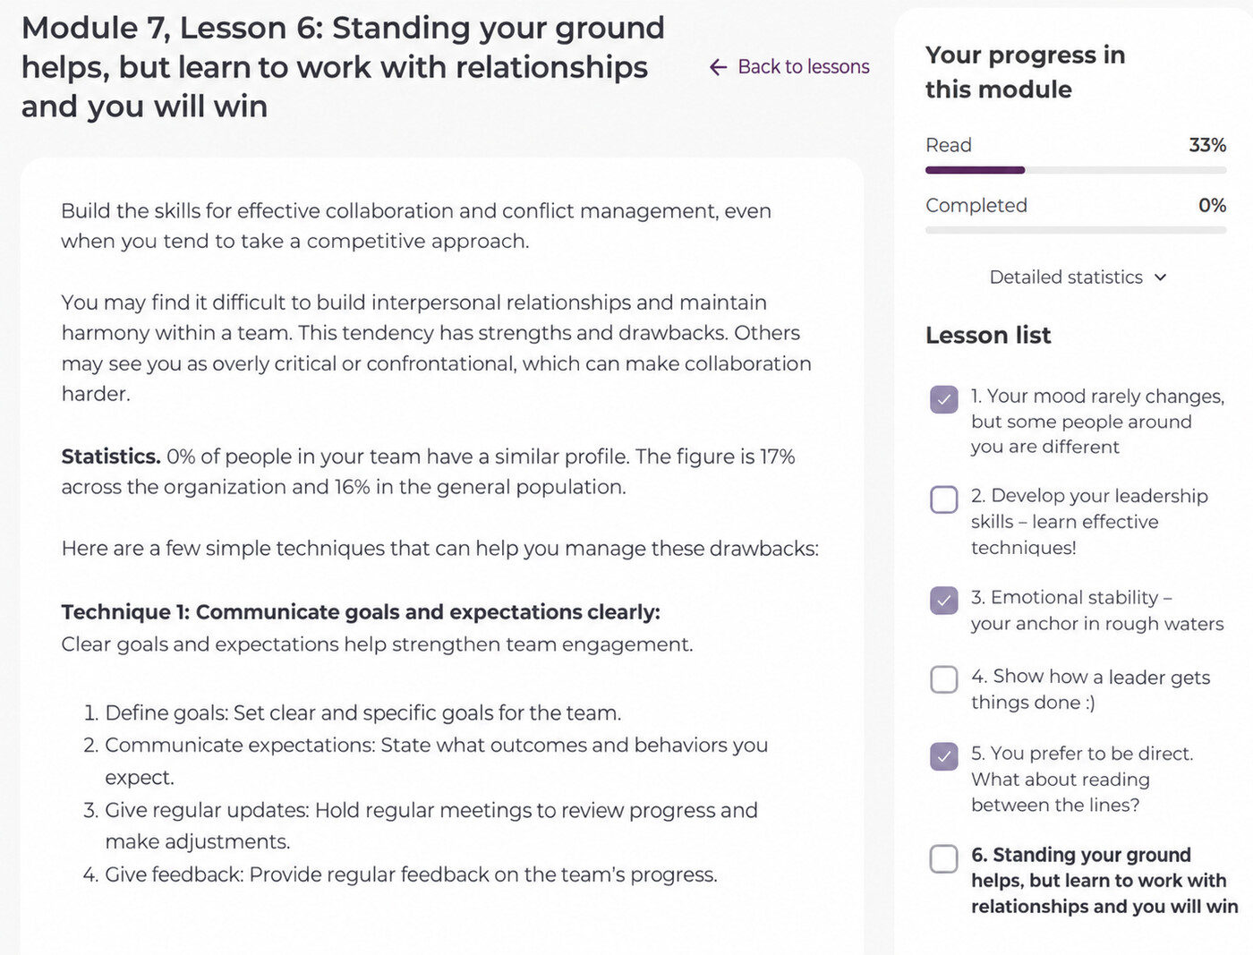
MICROLEARNING · LESSON
Turn insight into concrete action.
Each lesson connects an assessment insight with simple techniques you can use at work.
24
Notes:
[Sources]
- English interface reconstruction based on the user-provided Empatyzer product screenshot.
[/Sources]

Slide 25
SEE HOW IT WORKS IN PRACTICE
Prepare for an important conversation.
Ask Em.
Book a 30-minute demo.
hello@empatyzer.com
empatyzer.com
25
Notes:
[Sources]
- Approved Empatyzer brand positioning and current contact direction from the user's project brief.
[/Sources]

