Slide 1
EMPATYZER · STORIES FROM WORK
Deliver first
Kwestionowanie a dowożenie
Zofia reads Olek’s questions as avoiding responsibility, while Olek reads her reaction as a ban on thinking. Both begin to confirm their own stereotypes.
Notes:
Empatyzer. Story from work: Deliver first.
Zofia reads Olek’s questions as avoiding responsibility, while Olek reads her reaction as a ban on thinking. Both begin to confirm their own stereotypes.
Temat: Kwestionowanie a dowożenie. Bohaterowie: Zofia, Olek.

Slide 2

1
Why are we doing it this way? There’s a simpler route.
Deliver first. Improve it later.
Notes:
Empatyzer. Story from work: Deliver first.
Kadr 1 z 6. Olek kwestionuje sposób realizacji zadania.
Olek: Why are we doing it this way? There’s a simpler route. | Zofia: Deliver first. Improve it later.

Slide 3
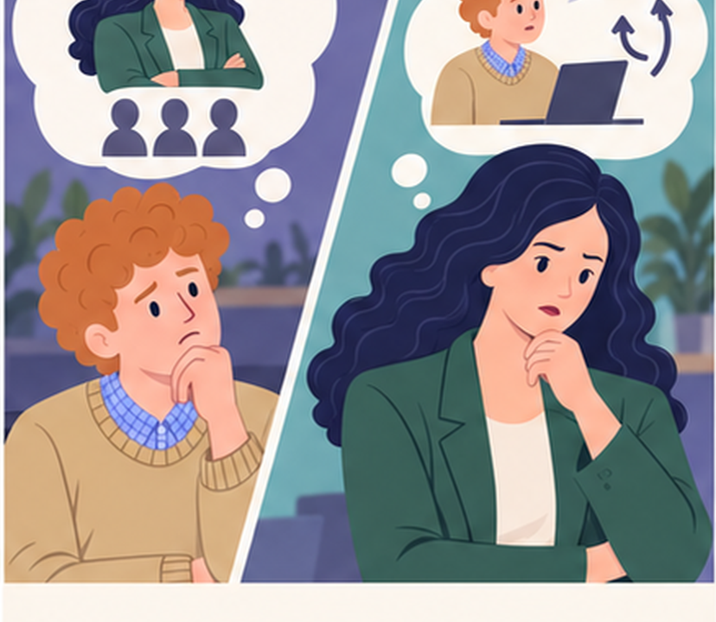
2
She doesn’t want ideas. She wants obedience.
Another debate instead of ownership.
Notes:
Empatyzer. Story from work: Deliver first.
Kadr 2 z 6. Oboje przypisują sobie nawzajem inną intencję.
Olek: She doesn’t want ideas. She wants obedience. | Zofia: Another debate instead of ownership.

Slide 4

3
I knew it. Not much ownership.
Notes:
Empatyzer. Story from work: Deliver first.
Kadr 3 z 6. Olek zaczyna robić tylko to, co zlecono, bez dodatkowych inicjatyw.
Zofia: I knew it. Not much ownership.

Slide 5

4
Why bother engaging if every question about the reason sounds like rebellion?
Notes:
Empatyzer. Story from work: Deliver first.
Kadr 4 z 6. Olek mówi koledze, dlaczego się wycofał.
Olek: Why bother engaging if every question about the reason sounds like rebellion?

Slide 6

5
I thought I was teaching him to deliver.
I learned to keep my head down.
Notes:
Empatyzer. Story from work: Deliver first.
Kadr 5 z 6. Oboje widzą zamknięte koło swoich interpretacji.
Zofia: I thought I was teaching him to deliver. | Olek: I learned to keep my head down.

Slide 7

6
Zofia reads Olek’s questions as a lack of ownership,
while Olek reads her response as a lack of respect
for his voice. He withdraws initiative and thereby
gives Zofia apparent evidence that confirms her
first judgement. Separate a question about method
from a refusal to deliver. Agree what is a closed
decision and what can still be improved.
EMPATYZER · BEFORE AN IMPORTANT CONVERSATION
Notes:
Empatyzer. Story from work: Deliver first.
Podsumowanie Em: Zofia reads Olek’s questions as a lack of ownership, while Olek reads her response as a lack of respect for his voice. He withdraws initiative and thereby gives Zofia apparent evidence that confirms her first judgement. Separate a question about method from a refusal to deliver. Agree what is a closed decision and what can still be improved.
Empatyzer pomaga przygotować sposób komunikacji przed ważną rozmową.

