Slide 1
EMPATYZER · STORIES FROM WORK
List versus diagram
Lista a diagram
Tomasz records the agreement as a list, while Amira uses a dependency diagram. Different formats look like a disagreement about content even though they show much of the same thing.
Notes:
Empatyzer. Story from work: List versus diagram.
Tomasz records the agreement as a list, while Amira uses a dependency diagram. Different formats look like a disagreement about content even though they show much of the same thing.
Temat: Lista a diagram. Bohaterowie: Tomasz, Amira.

Slide 2
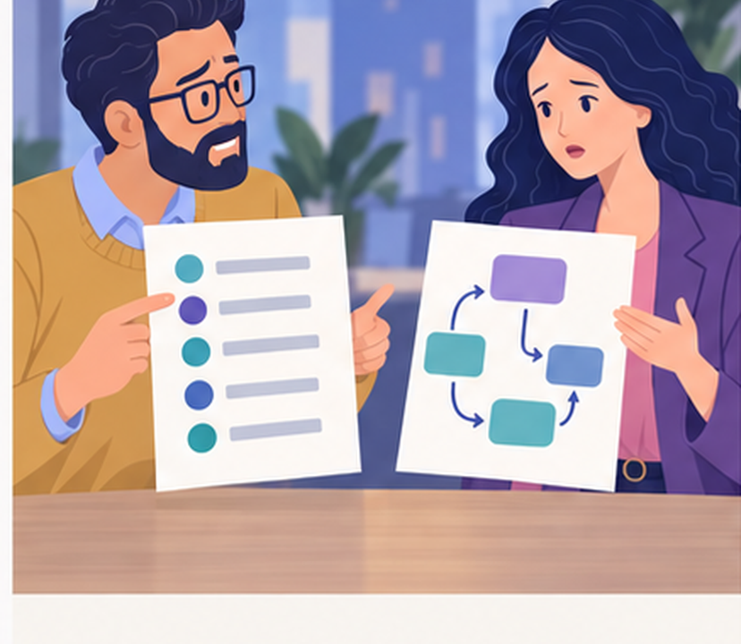
1
AFTER THE MEETING
This list leaves out the dependencies between the elements.
These are the decisions we made.
Notes:
Empatyzer. Story from work: List versus diagram.
Kadr 1 z 6. Po spotkaniu Tomasz ma listę punktów, Amira diagram przepływu.
Tomasz: These are the decisions we made. | Amira: This list leaves out the dependencies between the elements.

Slide 3

2
The diagram doesn’t show the order of decisions.
The list doesn’t show what depends on what.
Notes:
Empatyzer. Story from work: List versus diagram.
Kadr 2 z 6. Wymieniają się listą i diagramem w mailach.
Tomasz: The diagram doesn’t show the order of decisions. | Amira: The list doesn’t show what depends on what.

Slide 4
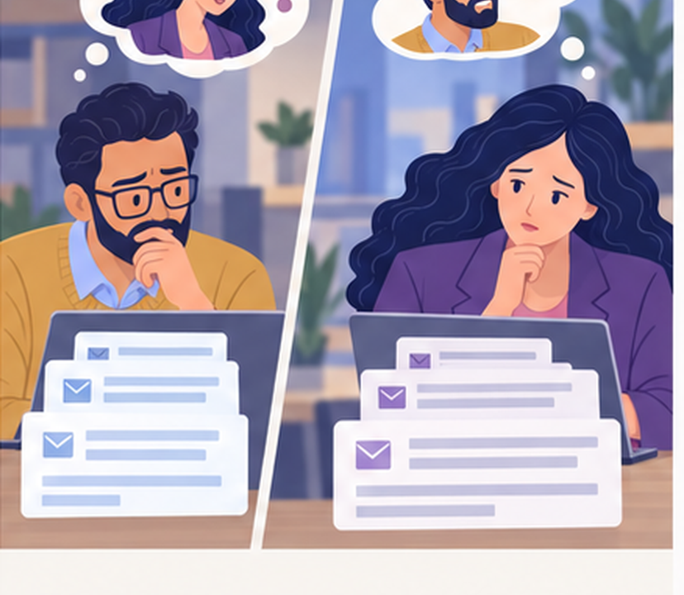
3
She’s changing what we agreed.
He’s flattening what we agreed.
Notes:
Empatyzer. Story from work: List versus diagram.
Kadr 3 z 6. Maile robią się dłuższe, a podejrzliwość rośnie.
Tomasz: She’s changing what we agreed. | Amira: He’s flattening what we agreed.

Slide 5
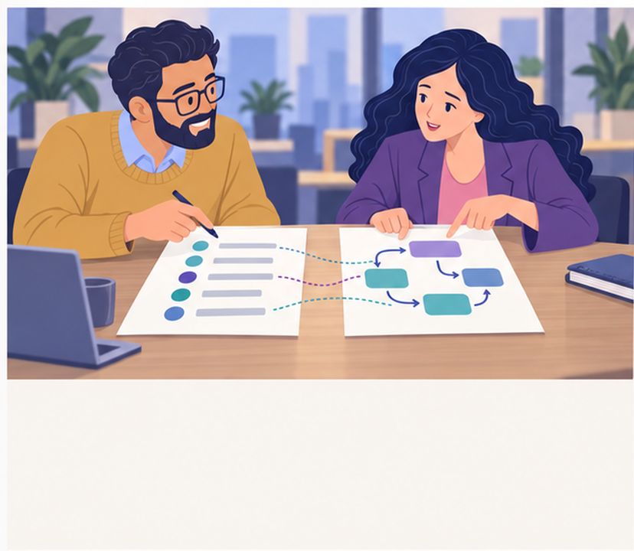
4
And this is exactly my condition from point five.
This block is your points two, three and four.
Notes:
Empatyzer. Story from work: List versus diagram.
Kadr 4 z 6. W 15-minutowej rozmowie kładą listę obok diagramu.
Amira: This block is your points two, three and four. | Tomasz: And this is exactly my condition from point five.

Slide 6
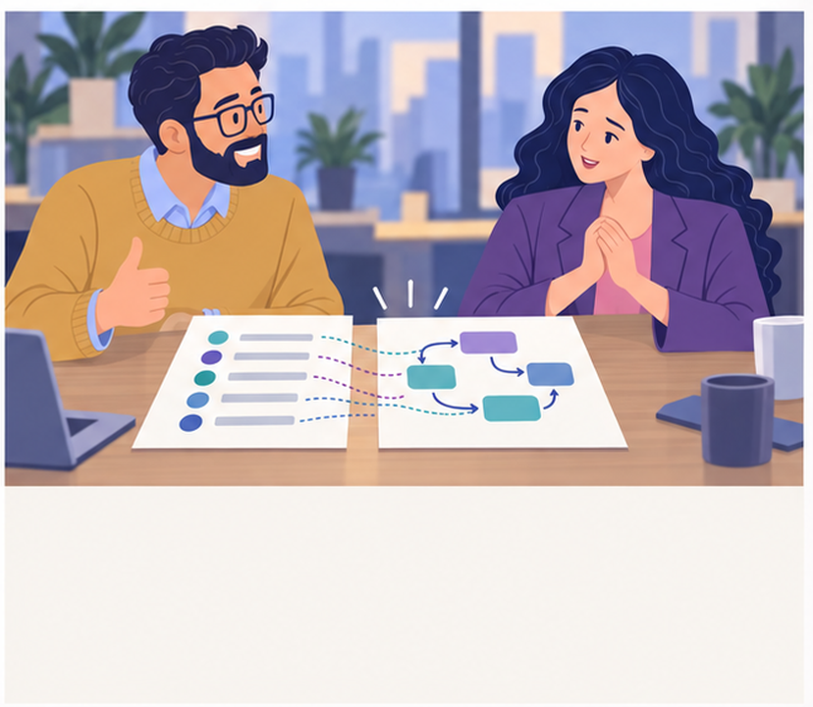
5
So most of the fight was about the representation.
And the representation made us distrust the content.
Notes:
Empatyzer. Story from work: List versus diagram.
Kadr 5 z 6. Większość elementów łączy się jeden do jednego.
Tomasz: So most of the fight was about the representation. | Amira: And the representation made us distrust the content.

Slide 7

6
Tomasz trusts sequences while Amira trusts
relationships between elements. As a result, each
treats their own format as proof of correct thinking
until putting the two side by side reveals that much
of the content dispute was really a representation
dispute. Place both formats side by side and map
their elements one to one before deciding that the
content has changed.
EMPATYZER · BEFORE AN IMPORTANT CONVERSATION
Notes:
Empatyzer. Story from work: List versus diagram.
Podsumowanie Em: Tomasz trusts sequences while Amira trusts relationships between elements. As a result, each treats their own format as proof of correct thinking until putting the two side by side reveals that much of the content dispute was really a representation dispute. Place both formats side by side and map their elements one to one before deciding that the content has changed.
Empatyzer pomaga przygotować sposób komunikacji przed ważną rozmową.

