Slide 1
EMPATYZER · STORIES FROM WORK
Two people, the whole team
Konflikt dwóch osób a klimat zespołu
Tension between Jonas and Maja begins to change the behaviour of people who are not part of the conflict. Neutral situations acquire suspicious new meanings.
Notes:
Empatyzer. Story from work: Two people, the whole team.
Tension between Jonas and Maja begins to change the behaviour of people who are not part of the conflict. Neutral situations acquire suspicious new meanings.
Temat: Konflikt dwóch osób a klimat zespołu. Bohaterowie: Jonas, Maja, Olek, Helena.

Slide 2

1
Too soft again.
And again you’re not listening.
Notes:
Empatyzer. Story from work: Two people, the whole team.
Kadr 1 z 6. Jonas i Maja ścierają się przy zwykłym przeglądzie.
Jonas: Too soft again. | Maja: And again you’re not listening.

Slide 3
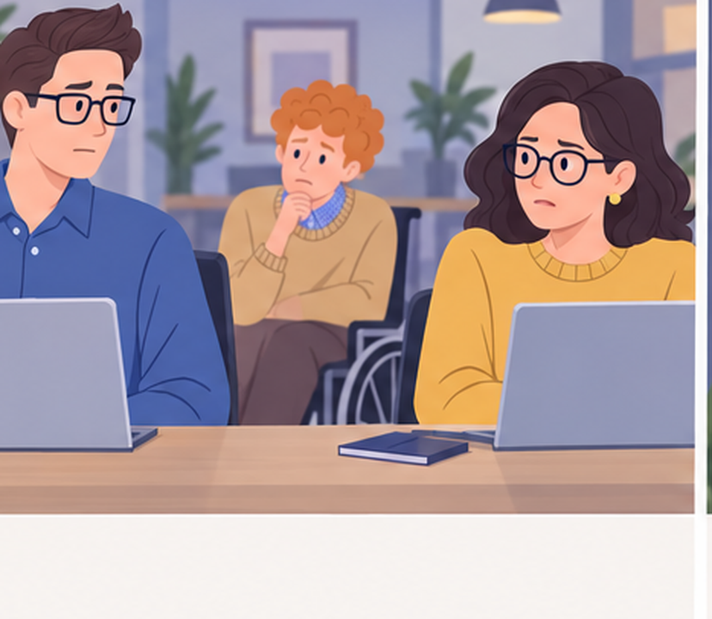
2
Here we go.
Notes:
Empatyzer. Story from work: Two people, the whole team.
Kadr 2 z 6. Na kolejnym spotkaniu tylko wymieniają neutralne spojrzenia; Olek już oczekuje awantury.
Olek: Here we go.

Slide 4

3
Better not put them together right now.
Notes:
Empatyzer. Story from work: Two people, the whole team.
Kadr 3 z 6. Helena zaczyna unikać przydzielania im wspólnych zadań.
Helena: Better not put them together right now.

Slide 5
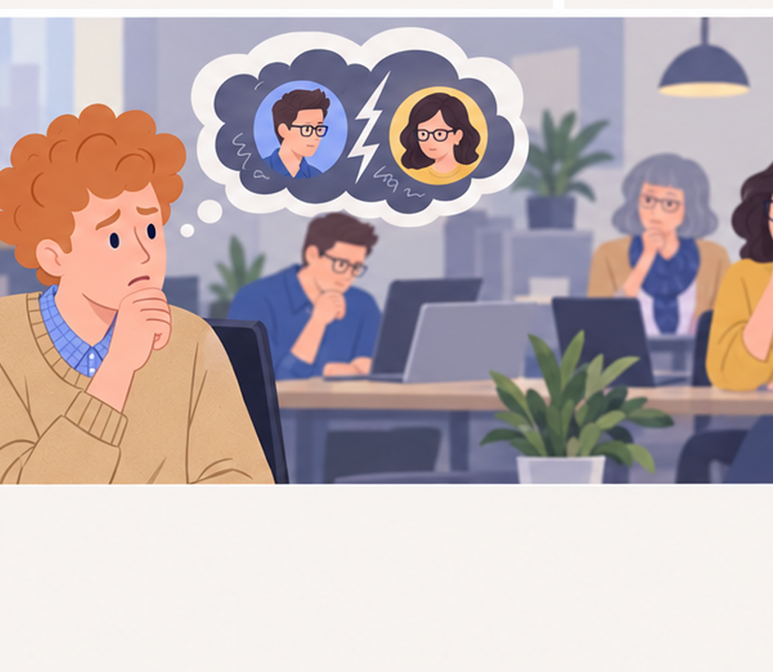
4
Now everything in this team sounds like conflict.
Notes:
Empatyzer. Story from work: Two people, the whole team.
Kadr 4 z 6. Zespół jest ostrożniejszy, mniej spontanicznie pomaga sobie, zwykłe uwagi są czytane jako napięcie.
Olek: Now everything in this team sounds like conflict.

Slide 6

5
We have a conflict between two people. Let’s not turn it into a description of the whole team.
Notes:
Empatyzer. Story from work: Two people, the whole team.
Kadr 5 z 6. Helena zatrzymuje uogólnienie.
Helena: We have a conflict between two people. Let’s not turn it into a description of the whole team.

Slide 7

6
Jonas and Maja have a real conflict, but Olek and
Helena begin expecting tension even in neutral
situations. As a result, a problem between two
people gradually changes the whole group’s behaviour
and starts to look like a team trait. Name the
specific conflict, not the atmosphere of the whole
team. Set working rules for the two people and
observe everyone else without inventing motives.
EMPATYZER · BEFORE AN IMPORTANT CONVERSATION
Notes:
Empatyzer. Story from work: Two people, the whole team.
Podsumowanie Em: Jonas and Maja have a real conflict, but Olek and Helena begin expecting tension even in neutral situations. As a result, a problem between two people gradually changes the whole group’s behaviour and starts to look like a team trait. Name the specific conflict, not the atmosphere of the whole team. Set working rules for the two people and observe everyone else without inventing motives.
Empatyzer pomaga przygotować sposób komunikacji przed ważną rozmową.

