Slide 1
EMPATYZER · STORIES FROM WORK
Why did you message my team?
Szybka pomoc a odpowiedzialność lidera
Nia asks Olek directly for urgent customer help, bypassing Karim. The problem disappears faster, but the team’s priorities change without its leader knowing.
Notes:
Empatyzer. Story from work: Why did you message my team?.
Nia asks Olek directly for urgent customer help, bypassing Karim. The problem disappears faster, but the team’s priorities change without its leader knowing.
Temat: Szybka pomoc a odpowiedzialność lidera. Bohaterowie: Nia, Karim, Olek.

Slide 2
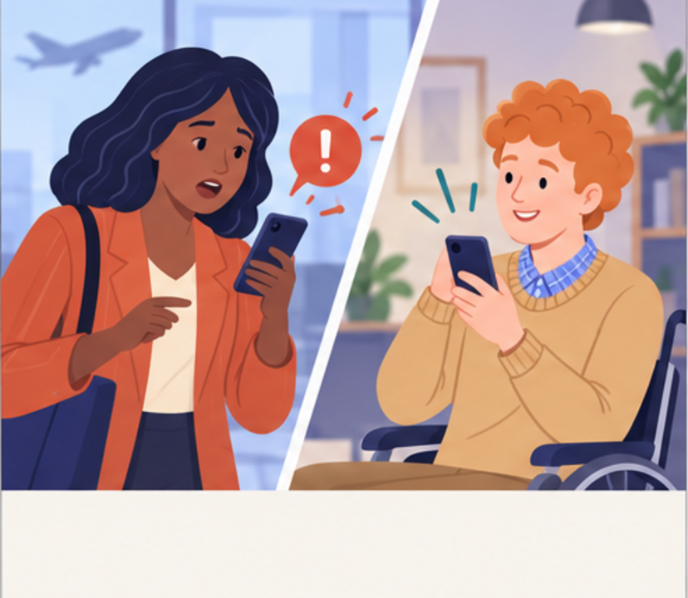
1
Olek, the client is blocked. Can you look at it now?
Sure.
Notes:
Empatyzer. Story from work: Why did you message my team?.
Kadr 1 z 6. Nia dostaje pilne zgłoszenie klienta i pisze bezpośrednio do Olka.
Nia: Olek, the client is blocked. Can you look at it now? | Olek: Sure.

Slide 3
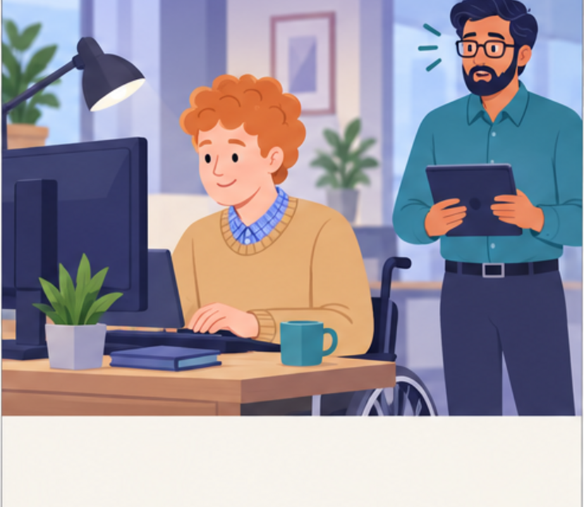
2
Why did my team get assigned work without me knowing?
Notes:
Empatyzer. Story from work: Why did you message my team?.
Kadr 2 z 6. Olek naprawia problem; Karim dowiaduje się o tym później.
Karim: Why did my team get assigned work without me knowing?

Slide 4

3
I need to know when someone is setting work for my team.
Something wrong?
Notes:
Empatyzer. Story from work: Why did you message my team?.
Kadr 3 z 6. Karim jest chłodniejszy wobec Nii.
Nia: Something wrong? | Karim: I need to know when someone is setting work for my team.

Slide 5

4
I wasn’t assigning work. I was trying to save the client.
And I’m accountable for what the team takes on.
Notes:
Empatyzer. Story from work: Why did you message my team?.
Kadr 4 z 6. Nia jest szczerze zaskoczona.
Nia: I wasn’t assigning work. I was trying to save the client. | Karim: And I’m accountable for what the team takes on.

Slide 6
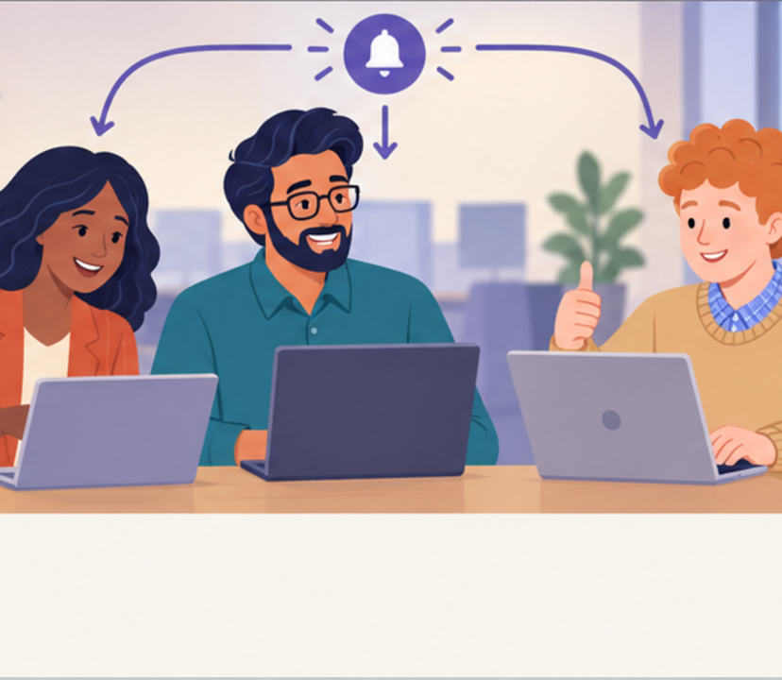
5
So I message Olek and tell you at the same time?
For urgent issues, perfect.
Notes:
Empatyzer. Story from work: Why did you message my team?.
Kadr 5 z 6. Ustalają ścieżkę na pilne przypadki.
Nia: So I message Olek and tell you at the same time? | Karim: For urgent issues, perfect.

Slide 7

6
Nia sees the fastest route to the person who can
solve the client’s problem. Karim sees his
responsibility for the team’s priorities and
workload. An efficient shortcut for one side
therefore feels like bypassing a role to the other.
In urgent situations, do not block direct contact.
Set a simple visibility rule instead: the specialist
receives the request and their leader is informed of
the new commitment at the same time.
EMPATYZER · BEFORE AN IMPORTANT CONVERSATION
Notes:
Empatyzer. Story from work: Why did you message my team?.
Podsumowanie Em: Nia sees the fastest route to the person who can solve the client’s problem. Karim sees his responsibility for the team’s priorities and workload. An efficient shortcut for one side therefore feels like bypassing a role to the other. In urgent situations, do not block direct contact. Set a simple visibility rule instead: the specialist receives the request and their leader is informed of the new commitment at the same time.
Empatyzer pomaga przygotować sposób komunikacji przed ważną rozmową.

