Slide 1
EMPATYZER · STORIES FROM WORK
Five goals, one job
Odpowiedzialność osoby a wynik zespołu
Anna assigns five goals to five people, while the team moves work to where the shared outcome needs it. The unit of accountability can be a person or a result.
Notes:
Empatyzer. Story from work: Five goals, one job.
Anna assigns five goals to five people, while the team moves work to where the shared outcome needs it. The unit of accountability can be a person or a result.
Temat: Odpowiedzialność osoby a wynik zespołu. Bohaterowie: Anna, Helena, Amira, Maja, Tomasz.

Slide 2

1
Everyone has their own scope and their own result. Clear?
Notes:
Empatyzer. Story from work: Five goals, one job.
Kadr 1 z 6. Anna rozdaje osobne cele każdej osobie.
Anna: Everyone has their own scope and their own result. Clear?

Slide 3

2
If everyone does only their own piece, the whole thing will fall apart.
Notes:
Empatyzer. Story from work: Five goals, one job.
Kadr 2 z 6. Zespół później zbiera wszystkie cele na jednej tablicy.
Helena: If everyone does only their own piece, the whole thing will fall apart.

Slide 4

3
I’ll take this part from Maja, and Tomasz can calculate both options.
Notes:
Empatyzer. Story from work: Five goals, one job.
Kadr 3 z 6. Ludzie przesuwają pracę między sobą zgodnie z zależnościami.
Amira: I’ll take this part from Maja, and Tomasz can calculate both options.

Slide 5
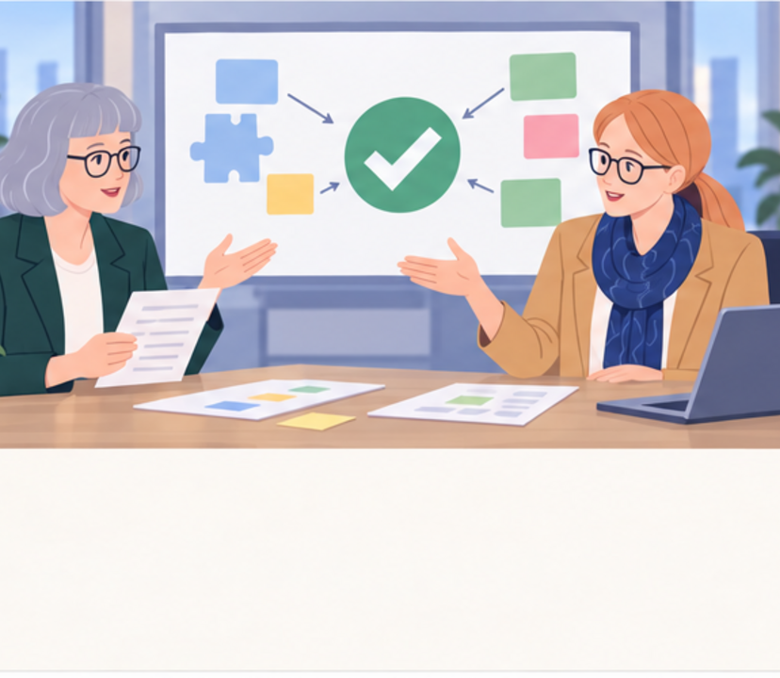
4
Why didn’t you complete your assigned tasks?
We completed the team’s task.
Notes:
Empatyzer. Story from work: Five goals, one job.
Kadr 4 z 6. Anna widzi, że indywidualne listy nie zgadzają się z wykonaniem.
Anna: Why didn’t you complete your assigned tasks? | Helena: We completed the team’s task.

Slide 6
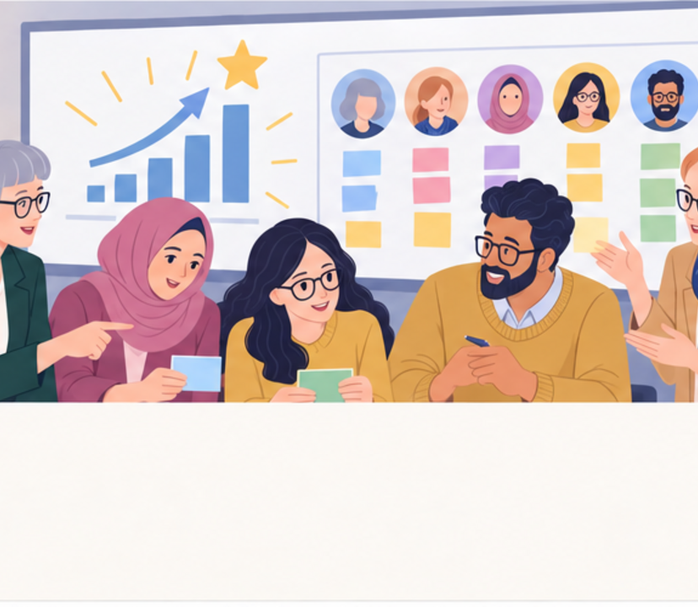
5
The result is good. But I can’t see who owned what.
Then let’s make ownership visible without breaking collaboration.
Notes:
Empatyzer. Story from work: Five goals, one job.
Kadr 5 z 6. Gotowy rezultat jest dobry, ale odpowiedzialność na papierze stała się nieczytelna.
Anna: The result is good. But I can’t see who owned what. | Helena: Then let’s make ownership visible without breaking collaboration.

Slide 7

6
Anna protects the result by assigning ownership to
specific people. Helena’s team protects the whole by
moving work flexibly around dependencies. The same
success can therefore look like strong collaboration
or blurred accountability. Do not force the team to
choose between them. Define the shared result, then
make the owners of decisions, areas and key
commitments visible alongside it.
EMPATYZER · BEFORE AN IMPORTANT CONVERSATION
Notes:
Empatyzer. Story from work: Five goals, one job.
Podsumowanie Em: Anna protects the result by assigning ownership to specific people. Helena’s team protects the whole by moving work flexibly around dependencies. The same success can therefore look like strong collaboration or blurred accountability. Do not force the team to choose between them. Define the shared result, then make the owners of decisions, areas and key commitments visible alongside it.
Empatyzer pomaga przygotować sposób komunikacji przed ważną rozmową.

