Slide 1
EMPATYZER · STORIES FROM WORK
New boss, new rules
Nowy lider a niewidzialne zasady
Zofia introduces a single decision centre into a team that previously worked more horizontally. The unwritten working contract changes without anyone naming it.
Notes:
Empatyzer. Story from work: New boss, new rules.
Zofia introduces a single decision centre into a team that previously worked more horizontally. The unwritten working contract changes without anyone naming it.
Temat: Nowy lider a niewidzialne zasady. Bohaterowie: Zofia, Olek, Jonas.

Slide 2

1
I’ll sort it out with the client and come back with a decision.
Notes:
Empatyzer. Story from work: New boss, new rules.
Kadr 1 z 6. Olek i Jonas dotąd sami rozmawiają z klientem w swoich obszarach.
Olek: I’ll sort it out with the client and come back with a decision.

Slide 3
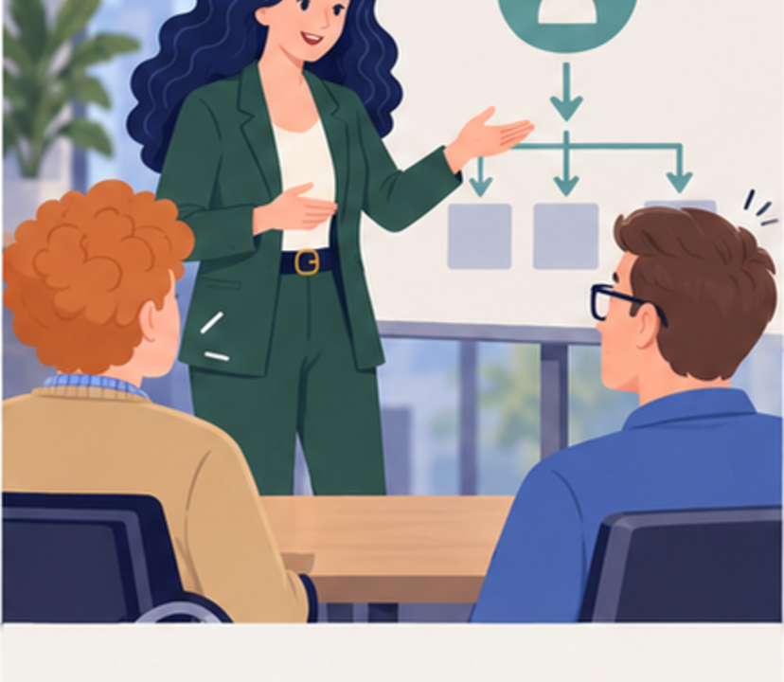
2
From now on, all client decisions go through me.
Notes:
Empatyzer. Story from work: New boss, new rules.
Kadr 2 z 6. Zofia przejmuje prowadzenie projektu.
Zofia: From now on, all client decisions go through me.

Slide 4

3
We’ve lost the information and the ownership.
Finally, someone is holding the project together.
Notes:
Empatyzer. Story from work: New boss, new rules.
Kadr 3 z 6. Zofia odbywa spotkanie sama i przekazuje gotowe ustalenia.
Jonas: We’ve lost the information and the ownership. | Zofia: Finally, someone is holding the project together.

Slide 5

4
We can’t be accountable for the result if we don’t have access to the conversation.
I don’t need a second command centre.
Notes:
Empatyzer. Story from work: New boss, new rules.
Kadr 4 z 6. Zespół zaczyna kwestionować nowy układ.
Olek: We can’t be accountable for the result if we don’t have access to the conversation. | Zofia: I don’t need a second command centre.

Slide 6

5
I’ll lead the key negotiations. You lead the technical decisions.
And everyone sees the notes.
Notes:
Empatyzer. Story from work: New boss, new rules.
Kadr 5 z 6. Ustalają nowy podział kanałów i odpowiedzialności.
Zofia: I’ll lead the key negotiations. You lead the technical decisions. | Jonas: And everyone sees the notes.

Slide 7

6
Zofia increases control because one decision centre
means clear accountability to her. Olek and Jonas
were used to direct influence and full access to
information. The same arrangement therefore feels
like order to her and lost trust to them. When
leadership changes, name the new working contract
explicitly: who leads which conversations, who
decides, who owns the result and where everyone can
see the agreements.
EMPATYZER · BEFORE AN IMPORTANT CONVERSATION
Notes:
Empatyzer. Story from work: New boss, new rules.
Podsumowanie Em: Zofia increases control because one decision centre means clear accountability to her. Olek and Jonas were used to direct influence and full access to information. The same arrangement therefore feels like order to her and lost trust to them. When leadership changes, name the new working contract explicitly: who leads which conversations, who decides, who owns the result and where everyone can see the agreements.
Empatyzer pomaga przygotować sposób komunikacji przed ważną rozmową.

