Slide 1
EMPATYZER · STORIES FROM WORK
My schedule, your problem
Autonomia a zależności operacyjne
Olek changes his schedule flexibly, but Jonas only finds out when it blocks his work. Personal autonomy can create a cost for someone else.
Notes:
Empatyzer. Story from work: My schedule, your problem.
Olek changes his schedule flexibly, but Jonas only finds out when it blocks his work. Personal autonomy can create a cost for someone else.
Temat: Autonomia a zależności operacyjne. Bohaterowie: Olek, Jonas, Karim.

Slide 2
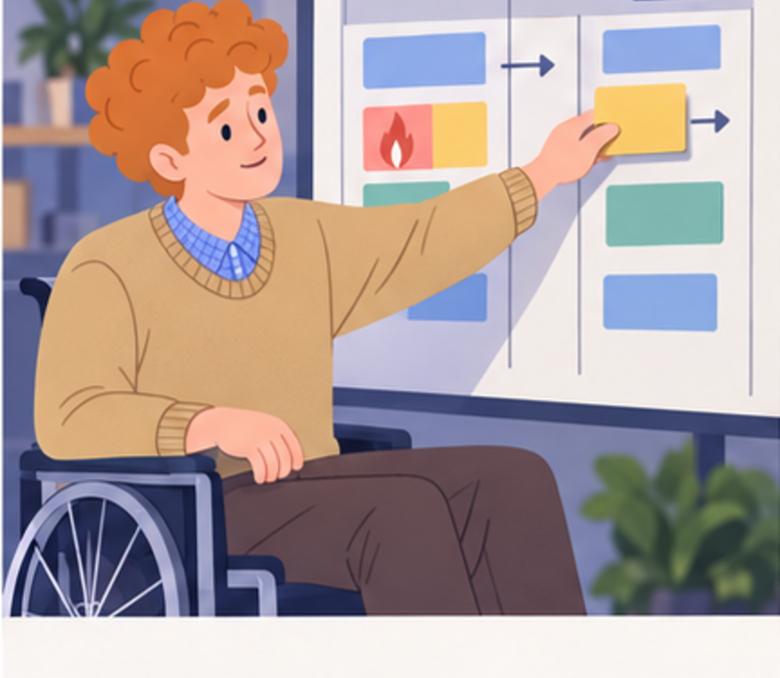
1
I’ll move this to tomorrow. Today I’ll save the client issue.
Notes:
Empatyzer. Story from work: My schedule, your problem.
Kadr 1 z 6. Olek sam przesuwa zadanie, żeby obsłużyć pilny temat klienta.
Olek: I’ll move this to tomorrow. Today I’ll save the client issue.

Slide 3

2
Who changed the sequence?
I did. It made more sense.
Notes:
Empatyzer. Story from work: My schedule, your problem.
Kadr 2 z 6. Jonas odkrywa zmianę dopiero, gdy jego praca nie może ruszyć.
Jonas: Who changed the sequence? | Olek: I did. It made more sense.

Slide 4

3
You can’t move things my work depends on without telling me.
Am I supposed to ask permission for every obvious adjustment?
Notes:
Empatyzer. Story from work: My schedule, your problem.
Kadr 3 z 6. Obaj bronią innego znaczenia autonomii.
Jonas: You can’t move things my work depends on without telling me. | Olek: Am I supposed to ask permission for every obvious adjustment?

Slide 5

4
Olek, autonomy doesn’t mean invisible changes. Jonas, being informed doesn’t mean approving everything.
Notes:
Empatyzer. Story from work: My schedule, your problem.
Kadr 4 z 6. Karim rozdziela prawo do decyzji od obowiązku poinformowania.
Karim: Olek, autonomy doesn’t mean invisible changes. Jonas, being informed doesn’t mean approving everything.

Slide 6

5
So I can change it without asking, but not without signalling it?
Exactly.
Notes:
Empatyzer. Story from work: My schedule, your problem.
Kadr 5 z 6. Ustalają prostą regułę zmiany zależności.
Olek: So I can change it without asking, but not without signalling it? | Jonas: Exactly.

Slide 7

6
Olek understands autonomy as the right to optimise
his own work. Jonas sees dependencies that make the
same decision change his plan too. The problem is
not the change itself, but its invisible cost to
another person. Set a simple boundary: people may
decide independently within their area, but any
change affecting someone else’s work must be
signalled clearly and immediately.
EMPATYZER · BEFORE AN IMPORTANT CONVERSATION
Notes:
Empatyzer. Story from work: My schedule, your problem.
Podsumowanie Em: Olek understands autonomy as the right to optimise his own work. Jonas sees dependencies that make the same decision change his plan too. The problem is not the change itself, but its invisible cost to another person. Set a simple boundary: people may decide independently within their area, but any change affecting someone else’s work must be signalled clearly and immediately.
Empatyzer pomaga przygotować sposób komunikacji przed ważną rozmową.

