Slide 1
EMPATYZER · STORIES FROM WORK
One more approval
Odpowiedzialność a prawo do decyzji
After a mistake, Anna adds another approval while Olek still owns the deadline. The extra control removes some authority without reducing accountability for the result.
Notes:
Empatyzer. Story from work: One more approval.
After a mistake, Anna adds another approval while Olek still owns the deadline. The extra control removes some authority without reducing accountability for the result.
Temat: Odpowiedzialność a prawo do decyzji. Bohaterowie: Olek, Anna, Karim.

Slide 2

1
I know the goal. The rest is mine.
Notes:
Empatyzer. Story from work: One more approval.
Kadr 1 z 6. Wcześniej Olek sam planuje i realizuje swój fragment projektu.
Olek: I know the goal. The rest is mine.

Slide 3

2
Approve the plan before you start. Approve the result before it goes out too.
Notes:
Empatyzer. Story from work: One more approval.
Kadr 2 z 6. Po wcześniejszym problemie Anna wprowadza dodatkowe akceptacje.
Anna: Approve the plan before you start. Approve the result before it goes out too.

Slide 4
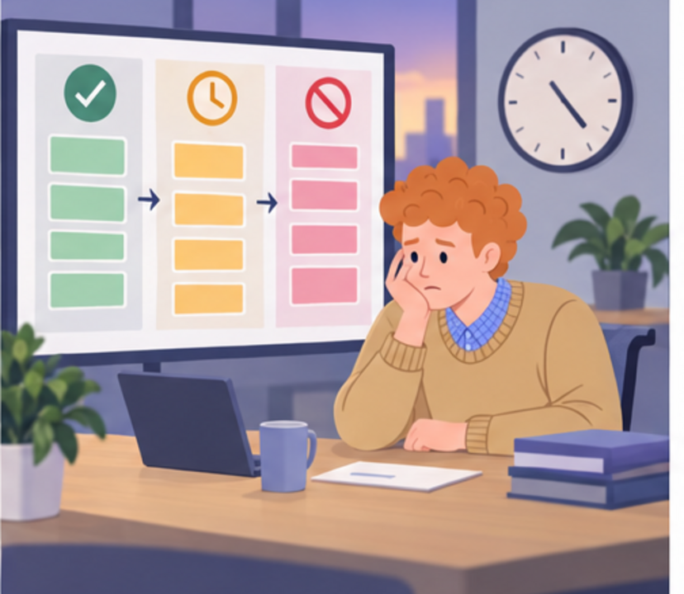
3
I’m accountable for the deadline, but I can’t make the decisions.
Notes:
Empatyzer. Story from work: One more approval.
Kadr 3 z 6. Olek czeka w kolejce na zgody.
Olek: I’m accountable for the deadline, but I can’t make the decisions.

Slide 5
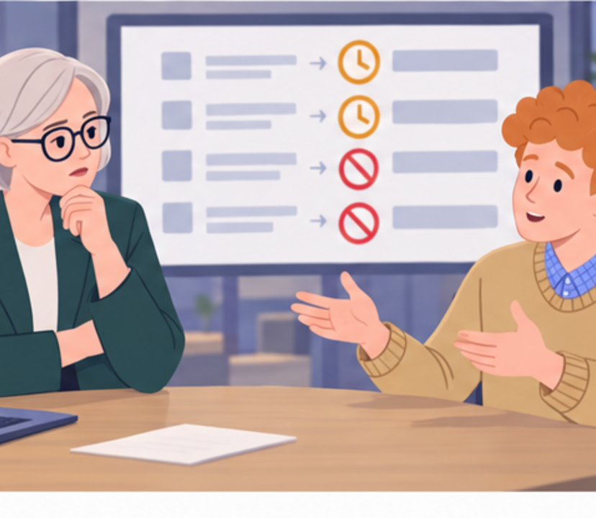
4
Why is this taking longer?
Because every decision now has a queue.
Notes:
Empatyzer. Story from work: One more approval.
Kadr 4 z 6. Anna widzi opóźnienie.
Anna: Why is this taking longer? | Olek: Because every decision now has a queue.

Slide 6

5
What exactly are these approvals supposed to protect us from?
Client risk. Not every detail.
Notes:
Empatyzer. Story from work: One more approval.
Kadr 5 z 6. Karim pyta, jakie ryzyko naprawdę miały zatrzymywać akceptacje.
Karim: What exactly are these approvals supposed to protect us from? | Anna: Client risk. Not every detail.

Slide 7

6
Anna adds approvals because she wants to reduce a
real risk. Olek still owns the deadline, even though
he now has less authority to decide. As a result,
control intended to increase safety removes the
agency he needs to deliver. Before adding another
approval stage, name the specific risk it is meant
to stop. Leave the remaining decisions with the
person accountable for the result.
EMPATYZER · BEFORE AN IMPORTANT CONVERSATION
Notes:
Empatyzer. Story from work: One more approval.
Podsumowanie Em: Anna adds approvals because she wants to reduce a real risk. Olek still owns the deadline, even though he now has less authority to decide. As a result, control intended to increase safety removes the agency he needs to deliver. Before adding another approval stage, name the specific risk it is meant to stop. Leave the remaining decisions with the person accountable for the result.
Empatyzer pomaga przygotować sposób komunikacji przed ważną rozmową.

