Slide 1
EMPATYZER · STORIES FROM WORK
You’re asking again?
Uczenie się a zależność
Olek frequently returns to Jonas for feedback. For Olek it is a way to learn; for Jonas it looks like increasing dependence on his judgement.
Notes:
Empatyzer. Story from work: You’re asking again?.
Olek frequently returns to Jonas for feedback. For Olek it is a way to learn; for Jonas it looks like increasing dependence on his judgement.
Temat: Uczenie się a zależność. Bohaterowie: Olek, Jonas.

Slide 2

1
Got a minute? Can you tell me if I’m heading in the right direction?
Sure.
Notes:
Empatyzer. Story from work: You’re asking again?.
Kadr 1 z 6. Olek podchodzi do Jonasa z ekranem.
Olek: Got a minute? Can you tell me if I’m heading in the right direction? | Jonas: Sure.

Slide 3

2
LATER
And now?
Notes:
Empatyzer. Story from work: You’re asking again?.
Kadr 2 z 6. Później Olek wraca z kolejnym fragmentem.
Olek: And now?

Slide 4

3
Olek, don’t you trust your own judgment?
What?
Notes:
Empatyzer. Story from work: You’re asking again?.
Kadr 3 z 6. Przy trzeciej prośbie Jonas zaczyna się irytować.
Jonas: Olek, don’t you trust your own judgment? | Olek: What?

Slide 5
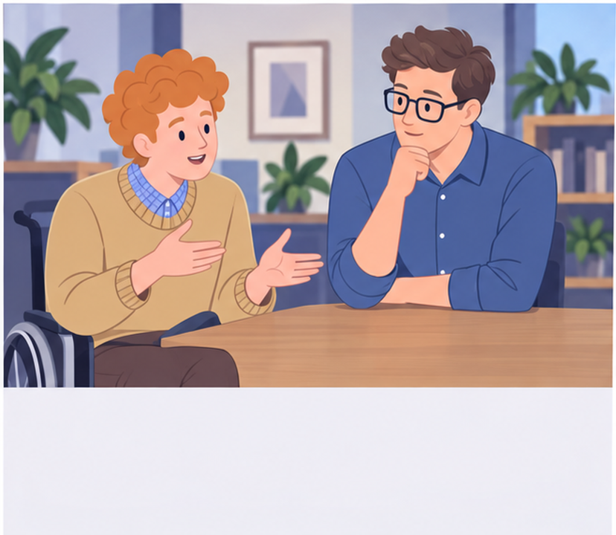
4
I ask you because I learn faster when I get correction immediately.
And I thought you wanted me to hold your hand.
Notes:
Empatyzer. Story from work: You’re asking again?.
Kadr 4 z 6. Olek tłumaczy cel pytań.
Olek: I ask you because I learn faster when I get correction immediately. | Jonas: And I thought you wanted me to hold your hand.

Slide 6

5
Collect the questions. We’ll do one review at three.
Works for me.
Notes:
Empatyzer. Story from work: You’re asking again?.
Kadr 5 z 6. Ustalają jeden stały przegląd dziennie.
Jonas: Collect the questions. We’ll do one review at three. | Olek: Works for me.

Slide 7

6
Olek asks for frequent feedback to learn faster,
while Jonas reads that frequency as a lack of
independent judgement. The same question is a
learning tool to one person and a sign of dependence
to the other. Set a consultation rhythm. Decide
which questions to collect, which to ask immediately
and which decisions genuinely require input.
EMPATYZER · BEFORE AN IMPORTANT CONVERSATION
Notes:
Empatyzer. Story from work: You’re asking again?.
Podsumowanie Em: Olek asks for frequent feedback to learn faster, while Jonas reads that frequency as a lack of independent judgement. The same question is a learning tool to one person and a sign of dependence to the other. Set a consultation rhythm. Decide which questions to collect, which to ask immediately and which decisions genuinely require input.
Empatyzer pomaga przygotować sposób komunikacji przed ważną rozmową.

