Slide 1
33
I’m not attacking you. I’m testing the plan.
Challenge and authority
Jonas publicly tests Anna’s plan because he sees challenge as a professional duty. Anna reads it as undermining her role after a decision has been made.
EMPATYZER · BEFORE AN IMPORTANT CONVERSATION
Notes:
I’m not attacking you. I’m testing the plan.. Challenge and authority.
Jonas publicly tests Anna’s plan because he sees challenge as a professional duty. Anna reads it as undermining her role after a decision has been made.
Empatyzer helps people prepare for important conversations at work by considering the specific person and situation.
Keywords: Empatyzer, Em, workplace communication, people management, important conversation, human differences.

Slide 2

1
We’re implementing this process next month.
Notes:
I’m not attacking you. I’m testing the plan.. Challenge and authority.
Jonas publicly tests Anna’s plan because he sees challenge as a professional duty. Anna reads it as undermining her role after a decision has been made.
Anna presents a new process during a meeting and points to its stages.
Empatyzer helps people prepare for important conversations at work by considering the specific person and situation.
Keywords: Empatyzer, Em, workplace communication, people management, important conversation, human differences.

Slide 3

2
Why this way? That step will slow implementation without improving quality.
Notes:
I’m not attacking you. I’m testing the plan.. Challenge and authority.
Jonas publicly tests Anna’s plan because he sees challenge as a professional duty. Anna reads it as undermining her role after a decision has been made.
Jonas raises a specific concern about a step that may slow implementation.
Empatyzer helps people prepare for important conversations at work by considering the specific person and situation.
Keywords: Empatyzer, Em, workplace communication, people management, important conversation, human differences.

Slide 4

3
He’s challenging the decision in front of everyone.
If I see a risk, it’s my job to say it.
Notes:
I’m not attacking you. I’m testing the plan.. Challenge and authority.
Jonas publicly tests Anna’s plan because he sees challenge as a professional duty. Anna reads it as undermining her role after a decision has been made.
Anna and Jonas silently interpret the same challenge differently, as undermining a decision and as a professional duty.
Empatyzer helps people prepare for important conversations at work by considering the specific person and situation.
Keywords: Empatyzer, Em, workplace communication, people management, important conversation, human differences.

Slide 5
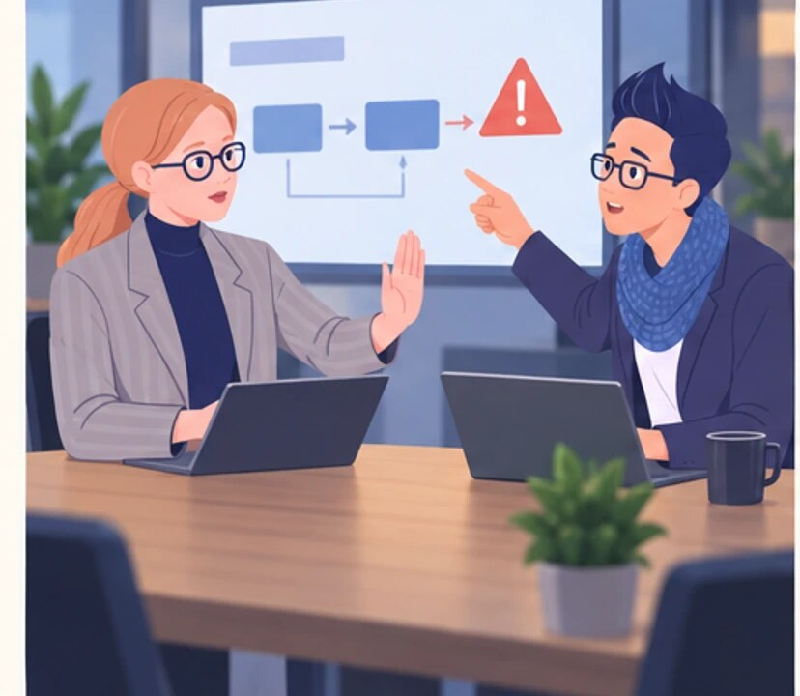
4
Jonas, the decision has been made.
That doesn’t remove the risk.
Notes:
I’m not attacking you. I’m testing the plan.. Challenge and authority.
Jonas publicly tests Anna’s plan because he sees challenge as a professional duty. Anna reads it as undermining her role after a decision has been made.
Anna closes the decision while Jonas continues to point out a risk in the plan.
Empatyzer helps people prepare for important conversations at work by considering the specific person and situation.
Keywords: Empatyzer, Em, workplace communication, people management, important conversation, human differences.

Slide 6

5
AFTER THE MEETING
I’m not fighting you. I’m testing the plan.
And I need to know when the debate is over.
Notes:
I’m not attacking you. I’m testing the plan.. Challenge and authority.
Jonas publicly tests Anna’s plan because he sees challenge as a professional duty. Anna reads it as undermining her role after a decision has been made.
After the meeting, Anna and Jonas calmly define the boundary between debate and executing the decision.
Empatyzer helps people prepare for important conversations at work by considering the specific person and situation.
Keywords: Empatyzer, Em, workplace communication, people management, important conversation, human differences.

Slide 7

6
Jonas sees public dissent as responsibility for the
plan, while Anna also hears it as challenging her
role after a decision has been announced. As a
result, they draw the line between debate and
execution in different places. Separate the moment
for testing a plan from the moment for executing the
decision. Agree where and until when challenge is
useful.
EMPATYZER · BEFORE AN IMPORTANT CONVERSATION
Notes:
I’m not attacking you. I’m testing the plan.. Challenge and authority.
Jonas publicly tests Anna’s plan because he sees challenge as a professional duty. Anna reads it as undermining her role after a decision has been made.
Empatyzer helps people prepare for important conversations at work by considering the specific person and situation.
Keywords: Empatyzer, Em, workplace communication, people management, important conversation, human differences.
Jonas sees public dissent as responsibility for the plan, while Anna also hears it as challenging her role after a decision has been announced. As a result, they draw the line between debate and execution in different places. Separate the moment for testing a plan from the moment for executing the decision. Agree where and until when challenge is useful.

