Slide 1
32
When I was your age
Experience and someone else’s situation
Marek tries to help Olek with a story from his own youth. Olek hears a comparison when he needs help with his current situation.
EMPATYZER · BEFORE AN IMPORTANT CONVERSATION
Notes:
When I was your age. Experience and someone else’s situation.
Marek tries to help Olek with a story from his own youth. Olek hears a comparison when he needs help with his current situation.
Empatyzer helps people prepare for important conversations at work by considering the specific person and situation.
Keywords: Empatyzer, Em, workplace communication, people management, important conversation, human differences.

Slide 2
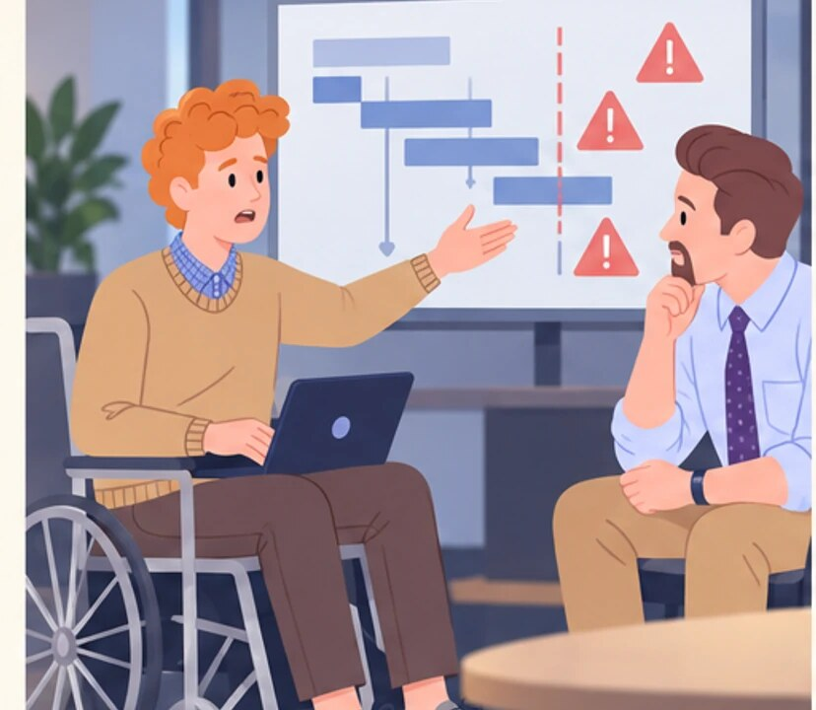
1
I don’t know how to solve this without blowing the deadline.
Notes:
When I was your age. Experience and someone else’s situation.
Marek tries to help Olek with a story from his own youth. Olek hears a comparison when he needs help with his current situation.
Olek, seated in his wheelchair, explains a scope and deadline problem to Marek.
Empatyzer helps people prepare for important conversations at work by considering the specific person and situation.
Keywords: Empatyzer, Em, workplace communication, people management, important conversation, human differences.

Slide 3

2
When I was your age, nobody held our hand. You worked until it was done.
Notes:
When I was your age. Experience and someone else’s situation.
Marek tries to help Olek with a story from his own youth. Olek hears a comparison when he needs help with his current situation.
Marek answers with a story from his youth, convinced that he is helping Olek.
Empatyzer helps people prepare for important conversations at work by considering the specific person and situation.
Keywords: Empatyzer, Em, workplace communication, people management, important conversation, human differences.

Slide 4

3
Back then I worked through the night and…
But that isn’t my problem.
Notes:
When I was your age. Experience and someone else’s situation.
Marek tries to help Olek with a story from his own youth. Olek hears a comparison when he needs help with his current situation.
Marek expands his story while Olek grows quiet and feels misunderstood.
Empatyzer helps people prepare for important conversations at work by considering the specific person and situation.
Keywords: Empatyzer, Em, workplace communication, people management, important conversation, human differences.

Slide 5

4
You’ll manage. You just have to want it.
Mm-hm.
Notes:
When I was your age. Experience and someone else’s situation.
Marek tries to help Olek with a story from his own youth. Olek hears a comparison when he needs help with his current situation.
Marek finishes with an encouraging gesture while Olek responds without conviction.
Empatyzer helps people prepare for important conversations at work by considering the specific person and situation.
Keywords: Empatyzer, Em, workplace communication, people management, important conversation, human differences.

Slide 6
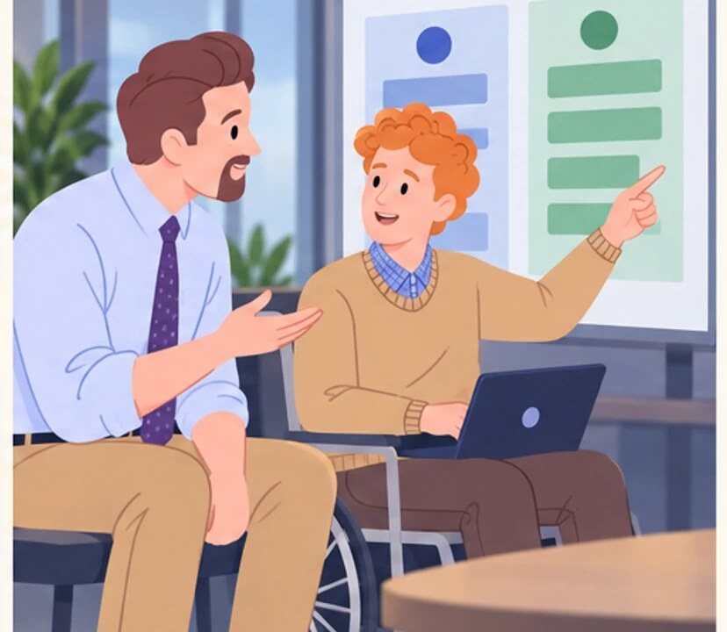
5
Okay. What exactly do you need from me?
Help me decide what we can drop.
Notes:
When I was your age. Experience and someone else’s situation.
Marek tries to help Olek with a story from his own youth. Olek hears a comparison when he needs help with his current situation.
Marek first asks what help Olek needs, and Olek points to items that could be removed from the scope.
Empatyzer helps people prepare for important conversations at work by considering the specific person and situation.
Keywords: Empatyzer, Em, workplace communication, people management, important conversation, human differences.

Slide 7

6
Marek offers Olek his own success story because he
sees experience as valuable help. Olek hears a
comparison suggesting that he should manage too. The
mentor’s good intention becomes a judgement of a
situation he has not yet understood. Before sharing
your own story, ask what kind of help the other
person needs now. Experience should serve their
situation, not obscure it.
EMPATYZER · BEFORE AN IMPORTANT CONVERSATION
Notes:
When I was your age. Experience and someone else’s situation.
Marek tries to help Olek with a story from his own youth. Olek hears a comparison when he needs help with his current situation.
Empatyzer helps people prepare for important conversations at work by considering the specific person and situation.
Keywords: Empatyzer, Em, workplace communication, people management, important conversation, human differences.
Marek offers Olek his own success story because he sees experience as valuable help. Olek hears a comparison suggesting that he should manage too. The mentor’s good intention becomes a judgement of a situation he has not yet understood. Before sharing your own story, ask what kind of help the other person needs now. Experience should serve their situation, not obscure it.

