Slide 1
30
The same checklist
Structure and autonomy
Anna gives Tomasz and Olek the same detailed checklist. It helps one of them move forward while taking ownership away from the other.
EMPATYZER · BEFORE AN IMPORTANT CONVERSATION
Notes:
The same checklist. Structure and autonomy.
Anna gives Tomasz and Olek the same detailed checklist. It helps one of them move forward while taking ownership away from the other.
Empatyzer helps people prepare for important conversations at work by considering the specific person and situation.
Keywords: Empatyzer, Em, workplace communication, people management, important conversation, human differences.

Slide 2

1
Here are the steps and the acceptance criteria.
Perfect.
Notes:
The same checklist. Structure and autonomy.
Anna gives Tomasz and Olek the same detailed checklist. It helps one of them move forward while taking ownership away from the other.
Anna gives Tomasz a detailed checklist, which he welcomes.
Empatyzer helps people prepare for important conversations at work by considering the specific person and situation.
Keywords: Empatyzer, Em, workplace communication, people management, important conversation, human differences.

Slide 3

2
I know exactly when this is complete.
Notes:
The same checklist. Structure and autonomy.
Anna gives Tomasz and Olek the same detailed checklist. It helps one of them move forward while taking ownership away from the other.
Tomasz works calmly with the checklist and knows exactly when the task will be complete.
Empatyzer helps people prepare for important conversations at work by considering the specific person and situation.
Keywords: Empatyzer, Em, workplace communication, people management, important conversation, human differences.

Slide 4
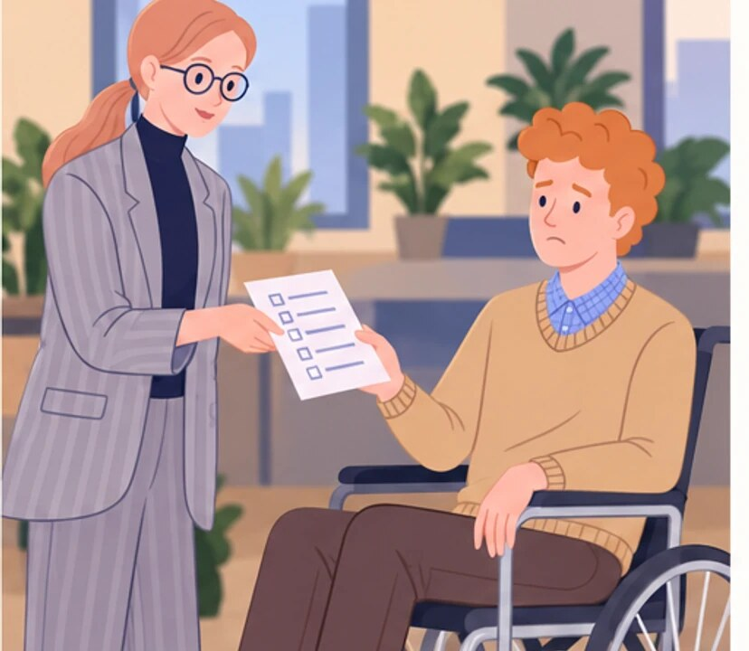
3
Here are the steps and the acceptance criteria.
Okay…
Notes:
The same checklist. Structure and autonomy.
Anna gives Tomasz and Olek the same detailed checklist. It helps one of them move forward while taking ownership away from the other.
Anna gives the same checklist to Olek, seated in his wheelchair, who reacts uncertainly.
Empatyzer helps people prepare for important conversations at work by considering the specific person and situation.
Keywords: Empatyzer, Em, workplace communication, people management, important conversation, human differences.

Slide 5

4
Why did they hire me if all I’m supposed to do is tick boxes?
Notes:
The same checklist. Structure and autonomy.
Anna gives Tomasz and Olek the same detailed checklist. It helps one of them move forward while taking ownership away from the other.
Olek tensely follows the checklist and loses his sense of autonomy.
Empatyzer helps people prepare for important conversations at work by considering the specific person and situation.
Keywords: Empatyzer, Em, workplace communication, people management, important conversation, human differences.

Slide 6

5
I gave you exactly the same thing.
You gave me structure.
And you took away my room to move.
Notes:
The same checklist. Structure and autonomy.
Anna gives Tomasz and Olek the same detailed checklist. It helps one of them move forward while taking ownership away from the other.
Anna sees that the same checklist gave Tomasz structure but took away Olek's room to act.
Empatyzer helps people prepare for important conversations at work by considering the specific person and situation.
Keywords: Empatyzer, Em, workplace communication, people management, important conversation, human differences.

Slide 7

6
Tomasz experiences a detailed checklist as support
and clarity, while Olek experiences it as a
restriction on his judgment. As a result, the same
management style makes one person more confident and
signals distrust to the other. Do not give everyone
identical structure. Agree on the needed level of
support and the room for independent choice.
EMPATYZER · BEFORE AN IMPORTANT CONVERSATION
Notes:
The same checklist. Structure and autonomy.
Anna gives Tomasz and Olek the same detailed checklist. It helps one of them move forward while taking ownership away from the other.
Empatyzer helps people prepare for important conversations at work by considering the specific person and situation.
Keywords: Empatyzer, Em, workplace communication, people management, important conversation, human differences.
Tomasz experiences a detailed checklist as support and clarity, while Olek experiences it as a restriction on his judgment. As a result, the same management style makes one person more confident and signals distrust to the other. Do not give everyone identical structure. Agree on the needed level of support and the room for independent choice.

