Slide 1
29
Why go straight to the boss?
Escalation and direct trust
Marek involves Zofia immediately, while Nia expects a direct conversation first. The same escalation can look like transparency or reporting someone behind their back.
EMPATYZER · BEFORE AN IMPORTANT CONVERSATION
Notes:
Why go straight to the boss?. Escalation and direct trust.
Marek involves Zofia immediately, while Nia expects a direct conversation first. The same escalation can look like transparency or reporting someone behind their back.
Empatyzer helps people prepare for important conversations at work by considering the specific person and situation.
Keywords: Empatyzer, Em, workplace communication, people management, important conversation, human differences.

Slide 2

1
I’d do it differently, but we can work it out.
Notes:
Why go straight to the boss?. Escalation and direct trust.
Marek involves Zofia immediately, while Nia expects a direct conversation first. The same escalation can look like transparency or reporting someone behind their back.
Nia and Marek calmly discuss different approaches to a minor client issue.
Empatyzer helps people prepare for important conversations at work by considering the specific person and situation.
Keywords: Empatyzer, Em, workplace communication, people management, important conversation, human differences.

Slide 3
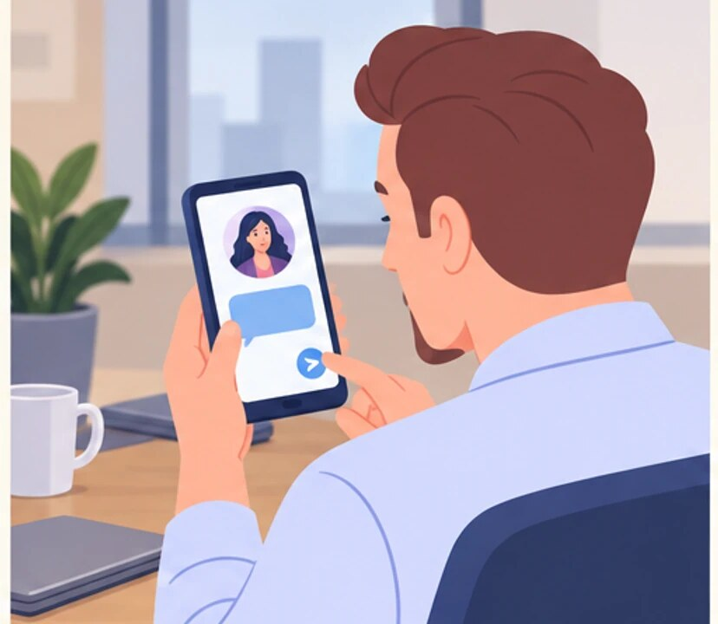
2
I need a decision on Nia’s approach.
Notes:
Why go straight to the boss?. Escalation and direct trust.
Marek involves Zofia immediately, while Nia expects a direct conversation first. The same escalation can look like transparency or reporting someone behind their back.
Marek messages Zofia for a decision before returning to the conversation with Nia.
Empatyzer helps people prepare for important conversations at work by considering the specific person and situation.
Keywords: Empatyzer, Em, workplace communication, people management, important conversation, human differences.

Slide 4

3
Marek raised an issue. What’s going on?
An issue? We had a difference of opinion.
Notes:
Why go straight to the boss?. Escalation and direct trust.
Marek involves Zofia immediately, while Nia expects a direct conversation first. The same escalation can look like transparency or reporting someone behind their back.
Zofia asks Nia about the reported issue, surprising Nia, who saw it as a difference of opinion.
Empatyzer helps people prepare for important conversations at work by considering the specific person and situation.
Keywords: Empatyzer, Em, workplace communication, people management, important conversation, human differences.

Slide 5

4
Zofia owns the decision. I prefer to make it clear.
Why didn’t you tell me first?
Notes:
Why go straight to the boss?. Escalation and direct trust.
Marek involves Zofia immediately, while Nia expects a direct conversation first. The same escalation can look like transparency or reporting someone behind their back.
Nia asks Marek why he went straight to Zofia, and Marek explains his need for a clear decision.
Empatyzer helps people prepare for important conversations at work by considering the specific person and situation.
Keywords: Empatyzer, Em, workplace communication, people management, important conversation, human differences.

Slide 6

5
Try between yourselves first. Bring me client risk, a deadlock, or a decision outside your mandate.
Notes:
Why go straight to the boss?. Escalation and direct trust.
Marek involves Zofia immediately, while Nia expects a direct conversation first. The same escalation can look like transparency or reporting someone behind their back.
Zofia shows Nia and Marek a simple map of situations that require escalation.
Empatyzer helps people prepare for important conversations at work by considering the specific person and situation.
Keywords: Empatyzer, Em, workplace communication, people management, important conversation, human differences.

Slide 7

6
Marek involves the manager because a hierarchical
decision gives him clarity and safety, while Nia
sees skipping the direct conversation with her as
distrust. As a result, the same escalation feels
like transparency to one person and reporting on a
colleague to the other. First tell the person
involved what you need. If escalation is necessary,
make it transparent and state its purpose.
EMPATYZER · BEFORE AN IMPORTANT CONVERSATION
Notes:
Why go straight to the boss?. Escalation and direct trust.
Marek involves Zofia immediately, while Nia expects a direct conversation first. The same escalation can look like transparency or reporting someone behind their back.
Empatyzer helps people prepare for important conversations at work by considering the specific person and situation.
Keywords: Empatyzer, Em, workplace communication, people management, important conversation, human differences.
Marek involves the manager because a hierarchical decision gives him clarity and safety, while Nia sees skipping the direct conversation with her as distrust. As a result, the same escalation feels like transparency to one person and reporting on a colleague to the other. First tell the person involved what you need. If escalation is necessary, make it transparent and state its purpose.

