Slide 1
28
CC: boss, boss, and another boss
Documentation and public blame
Amira copies managers to preserve a record of the agreement. Olek experiences the same action as a public display of his mistake.
EMPATYZER · BEFORE AN IMPORTANT CONVERSATION
Notes:
CC: boss, boss, and another boss. Documentation and public blame.
Amira copies managers to preserve a record of the agreement. Olek experiences the same action as a public display of his mistake.
Empatyzer helps people prepare for important conversations at work by considering the specific person and situation.
Keywords: Empatyzer, Em, workplace communication, people management, important conversation, human differences.

Slide 2

1
Olek, screen 3 doesn’t match the specification.
Notes:
CC: boss, boss, and another boss. Documentation and public blame.
Amira copies managers to preserve a record of the agreement. Olek experiences the same action as a public display of his mistake.
Amira notices that the implementation does not match the specification and prepares a message to Olek.
Empatyzer helps people prepare for important conversations at work by considering the specific person and situation.
Keywords: Empatyzer, Em, workplace communication, people management, important conversation, human differences.

Slide 3
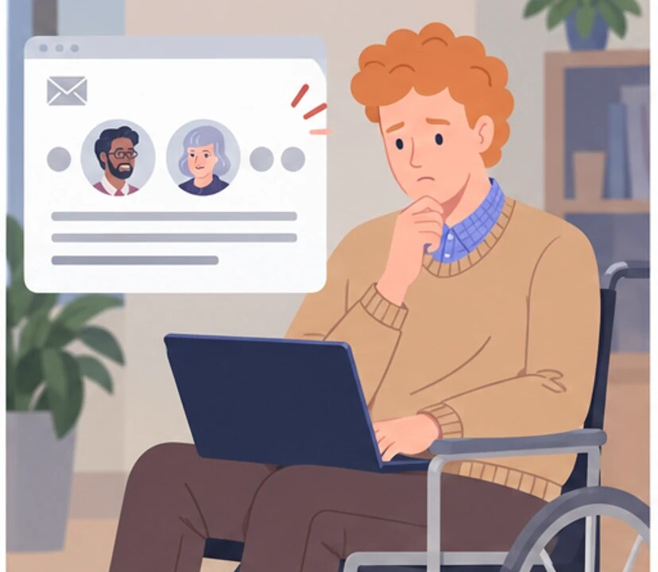
2
Why are all the managers copied immediately?
Notes:
CC: boss, boss, and another boss. Documentation and public blame.
Amira copies managers to preserve a record of the agreement. Olek experiences the same action as a public display of his mistake.
Olek, seated in his wheelchair, sees that managers Karim and Helena were copied on the message.
Empatyzer helps people prepare for important conversations at work by considering the specific person and situation.
Keywords: Empatyzer, Em, workplace communication, people management, important conversation, human differences.

Slide 4

3
Everyone responsible has the same information.
Notes:
CC: boss, boss, and another boss. Documentation and public blame.
Amira copies managers to preserve a record of the agreement. Olek experiences the same action as a public display of his mistake.
Amira calmly returns to work, believing that everyone responsible now has the same information.
Empatyzer helps people prepare for important conversations at work by considering the specific person and situation.
Keywords: Empatyzer, Em, workplace communication, people management, important conversation, human differences.

Slide 5

4
If you have an issue with my work, tell me. Copying the managers looks like protecting yourself at my expense.
To me it’s documentation, not punishment.
Notes:
CC: boss, boss, and another boss. Documentation and public blame.
Amira copies managers to preserve a record of the agreement. Olek experiences the same action as a public display of his mistake.
Olek explains to Amira why copying managers feels like public blame to him.
Empatyzer helps people prepare for important conversations at work by considering the specific person and situation.
Keywords: Empatyzer, Em, workplace communication, people management, important conversation, human differences.

Slide 6
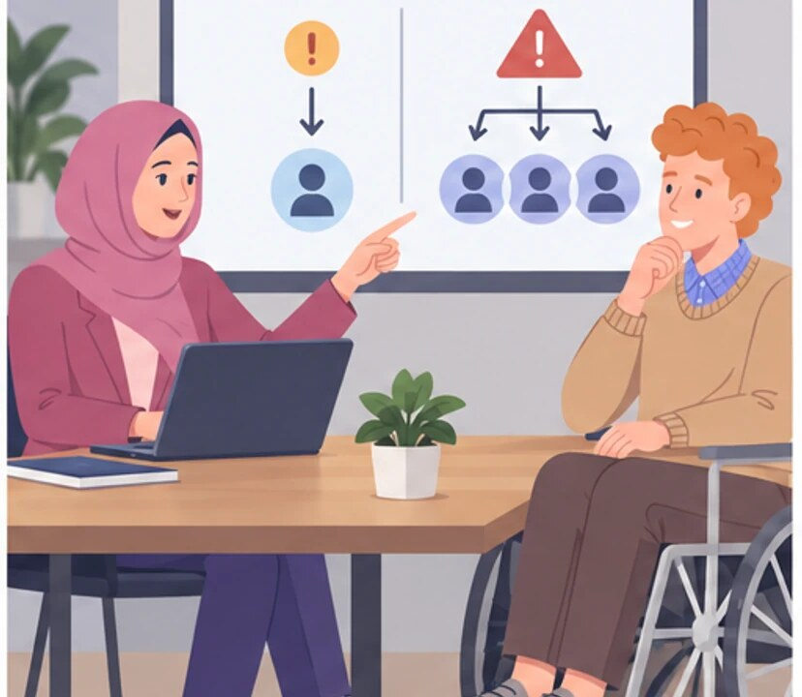
5
And wider visibility only when there’s actually something to escalate.
Small mistakes go directly first.
Notes:
CC: boss, boss, and another boss. Documentation and public blame.
Amira copies managers to preserve a record of the agreement. Olek experiences the same action as a public display of his mistake.
Amira and Olek agree to discuss small corrections directly and escalate genuine risks more widely.
Empatyzer helps people prepare for important conversations at work by considering the specific person and situation.
Keywords: Empatyzer, Em, workplace communication, people management, important conversation, human differences.

Slide 7

6
Amira uses CC as a shared record of accountability,
while Olek sees it as exposing his mistake to people
above him. As a result, the same two email addresses
mean documentation to one person and reputational
escalation to the other. Before copying managers,
state why they are included and what you expect from
them. The recipient list alone does not explain the
message’s purpose.
EMPATYZER · BEFORE AN IMPORTANT CONVERSATION
Notes:
CC: boss, boss, and another boss. Documentation and public blame.
Amira copies managers to preserve a record of the agreement. Olek experiences the same action as a public display of his mistake.
Empatyzer helps people prepare for important conversations at work by considering the specific person and situation.
Keywords: Empatyzer, Em, workplace communication, people management, important conversation, human differences.
Amira uses CC as a shared record of accountability, while Olek sees it as exposing his mistake to people above him. As a result, the same two email addresses mean documentation to one person and reputational escalation to the other. Before copying managers, state why they are included and what you expect from them. The recipient list alone does not explain the message’s purpose.

