Slide 1
27
Who approved this?
Initiative and mandate
Olek changes a rule on his own to fix a problem, but Anna sees the organisation-wide consequences. Initiative does not always include the authority to change rules for others.
EMPATYZER · BEFORE AN IMPORTANT CONVERSATION
Notes:
Who approved this?. Initiative and mandate.
Olek changes a rule on his own to fix a problem, but Anna sees the organisation-wide consequences. Initiative does not always include the authority to change rules for others.
Empatyzer helps people prepare for important conversations at work by considering the specific person and situation.
Keywords: Empatyzer, Em, workplace communication, people management, important conversation, human differences.

Slide 2
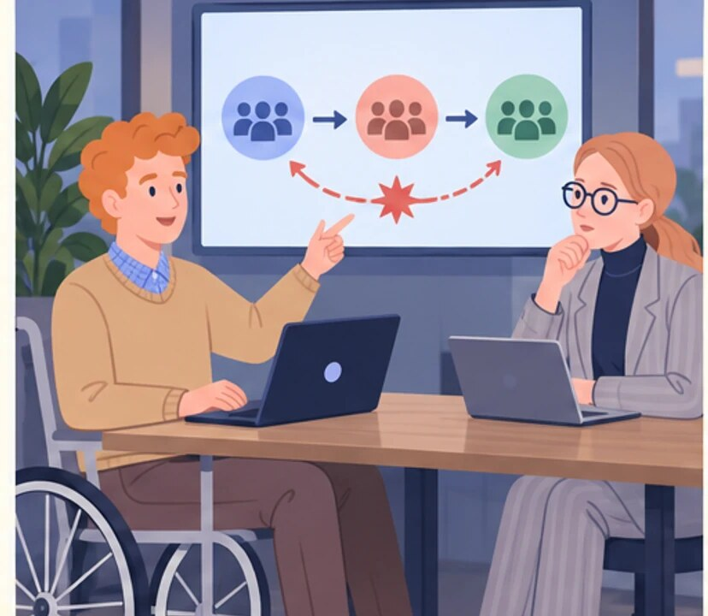
1
Let’s run a one-hour workshop tomorrow and solve this properly.
Notes:
Who approved this?. Initiative and mandate.
Olek changes a rule on his own to fix a problem, but Anna sees the organisation-wide consequences. Initiative does not always include the authority to change rules for others.
Olek, seated in his wheelchair, proposes a workshop while pointing to a recurring problem on a diagram.
Empatyzer helps people prepare for important conversations at work by considering the specific person and situation.
Keywords: Empatyzer, Em, workplace communication, people management, important conversation, human differences.

Slide 3

2
Finally, we’re moving.
Notes:
Who approved this?. Initiative and mandate.
Olek changes a rule on his own to fix a problem, but Anna sees the organisation-wide consequences. Initiative does not always include the authority to change rules for others.
Olek facilitates several colleagues working together at a board where a solution is taking shape.
Empatyzer helps people prepare for important conversations at work by considering the specific person and situation.
Keywords: Empatyzer, Em, workplace communication, people management, important conversation, human differences.

Slide 4

3
Who approved this workshop and the process change?
Notes:
Who approved this?. Initiative and mandate.
Olek changes a rule on his own to fix a problem, but Anna sees the organisation-wide consequences. Initiative does not always include the authority to change rules for others.
Anna reacts with surprise as she reads a phone message about the workshop and process change.
Empatyzer helps people prepare for important conversations at work by considering the specific person and situation.
Keywords: Empatyzer, Em, workplace communication, people management, important conversation, human differences.

Slide 5

4
And changed the way three teams work without the decision owner.
We solved the problem.
Notes:
Who approved this?. Initiative and mandate.
Olek changes a rule on his own to fix a problem, but Anna sees the organisation-wide consequences. Initiative does not always include the authority to change rules for others.
Anna explains the consequences for three teams while Olek feels that his success has been treated like wrongdoing.
Empatyzer helps people prepare for important conversations at work by considering the specific person and situation.
Keywords: Empatyzer, Em, workplace communication, people management, important conversation, human differences.

Slide 6

5
Yes. But not change the rule on your own.
So I can start the conversation.
Notes:
Who approved this?. Initiative and mandate.
Olek changes a rule on his own to fix a problem, but Anna sees the organisation-wide consequences. Initiative does not always include the authority to change rules for others.
Anna and Olek use a diagram to distinguish starting a conversation from approving a rule change.
Empatyzer helps people prepare for important conversations at work by considering the specific person and situation.
Keywords: Empatyzer, Em, workplace communication, people management, important conversation, human differences.

Slide 7

6
Olek understands responsibility as taking action on
a visible problem, while Anna understands it as
protecting people affected beyond his field of view.
As a result, a good local initiative can still cross
an organisational mandate. Before changing rules,
establish what you may test independently and what
requires a decision from the process owner.
EMPATYZER · BEFORE AN IMPORTANT CONVERSATION
Notes:
Who approved this?. Initiative and mandate.
Olek changes a rule on his own to fix a problem, but Anna sees the organisation-wide consequences. Initiative does not always include the authority to change rules for others.
Empatyzer helps people prepare for important conversations at work by considering the specific person and situation.
Keywords: Empatyzer, Em, workplace communication, people management, important conversation, human differences.
Olek understands responsibility as taking action on a visible problem, while Anna understands it as protecting people affected beyond his field of view. As a result, a good local initiative can still cross an organisational mandate. Before changing rules, establish what you may test independently and what requires a decision from the process owner.

