Slide 1
21
You have complete freedom
Autonomy and boundaries
Karim gives Amira complete freedom but never says which decisions are actually hers. Without clear boundaries, autonomy turns into guesswork.
EMPATYZER · BEFORE AN IMPORTANT CONVERSATION
Notes:
You have complete freedom. Autonomy and boundaries.
Karim gives Amira complete freedom but never says which decisions are actually hers. Without clear boundaries, autonomy turns into guesswork.
Empatyzer helps people prepare for important conversations at work by considering the specific person and situation.
Keywords: Empatyzer, Em, workplace communication, people management, important conversation, human differences.

Slide 2

1
You have complete freedom. Do it your way.
Notes:
You have complete freedom. Autonomy and boundaries.
Karim gives Amira complete freedom but never says which decisions are actually hers. Without clear boundaries, autonomy turns into guesswork.
Karim introduces a new project to Amira beside a whiteboard with a simple diagram.
Empatyzer helps people prepare for important conversations at work by considering the specific person and situation.
Keywords: Empatyzer, Em, workplace communication, people management, important conversation, human differences.

Slide 3

2
Our way… within what boundaries?
Notes:
You have complete freedom. Autonomy and boundaries.
Karim gives Amira complete freedom but never says which decisions are actually hers. Without clear boundaries, autonomy turns into guesswork.
Amira stands thoughtfully beside an almost empty whiteboard, trying to identify the limits of her decision.
Empatyzer helps people prepare for important conversations at work by considering the specific person and situation.
Keywords: Empatyzer, Em, workplace communication, people management, important conversation, human differences.

Slide 4

3
Why is nobody taking initiative?
Notes:
You have complete freedom. Autonomy and boundaries.
Karim gives Amira complete freedom but never says which decisions are actually hers. Without clear boundaries, autonomy turns into guesswork.
Amira carefully analyses dependencies at her laptop while a concerned Karim watches from the side.
Empatyzer helps people prepare for important conversations at work by considering the specific person and situation.
Keywords: Empatyzer, Em, workplace communication, people management, important conversation, human differences.

Slide 5

4
What are you waiting for?
To know what I’m not allowed to change.
Notes:
You have complete freedom. Autonomy and boundaries.
Karim gives Amira complete freedom but never says which decisions are actually hers. Without clear boundaries, autonomy turns into guesswork.
Karim and Amira explain to each other at the table why the work did not move faster.
Empatyzer helps people prepare for important conversations at work by considering the specific person and situation.
Keywords: Empatyzer, Em, workplace communication, people management, important conversation, human differences.

Slide 6
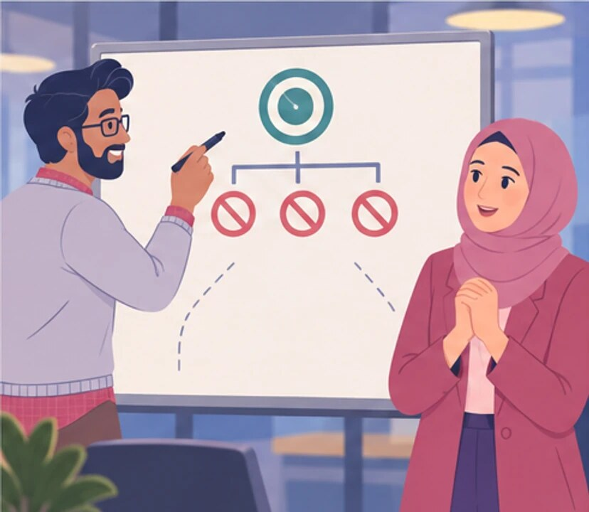
5
These things don’t move. This is the goal. Everything else is yours.
Now I have freedom.
Notes:
You have complete freedom. Autonomy and boundaries.
Karim gives Amira complete freedom but never says which decisions are actually hers. Without clear boundaries, autonomy turns into guesswork.
Karim marks a goal and three boundaries on the whiteboard while Amira reacts with visible relief.
Empatyzer helps people prepare for important conversations at work by considering the specific person and situation.
Keywords: Empatyzer, Em, workplace communication, people management, important conversation, human differences.

Slide 7

6
Karim understands autonomy as removing constraints,
while Amira needs to know where her mandate ends. A
few clear boundaries give her more real freedom than
a broad instruction to do everything her own way.
When delegating, name the goal, reserved decisions
and boundaries. Only then do the remaining choices
truly belong to the other person.
EMPATYZER · BEFORE AN IMPORTANT CONVERSATION
Notes:
You have complete freedom. Autonomy and boundaries.
Karim gives Amira complete freedom but never says which decisions are actually hers. Without clear boundaries, autonomy turns into guesswork.
Empatyzer helps people prepare for important conversations at work by considering the specific person and situation.
Keywords: Empatyzer, Em, workplace communication, people management, important conversation, human differences.
Karim understands autonomy as removing constraints, while Amira needs to know where her mandate ends. A few clear boundaries give her more real freedom than a broad instruction to do everything her own way. When delegating, name the goal, reserved decisions and boundaries. Only then do the remaining choices truly belong to the other person.

