Slide 1
20
Respecting time
Saving someone’s time and deliberately giving it
Zofia shows respect through efficiency. Karim shows it by giving guests unhurried time.
EMPATYZER · BEFORE AN IMPORTANT CONVERSATION
Notes:
Respecting time. Saving someone’s time and deliberately giving it.
Zofia shows respect through efficiency. Karim shows it by giving guests unhurried time.
Empatyzer helps people prepare for important conversations at work by considering the specific person and situation.
Keywords: Empatyzer, Em, workplace communication, people management, important conversation, human differences.

Slide 2
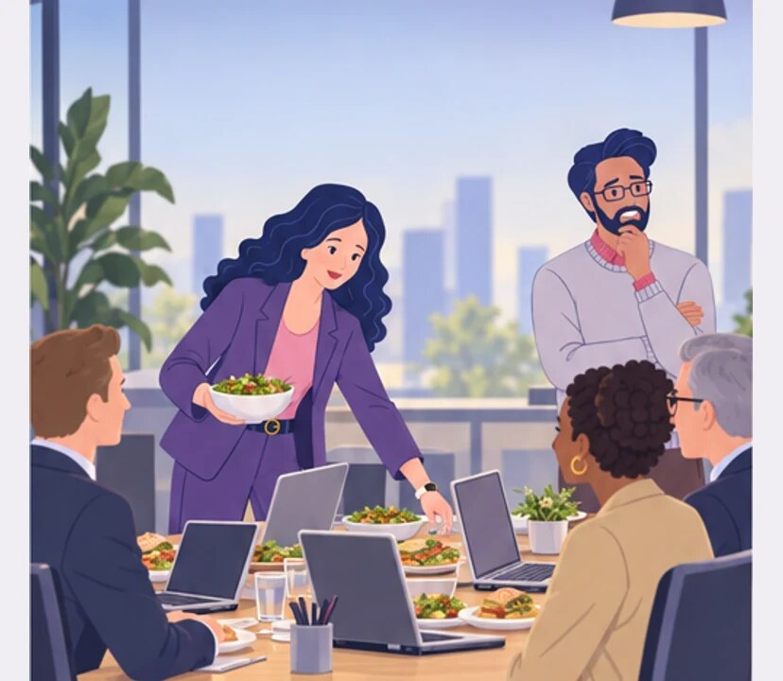
1
We’ll eat here, by the laptops. We won’t take half their day.
At the laptops? We won’t even have time for a proper conversation.
Notes:
Respecting time. Saving someone’s time and deliberately giving it.
Zofia shows respect through efficiency. Karim shows it by giving guests unhurried time.
Zofia arranges lunch by the laptops to avoid taking the guests’ time.
Empatyzer helps people prepare for important conversations at work by considering the specific person and situation.
Keywords: Empatyzer, Em, workplace communication, people management, important conversation, human differences.

Slide 3
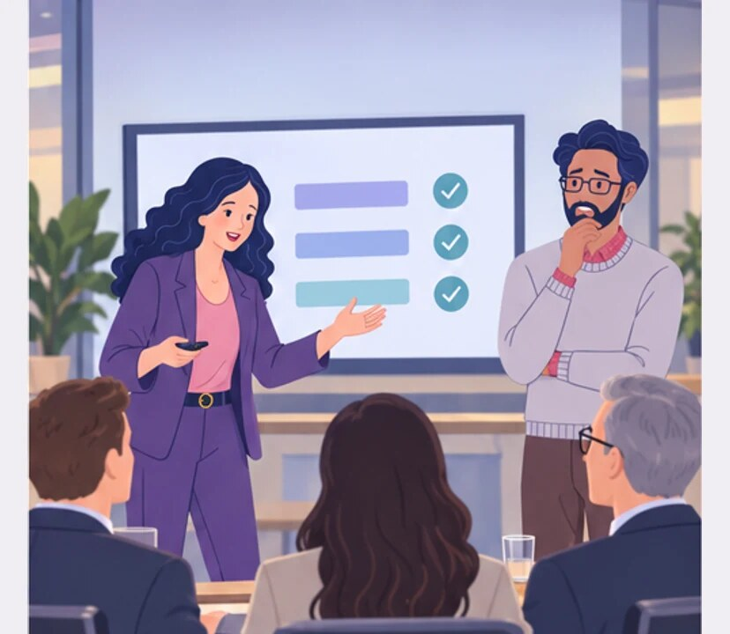
2
It looks like we want to get rid of them as fast as possible.
Efficient. We are respecting their time.
Notes:
Respecting time. Saving someone’s time and deliberately giving it.
Zofia shows respect through efficiency. Karim shows it by giving guests unhurried time.
The meeting runs efficiently but Karim sees cold haste.
Empatyzer helps people prepare for important conversations at work by considering the specific person and situation.
Keywords: Empatyzer, Em, workplace communication, people management, important conversation, human differences.

Slide 4
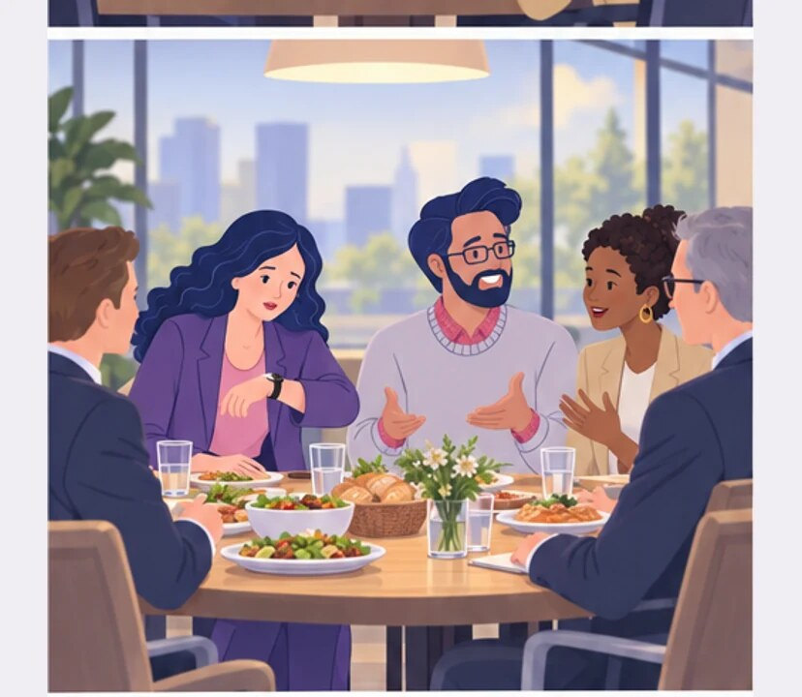
3
A WEEK LATER
Are we ever going to get to business?
Let’s have a proper meal first.
Notes:
Respecting time. Saving someone’s time and deliberately giving it.
Zofia shows respect through efficiency. Karim shows it by giving guests unhurried time.
A week later Karim hosts a long relaxed meal.
Empatyzer helps people prepare for important conversations at work by considering the specific person and situation.
Keywords: Empatyzer, Em, workplace communication, people management, important conversation, human differences.

Slide 5
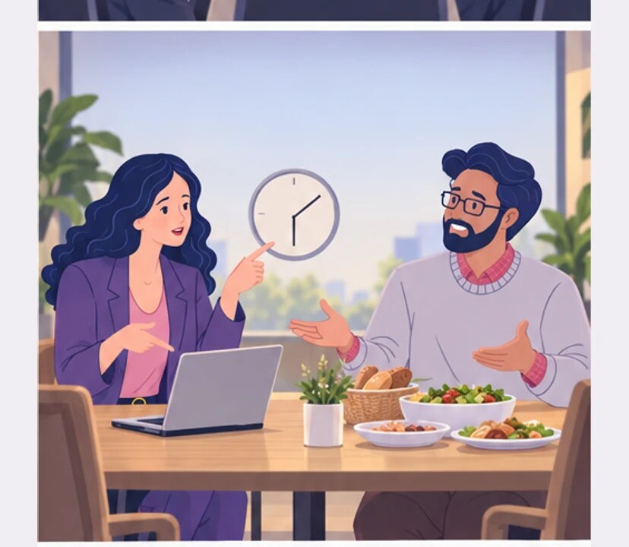
4
And to me, a good host deliberately gives them time.
To me, a good host saves the guests’ time.
Notes:
Respecting time. Saving someone’s time and deliberately giving it.
Zofia shows respect through efficiency. Karim shows it by giving guests unhurried time.
Zofia and Karim compare two definitions of a good host.
Empatyzer helps people prepare for important conversations at work by considering the specific person and situation.
Keywords: Empatyzer, Em, workplace communication, people management, important conversation, human differences.

Slide 6
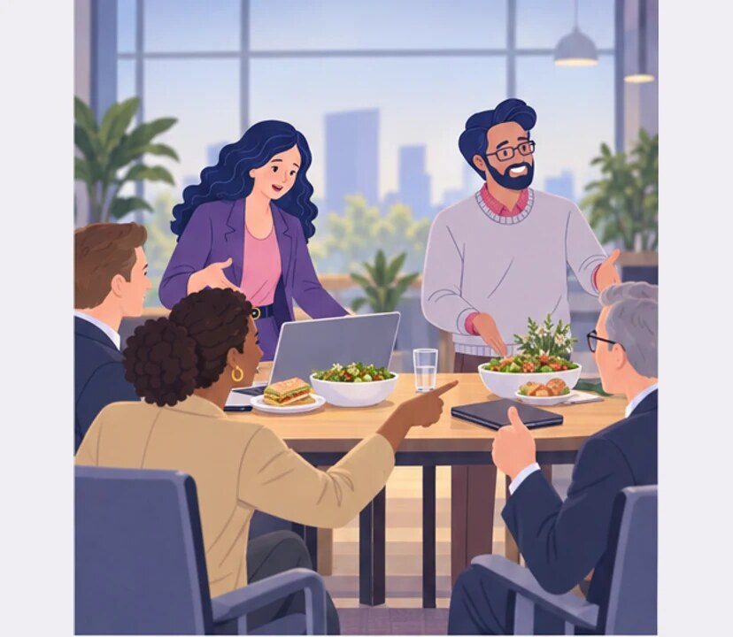
5
NEXT TIME
Would you prefer a quick working lunch or a relaxed meal and business afterwards?
We don’t have to guess for them.
Notes:
Respecting time. Saving someone’s time and deliberately giving it.
Zofia shows respect through efficiency. Karim shows it by giving guests unhurried time.
At the next meeting they ask guests which rhythm they prefer.
Empatyzer helps people prepare for important conversations at work by considering the specific person and situation.
Keywords: Empatyzer, Em, workplace communication, people management, important conversation, human differences.

Slide 7

6
Zofia shows respect by moving efficiently through
the agenda and taking no more of the guests’ time
than necessary. Karim shows respect in the opposite
way: he slows down and demonstrates that the guests
are worth his time. A short meeting can look
professional or cold, while a long meal can feel
hospitable or wasteful. The simplest solution is not
to guess, but ask the guests which rhythm they
prefer.
EMPATYZER · BEFORE AN IMPORTANT CONVERSATION
Notes:
Respecting time. Saving someone’s time and deliberately giving it.
Zofia shows respect through efficiency. Karim shows it by giving guests unhurried time.
Empatyzer helps people prepare for important conversations at work by considering the specific person and situation.
Keywords: Empatyzer, Em, workplace communication, people management, important conversation, human differences.
Zofia shows respect by moving efficiently through the agenda and taking no more of the guests’ time than necessary. Karim shows respect in the opposite way: he slows down and demonstrates that the guests are worth his time. A short meeting can look professional or cold, while a long meal can feel hospitable or wasteful. The simplest solution is not to guess, but ask the guests which rhythm they prefer.

