Slide 1
18
Is everything clear?
No questions and shared understanding
Samuel takes silence as confirmation. Tom and Olek fill the gaps with two different assumptions.
EMPATYZER · BEFORE AN IMPORTANT CONVERSATION
Notes:
Is everything clear?. No questions and shared understanding.
Samuel takes silence as confirmation. Tom and Olek fill the gaps with two different assumptions.
Empatyzer helps people prepare for important conversations at work by considering the specific person and situation.
Keywords: Empatyzer, Em, workplace communication, people management, important conversation, human differences.

Slide 2

1
I think that is everything. Is it all clear?
Notes:
Is everything clear?. No questions and shared understanding.
Samuel takes silence as confirmation. Tom and Olek fill the gaps with two different assumptions.
Samuel quickly finishes explaining a new task.
Empatyzer helps people prepare for important conversations at work by considering the specific person and situation.
Keywords: Empatyzer, Em, workplace communication, people management, important conversation, human differences.

Slide 3

2
Great. Let’s go.
Notes:
Is everything clear?. No questions and shared understanding.
Samuel takes silence as confirmation. Tom and Olek fill the gaps with two different assumptions.
Tom and Olek have different doubts but stay quiet.
Empatyzer helps people prepare for important conversations at work by considering the specific person and situation.
Keywords: Empatyzer, Em, workplace communication, people management, important conversation, human differences.

Slide 4

3
We measure first.
We build first.
Notes:
Is everything clear?. No questions and shared understanding.
Samuel takes silence as confirmation. Tom and Olek fill the gaps with two different assumptions.
Tom starts analysis while Olek builds a prototype.
Empatyzer helps people prepare for important conversations at work by considering the specific person and situation.
Keywords: Empatyzer, Em, workplace communication, people management, important conversation, human differences.

Slide 5
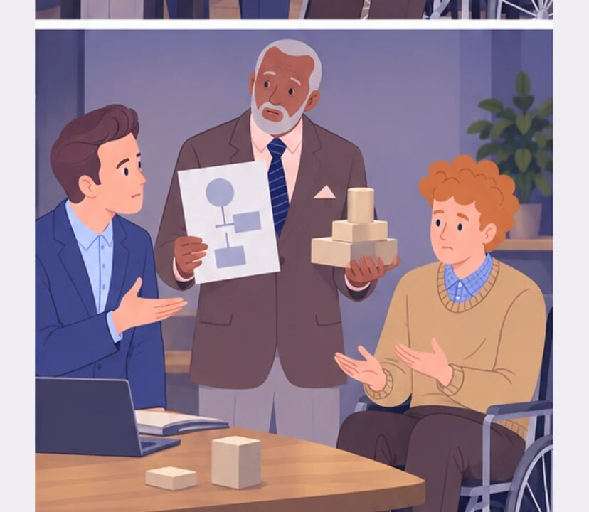
4
We didn’t check whether everyone understood the task the same way.
How did you understand this differently?
Notes:
Is everything clear?. No questions and shared understanding.
Samuel takes silence as confirmation. Tom and Olek fill the gaps with two different assumptions.
Samuel sees two incompatible results.
Empatyzer helps people prepare for important conversations at work by considering the specific person and situation.
Keywords: Empatyzer, Em, workplace communication, people management, important conversation, human differences.

Slide 6
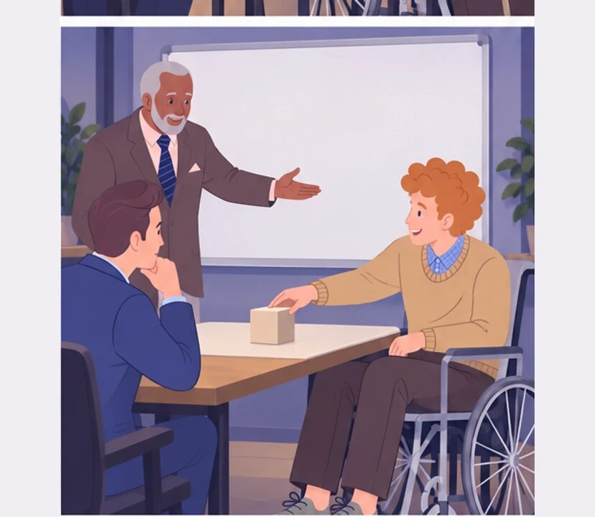
5
Olek, in your own words: what is your first step?
Now I can see it is not what I thought.
Notes:
Is everything clear?. No questions and shared understanding.
Samuel takes silence as confirmation. Tom and Olek fill the gaps with two different assumptions.
Samuel asks Olek to describe the first step.
Empatyzer helps people prepare for important conversations at work by considering the specific person and situation.
Keywords: Empatyzer, Em, workplace communication, people management, important conversation, human differences.

Slide 7

6
Samuel treats the absence of questions as proof of
shared understanding. Tom and Olek do not want to
hold up the group, so they stay quiet and fill the
missing details in their own ways. One confirmation
can then hide two different tasks. Instead of asking
whether everything is clear, ask each person for a
brief summary of the first step.
EMPATYZER · BEFORE AN IMPORTANT CONVERSATION
Notes:
Is everything clear?. No questions and shared understanding.
Samuel takes silence as confirmation. Tom and Olek fill the gaps with two different assumptions.
Empatyzer helps people prepare for important conversations at work by considering the specific person and situation.
Keywords: Empatyzer, Em, workplace communication, people management, important conversation, human differences.
Samuel treats the absence of questions as proof of shared understanding. Tom and Olek do not want to hold up the group, so they stay quiet and fill the missing details in their own ways. One confirmation can then hide two different tasks. Instead of asking whether everything is clear, ask each person for a brief summary of the first step.

