Slide 1
16
It was not my turn
Jumping in and not interrupting others
Zofia reads Amira’s silence as a lack of ideas. Amira waits for a pause that never comes.
EMPATYZER · BEFORE AN IMPORTANT CONVERSATION
Notes:
It was not my turn. Jumping in and not interrupting others.
Zofia reads Amira’s silence as a lack of ideas. Amira waits for a pause that never comes.
Empatyzer helps people prepare for important conversations at work by considering the specific person and situation.
Keywords: Empatyzer, Em, workplace communication, people management, important conversation, human differences.

Slide 2

1
All right, give me your ideas.
Notes:
It was not my turn. Jumping in and not interrupting others.
Zofia reads Amira’s silence as a lack of ideas. Amira waits for a pause that never comes.
During a fast brainstorm Zofia invites ideas.
Empatyzer helps people prepare for important conversations at work by considering the specific person and situation.
Keywords: Empatyzer, Em, workplace communication, people management, important conversation, human differences.

Slide 3
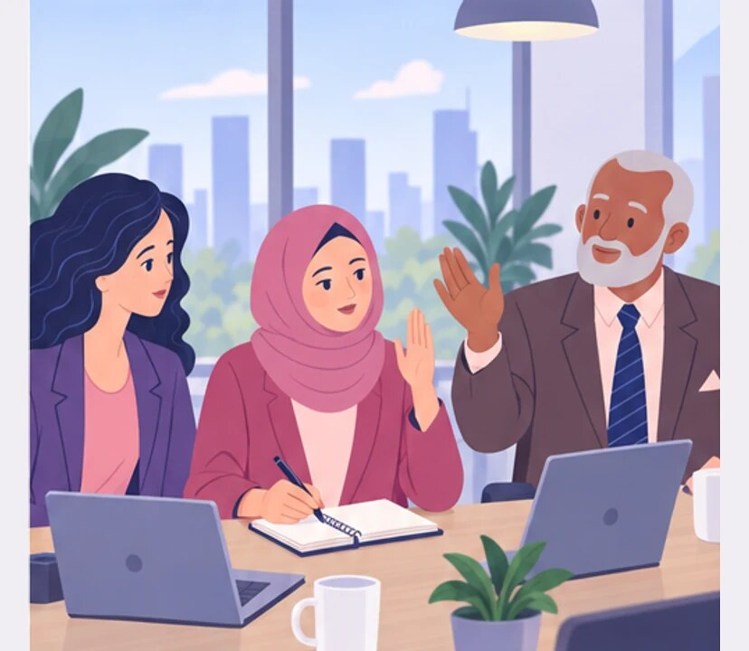
2
I won’t interrupt. I’ll wait for a pause.
Yes! Who is next?
Notes:
It was not my turn. Jumping in and not interrupting others.
Zofia reads Amira’s silence as a lack of ideas. Amira waits for a pause that never comes.
Amira tries to join in but someone starts speaking before her.
Empatyzer helps people prepare for important conversations at work by considering the specific person and situation.
Keywords: Empatyzer, Em, workplace communication, people management, important conversation, human differences.

Slide 4
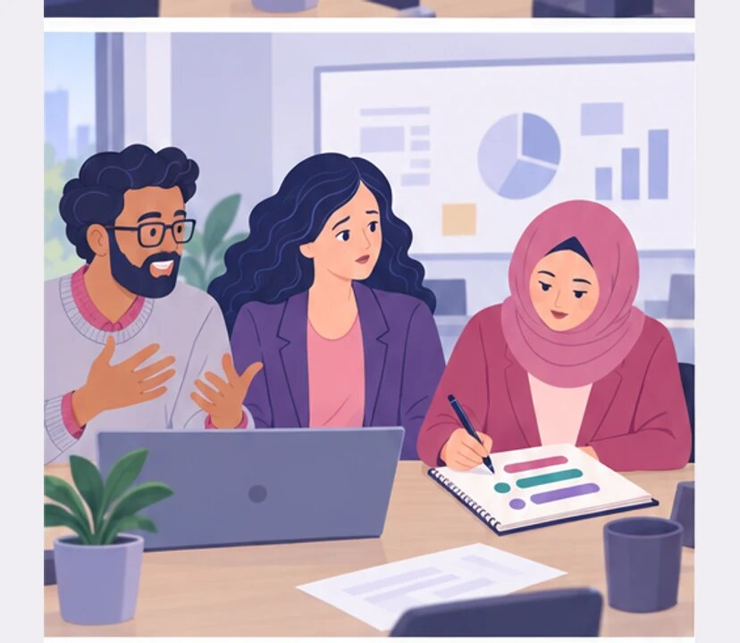
3
Amira isn’t contributing again.
Notes:
It was not my turn. Jumping in and not interrupting others.
Zofia reads Amira’s silence as a lack of ideas. Amira waits for a pause that never comes.
Another person takes the floor and Zofia misreads Amira’s silence.
Empatyzer helps people prepare for important conversations at work by considering the specific person and situation.
Keywords: Empatyzer, Em, workplace communication, people management, important conversation, human differences.

Slide 5
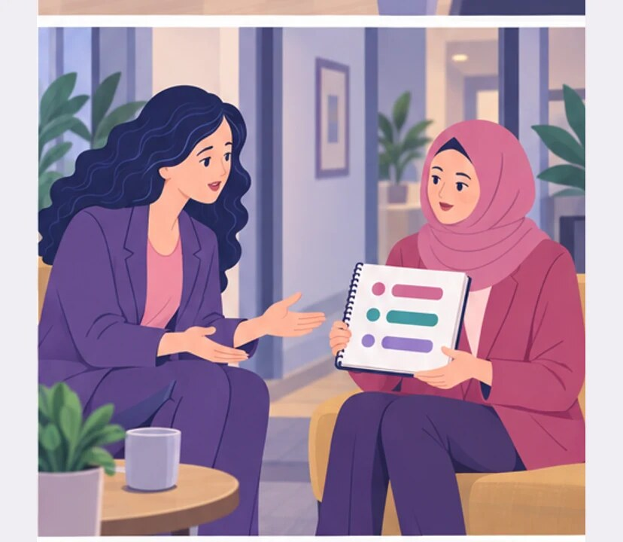
4
AFTER THE MEETING
Amira, I need you to be more active in meetings.
I had three ideas.
Notes:
It was not my turn. Jumping in and not interrupting others.
Zofia reads Amira’s silence as a lack of ideas. Amira waits for a pause that never comes.
After the meeting Zofia asks Amira for more participation.
Empatyzer helps people prepare for important conversations at work by considering the specific person and situation.
Keywords: Empatyzer, Em, workplace communication, people management, important conversation, human differences.

Slide 6
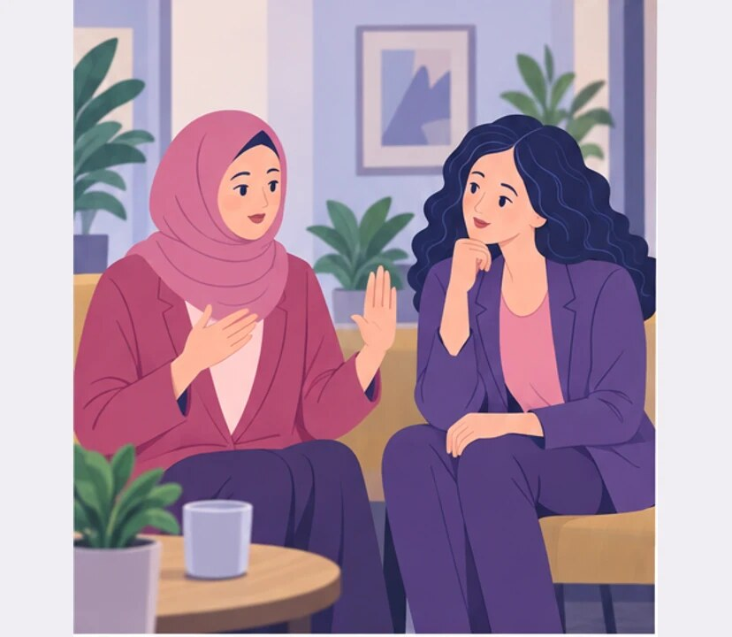
5
I waited for someone to finish and leave room for me to speak.
Then why didn’t you say them?
Notes:
It was not my turn. Jumping in and not interrupting others.
Zofia reads Amira’s silence as a lack of ideas. Amira waits for a pause that never comes.
Amira shows her notes and explains she waited for room to speak.
Empatyzer helps people prepare for important conversations at work by considering the specific person and situation.
Keywords: Empatyzer, Em, workplace communication, people management, important conversation, human differences.

Slide 7

6
Zofia treats jumping into a conversation as a sign
of engagement. Amira shows respect by not
interrupting. In a meeting without pauses, three
good ideas stay in her notebook and silence looks
like no contribution. A simple rule helps: leave
deliberate pauses or invite people to speak in turn.
EMPATYZER · BEFORE AN IMPORTANT CONVERSATION
Notes:
It was not my turn. Jumping in and not interrupting others.
Zofia reads Amira’s silence as a lack of ideas. Amira waits for a pause that never comes.
Empatyzer helps people prepare for important conversations at work by considering the specific person and situation.
Keywords: Empatyzer, Em, workplace communication, people management, important conversation, human differences.
Zofia treats jumping into a conversation as a sign of engagement. Amira shows respect by not interrupting. In a meeting without pauses, three good ideas stay in her notebook and silence looks like no contribution. A simple rule helps: leave deliberate pauses or invite people to speak in turn.

