Slide 1
14
A binder does not build trust
Trust through data and trust through relationship
Anna presents more proof of competence. The partner opens up only over an ordinary dinner.
EMPATYZER · BEFORE AN IMPORTANT CONVERSATION
Notes:
A binder does not build trust. Trust through data and trust through relationship.
Anna presents more proof of competence. The partner opens up only over an ordinary dinner.
Empatyzer helps people prepare for important conversations at work by considering the specific person and situation.
Keywords: Empatyzer, Em, workplace communication, people management, important conversation, human differences.

Slide 2

1
We have everything: numbers, dates and risks. Full transparency.
And when do we simply sit down with them?
Notes:
A binder does not build trust. Trust through data and trust through relationship.
Anna presents more proof of competence. The partner opens up only over an ordinary dinner.
Anna presents a meticulous binder while Karim asks about sitting down with the partner.
Empatyzer helps people prepare for important conversations at work by considering the specific person and situation.
Keywords: Empatyzer, Em, workplace communication, people management, important conversation, human differences.

Slide 3
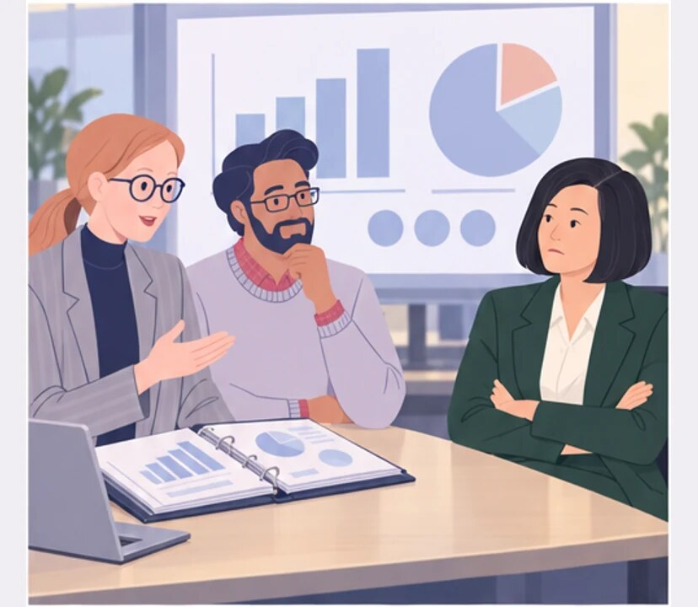
2
What else do they need before they trust us?
Notes:
A binder does not build trust. Trust through data and trust through relationship.
Anna presents more proof of competence. The partner opens up only over an ordinary dinner.
At a formal meeting the partner remains guarded despite good data.
Empatyzer helps people prepare for important conversations at work by considering the specific person and situation.
Keywords: Empatyzer, Em, workplace communication, people management, important conversation, human differences.

Slide 4

3
No presentation tonight. Let’s invite them to dinner.
That is supposed to move the deal forward?
Notes:
A binder does not build trust. Trust through data and trust through relationship.
Anna presents more proof of competence. The partner opens up only over an ordinary dinner.
Karim proposes dinner without a presentation.
Empatyzer helps people prepare for important conversations at work by considering the specific person and situation.
Keywords: Empatyzer, Em, workplace communication, people management, important conversation, human differences.

Slide 5
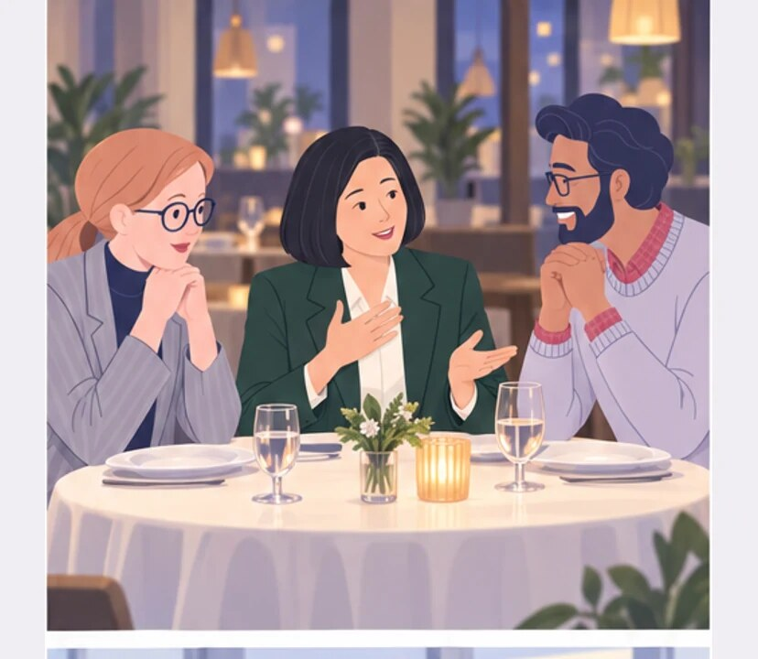
4
THAT EVENING
Do you know what we are really worried about?
Notes:
A binder does not build trust. Trust through data and trust through relationship.
Anna presents more proof of competence. The partner opens up only over an ordinary dinner.
Over dinner the partner shares the real concern.
Empatyzer helps people prepare for important conversations at work by considering the specific person and situation.
Keywords: Empatyzer, Em, workplace communication, people management, important conversation, human differences.

Slide 6

5
THE NEXT DAY
We didn’t show them a single new number yesterday.
But we showed them who we are.
Notes:
A binder does not build trust. Trust through data and trust through relationship.
Anna presents more proof of competence. The partner opens up only over an ordinary dinner.
The next day Anna receives a concrete response.
Empatyzer helps people prepare for important conversations at work by considering the specific person and situation.
Keywords: Empatyzer, Em, workplace communication, people management, important conversation, human differences.

Slide 7

6
Anna builds trust through competence, data and
predictability. Karim knows the other side first
needs to know the people they may work with. Another
chart does not open the conversation, while an
ordinary dinner does. Relationship does not replace
facts: credible data combined with personal contact
gives the partner a reason to share the real
concern.
EMPATYZER · BEFORE AN IMPORTANT CONVERSATION
Notes:
A binder does not build trust. Trust through data and trust through relationship.
Anna presents more proof of competence. The partner opens up only over an ordinary dinner.
Empatyzer helps people prepare for important conversations at work by considering the specific person and situation.
Keywords: Empatyzer, Em, workplace communication, people management, important conversation, human differences.
Anna builds trust through competence, data and predictability. Karim knows the other side first needs to know the people they may work with. Another chart does not open the conversation, while an ordinary dinner does. Relationship does not replace facts: credible data combined with personal contact gives the partner a reason to share the real concern.

