Slide 1
13
The answer before the question
An invitation to discuss and the force of a leader’s view
Anna asks for opinions only after naming her choice. Amira hears a decision already made.
EMPATYZER · BEFORE AN IMPORTANT CONVERSATION
Notes:
The answer before the question. An invitation to discuss and the force of a leader’s view.
Anna asks for opinions only after naming her choice. Amira hears a decision already made.
Empatyzer helps people prepare for important conversations at work by considering the specific person and situation.
Keywords: Empatyzer, Em, workplace communication, people management, important conversation, human differences.

Slide 2

1
I would choose option A. What do you think?
Notes:
The answer before the question. An invitation to discuss and the force of a leader’s view.
Anna asks for opinions only after naming her choice. Amira hears a decision already made.
Anna shows option A and immediately names her choice.
Empatyzer helps people prepare for important conversations at work by considering the specific person and situation.
Keywords: Empatyzer, Em, workplace communication, people management, important conversation, human differences.

Slide 3

2
Does no one really have an opinion?
The decision has already been made.
Notes:
The answer before the question. An invitation to discuss and the force of a leader’s view.
Anna asks for opinions only after naming her choice. Amira hears a decision already made.
Amira holds a different option but stays silent.
Empatyzer helps people prepare for important conversations at work by considering the specific person and situation.
Keywords: Empatyzer, Em, workplace communication, people management, important conversation, human differences.

Slide 4

3
You really can disagree with me.
Option A is fine.
Notes:
The answer before the question. An invitation to discuss and the force of a leader’s view.
Anna asks for opinions only after naming her choice. Amira hears a decision already made.
Anna encourages dissent and Amira reluctantly accepts option A.
Empatyzer helps people prepare for important conversations at work by considering the specific person and situation.
Keywords: Empatyzer, Em, workplace communication, people management, important conversation, human differences.

Slide 5

4
IN A ONE-TO-ONE
Amira, option B is much better. Why didn’t you show it in the meeting?
Because you told us what you were choosing first.
Notes:
The answer before the question. An invitation to discuss and the force of a leader’s view.
Anna asks for opinions only after naming her choice. Amira hears a decision already made.
In a private meeting Anna sees Amira’s stronger option.
Empatyzer helps people prepare for important conversations at work by considering the specific person and situation.
Keywords: Empatyzer, Em, workplace communication, people management, important conversation, human differences.

Slide 6
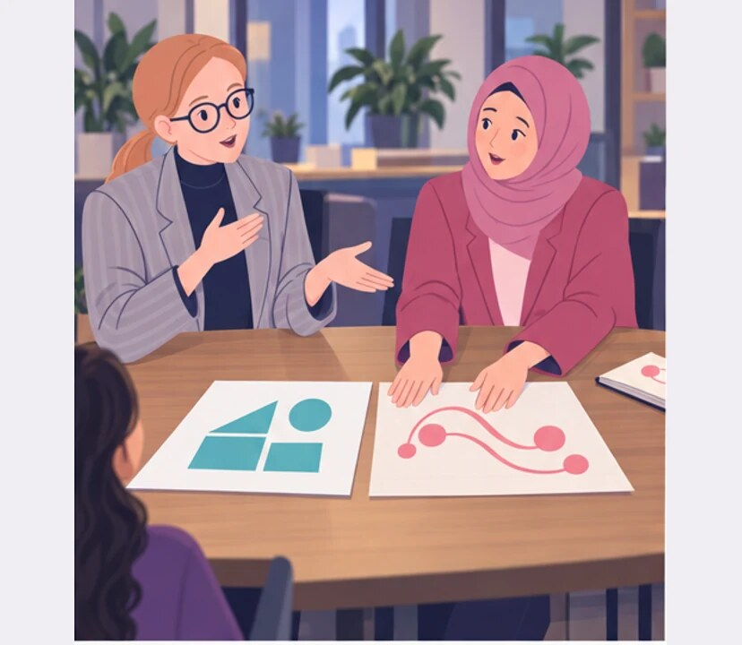
5
I gave an opinion.
I heard a decision.
Notes:
The answer before the question. An invitation to discuss and the force of a leader’s view.
Anna asks for opinions only after naming her choice. Amira hears a decision already made.
Anna and Amira discover two meanings of a leader’s opinion.
Empatyzer helps people prepare for important conversations at work by considering the specific person and situation.
Keywords: Empatyzer, Em, workplace communication, people management, important conversation, human differences.

Slide 7

6
Anna wants an open discussion but reveals her own
choice first. To Amira, the CEO’s opinion carries
more weight than one person’s view, so a later
invitation to disagree does not remove the cost of
dissent. A leader gets more independent answers by
collecting the team’s views first and sharing her
own last.
EMPATYZER · BEFORE AN IMPORTANT CONVERSATION
Notes:
The answer before the question. An invitation to discuss and the force of a leader’s view.
Anna asks for opinions only after naming her choice. Amira hears a decision already made.
Empatyzer helps people prepare for important conversations at work by considering the specific person and situation.
Keywords: Empatyzer, Em, workplace communication, people management, important conversation, human differences.
Anna wants an open discussion but reveals her own choice first. To Amira, the CEO’s opinion carries more weight than one person’s view, so a later invitation to disagree does not remove the cost of dissent. A leader gets more independent answers by collecting the team’s views first and sharing her own last.

