Slide 1
12
Difficult or impossible?
A polite refusal and literal meaning
Samuel believes he rejected the deadline. Jonas hears that it is difficult but still possible.
EMPATYZER · BEFORE AN IMPORTANT CONVERSATION
Notes:
Difficult or impossible?. A polite refusal and literal meaning.
Samuel believes he rejected the deadline. Jonas hears that it is difficult but still possible.
Empatyzer helps people prepare for important conversations at work by considering the specific person and situation.
Keywords: Empatyzer, Em, workplace communication, people management, important conversation, human differences.

Slide 2

1
Can we have it done by Friday?
Hmm… Friday will be very difficult.
Notes:
Difficult or impossible?. A polite refusal and literal meaning.
Samuel believes he rejected the deadline. Jonas hears that it is difficult but still possible.
Jonas asks Samuel about a Friday deployment deadline.
Empatyzer helps people prepare for important conversations at work by considering the specific person and situation.
Keywords: Empatyzer, Em, workplace communication, people management, important conversation, human differences.

Slide 3

2
Difficult, but possible.
Clearly, no.
Notes:
Difficult or impossible?. A polite refusal and literal meaning.
Samuel believes he rejected the deadline. Jonas hears that it is difficult but still possible.
Samuel and Jonas leave the exchange with opposite conclusions.
Empatyzer helps people prepare for important conversations at work by considering the specific person and situation.
Keywords: Empatyzer, Em, workplace communication, people management, important conversation, human differences.

Slide 4

3
ON THURSDAY
Samuel, are we ready for tomorrow?
Tomorrow? I said Friday would be difficult.
Notes:
Difficult or impossible?. A polite refusal and literal meaning.
Samuel believes he rejected the deadline. Jonas hears that it is difficult but still possible.
On Thursday Jonas checks readiness and Samuel is surprised.
Empatyzer helps people prepare for important conversations at work by considering the specific person and situation.
Keywords: Empatyzer, Em, workplace communication, people management, important conversation, human differences.

Slide 5
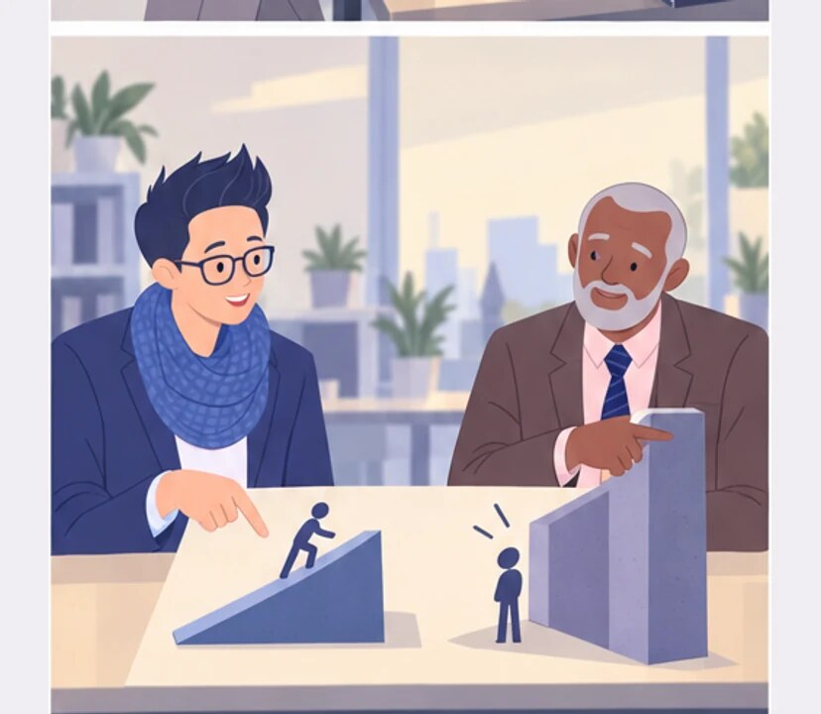
4
Difficult doesn’t mean impossible.
In that conversation, to me it did.
Notes:
Difficult or impossible?. A polite refusal and literal meaning.
Samuel believes he rejected the deadline. Jonas hears that it is difficult but still possible.
Samuel and Jonas discover two meanings of difficult.
Empatyzer helps people prepare for important conversations at work by considering the specific person and situation.
Keywords: Empatyzer, Em, workplace communication, people management, important conversation, human differences.

Slide 6

5
We can’t make Friday. Tuesday is realistic.
Now I know.
Notes:
Difficult or impossible?. A polite refusal and literal meaning.
Samuel believes he rejected the deadline. Jonas hears that it is difficult but still possible.
Samuel gives a clear realistic deadline.
Empatyzer helps people prepare for important conversations at work by considering the specific person and situation.
Keywords: Empatyzer, Em, workplace communication, people management, important conversation, human differences.

Slide 7

6
Samuel uses softened language to decline politely.
Jonas hears it literally: difficult does not mean
impossible. Both leave believing the deadline has
been settled, but each has a different day in mind.
If an answer changes the plan, say no explicitly and
give a realistic alternative immediately.
EMPATYZER · BEFORE AN IMPORTANT CONVERSATION
Notes:
Difficult or impossible?. A polite refusal and literal meaning.
Samuel believes he rejected the deadline. Jonas hears that it is difficult but still possible.
Empatyzer helps people prepare for important conversations at work by considering the specific person and situation.
Keywords: Empatyzer, Em, workplace communication, people management, important conversation, human differences.
Samuel uses softened language to decline politely. Jonas hears it literally: difficult does not mean impossible. Both leave believing the deadline has been settled, but each has a different day in mind. If an answer changes the plan, say no explicitly and give a realistic alternative immediately.

