Slide 1
11
When am I supposed to ask?
Independence and an unspoken escalation threshold
Jonas tells Olek to ask less, then criticises him for asking for help too late.
EMPATYZER · BEFORE AN IMPORTANT CONVERSATION
Notes:
When am I supposed to ask?. Independence and an unspoken escalation threshold.
Jonas tells Olek to ask less, then criticises him for asking for help too late.
Empatyzer helps people prepare for important conversations at work by considering the specific person and situation.
Keywords: Empatyzer, Em, workplace communication, people management, important conversation, human differences.

Slide 2
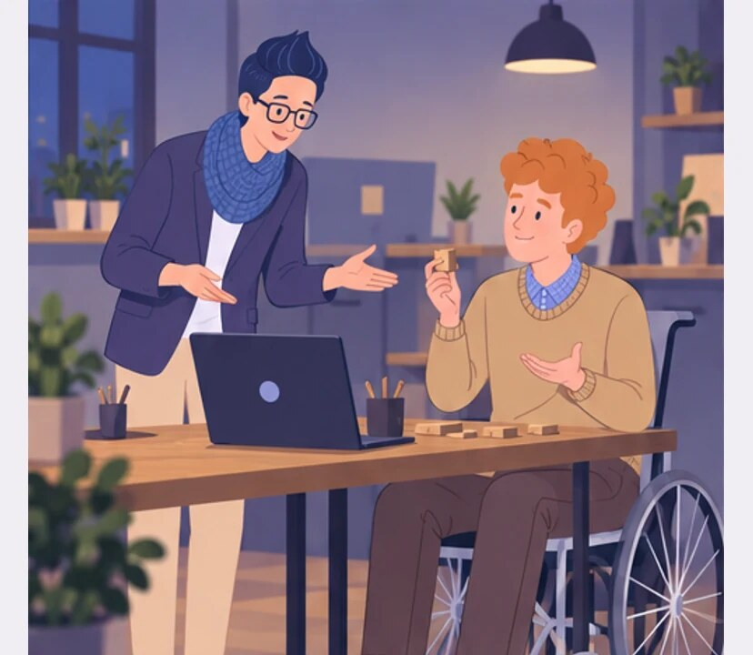
1
Olek, don’t come to me with every small thing. Try it yourself first.
Okay.
Notes:
When am I supposed to ask?. Independence and an unspoken escalation threshold.
Jonas tells Olek to ask less, then criticises him for asking for help too late.
Olek asks Jonas a small question and Jonas tells him to try alone first.
Empatyzer helps people prepare for important conversations at work by considering the specific person and situation.
Keywords: Empatyzer, Em, workplace communication, people management, important conversation, human differences.

Slide 3
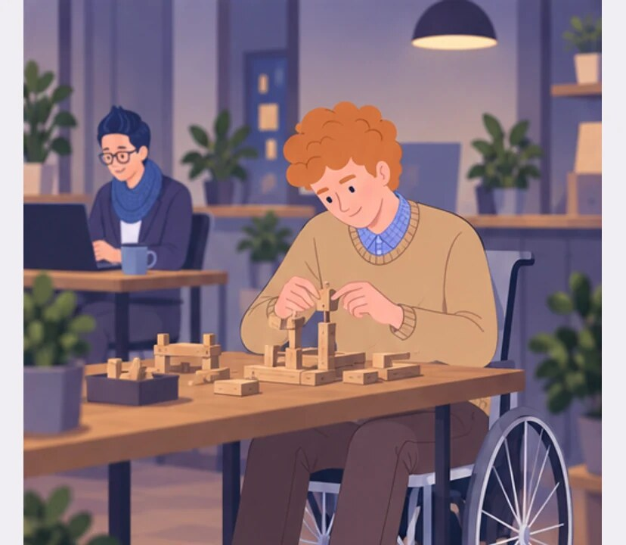
2
I’m supposed to show more independence.
Notes:
When am I supposed to ask?. Independence and an unspoken escalation threshold.
Jonas tells Olek to ask less, then criticises him for asking for help too late.
Olek works independently and does not want to interrupt Jonas.
Empatyzer helps people prepare for important conversations at work by considering the specific person and situation.
Keywords: Empatyzer, Em, workplace communication, people management, important conversation, human differences.

Slide 4
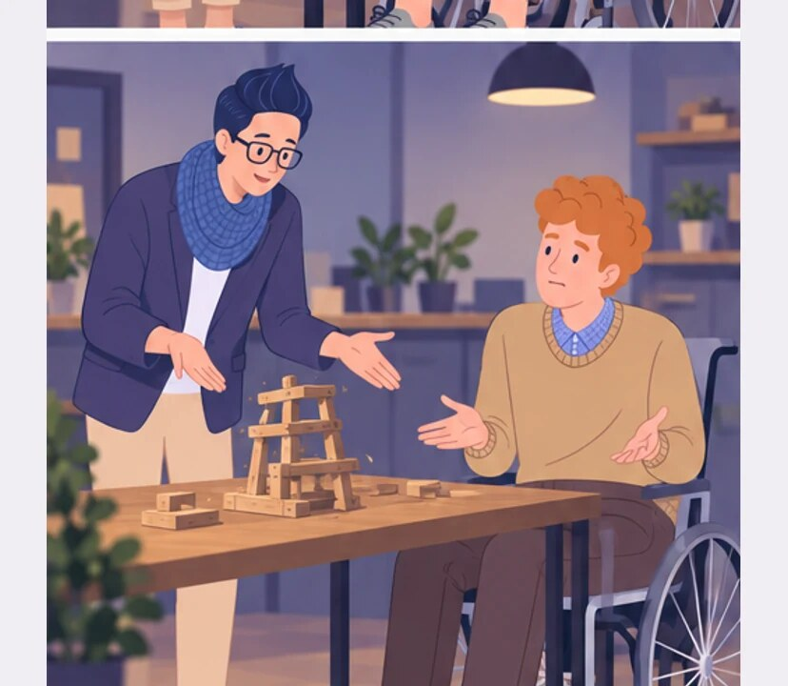
3
DURING THE REVIEW
One thing: when you get stuck, you ask for help too late.
But you told me to ask less.
Notes:
When am I supposed to ask?. Independence and an unspoken escalation threshold.
Jonas tells Olek to ask less, then criticises him for asking for help too late.
During a review Jonas says Olek asks for help too late.
Empatyzer helps people prepare for important conversations at work by considering the specific person and situation.
Keywords: Empatyzer, Em, workplace communication, people management, important conversation, human differences.

Slide 5

4
Ask less about small things, but immediately when timing or quality is at risk.
How was I supposed to know that threshold?
Notes:
When am I supposed to ask?. Independence and an unspoken escalation threshold.
Jonas tells Olek to ask less, then criticises him for asking for help too late.
Jonas names the difference between a small issue and real risk.
Empatyzer helps people prepare for important conversations at work by considering the specific person and situation.
Keywords: Empatyzer, Em, workplace communication, people management, important conversation, human differences.

Slide 6
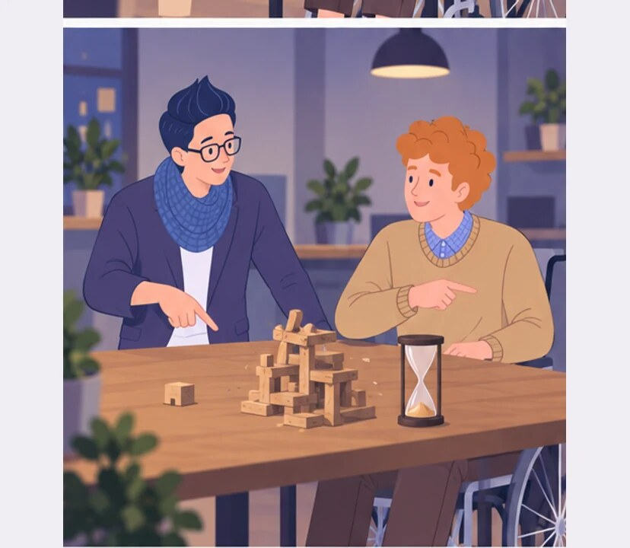
5
If you are still stuck after an hour or see a risk, ask.
Now those messages don’t contradict each other.
Notes:
When am I supposed to ask?. Independence and an unspoken escalation threshold.
Jonas tells Olek to ask less, then criticises him for asking for help too late.
Olek and Jonas write down a clear escalation threshold.
Empatyzer helps people prepare for important conversations at work by considering the specific person and situation.
Keywords: Empatyzer, Em, workplace communication, people management, important conversation, human differences.

Slide 7

6
Jonas has a clear internal line between asking too
early and a necessary request for help. Olek does
not know that line, so the messages ask less and you
should have asked create a trap. Independence works
only when both sides know the threshold: how long to
try alone and what level of risk requires immediate
escalation.
EMPATYZER · BEFORE AN IMPORTANT CONVERSATION
Notes:
When am I supposed to ask?. Independence and an unspoken escalation threshold.
Jonas tells Olek to ask less, then criticises him for asking for help too late.
Empatyzer helps people prepare for important conversations at work by considering the specific person and situation.
Keywords: Empatyzer, Em, workplace communication, people management, important conversation, human differences.
Jonas has a clear internal line between asking too early and a necessary request for help. Olek does not know that line, so the messages ask less and you should have asked create a trap. Independence works only when both sides know the threshold: how long to try alone and what level of risk requires immediate escalation.

