Slide 1
10
A voluntary dinner with the boss
Team bonding and pressure from hierarchy
Karim means the invitation to be optional. Olek knows an invitation from the boss can feel like a test.
EMPATYZER · BEFORE AN IMPORTANT CONVERSATION
Notes:
A voluntary dinner with the boss. Team bonding and pressure from hierarchy.
Karim means the invitation to be optional. Olek knows an invitation from the boss can feel like a test.
Empatyzer helps people prepare for important conversations at work by considering the specific person and situation.
Keywords: Empatyzer, Em, workplace communication, people management, important conversation, human differences.

Slide 2
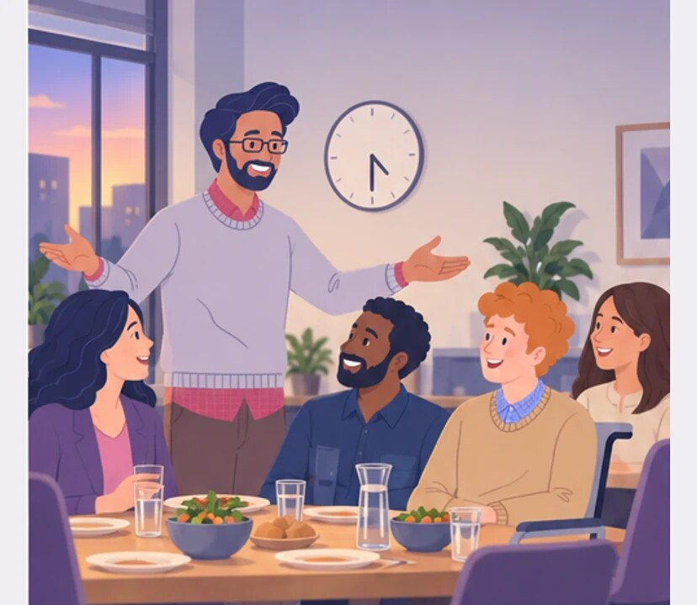
1
4:30 PM
Dinner is on the company tonight. Come along, everyone — it’ll be fun.
Notes:
A voluntary dinner with the boss. Team bonding and pressure from hierarchy.
Karim means the invitation to be optional. Olek knows an invitation from the boss can feel like a test.
Karim invites the whole team to a company dinner.
Empatyzer helps people prepare for important conversations at work by considering the specific person and situation.
Keywords: Empatyzer, Em, workplace communication, people management, important conversation, human differences.

Slide 3
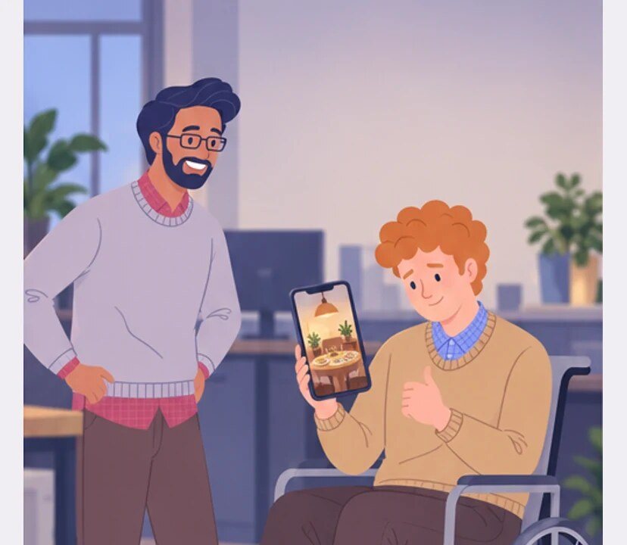
2
If I say no to my boss, I’ll look uncommitted.
Sure, I’ll be there.
Notes:
A voluntary dinner with the boss. Team bonding and pressure from hierarchy.
Karim means the invitation to be optional. Olek knows an invitation from the boss can feel like a test.
Olek agrees although he already has personal plans.
Empatyzer helps people prepare for important conversations at work by considering the specific person and situation.
Keywords: Empatyzer, Em, workplace communication, people management, important conversation, human differences.

Slide 4
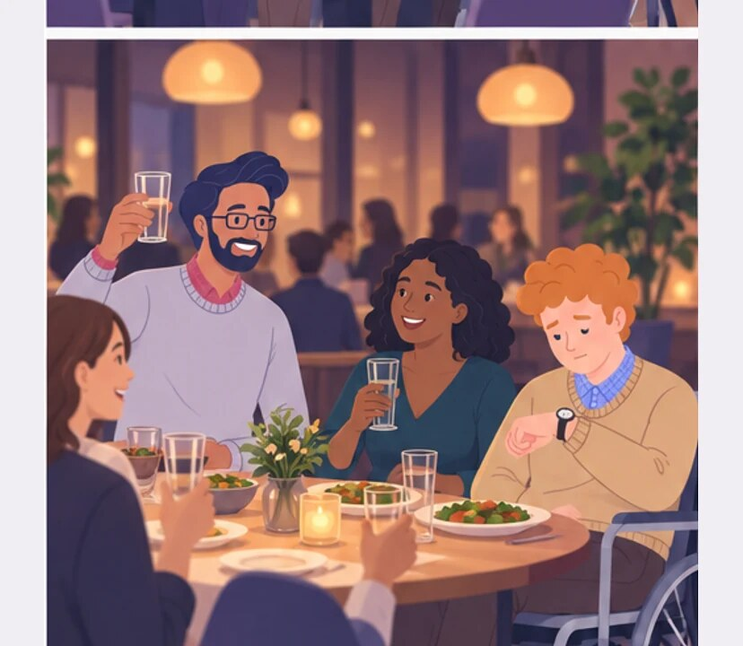
3
To the team. It’s good to spend time together outside work too.
Notes:
A voluntary dinner with the boss. Team bonding and pressure from hierarchy.
Karim means the invitation to be optional. Olek knows an invitation from the boss can feel like a test.
At dinner Karim raises a toast while Olek checks the time.
Empatyzer helps people prepare for important conversations at work by considering the specific person and situation.
Keywords: Empatyzer, Em, workplace communication, people management, important conversation, human differences.

Slide 5
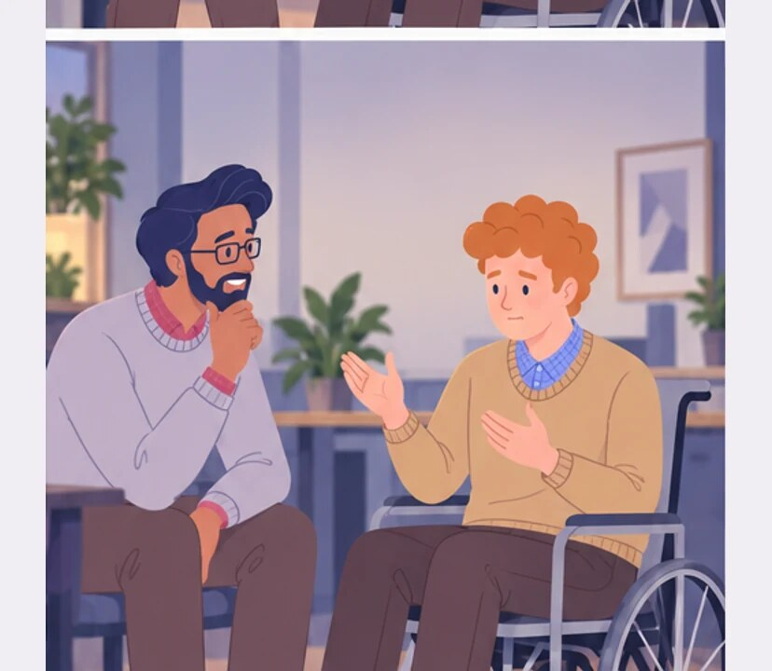
4
THE NEXT DAY
That’s easy to say when the invitation comes from the boss.
I said the dinner was optional.
Notes:
A voluntary dinner with the boss. Team bonding and pressure from hierarchy.
Karim means the invitation to be optional. Olek knows an invitation from the boss can feel like a test.
The next day Olek explains the pressure hidden in the invitation.
Empatyzer helps people prepare for important conversations at work by considering the specific person and situation.
Keywords: Empatyzer, Em, workplace communication, people management, important conversation, human differences.

Slide 6
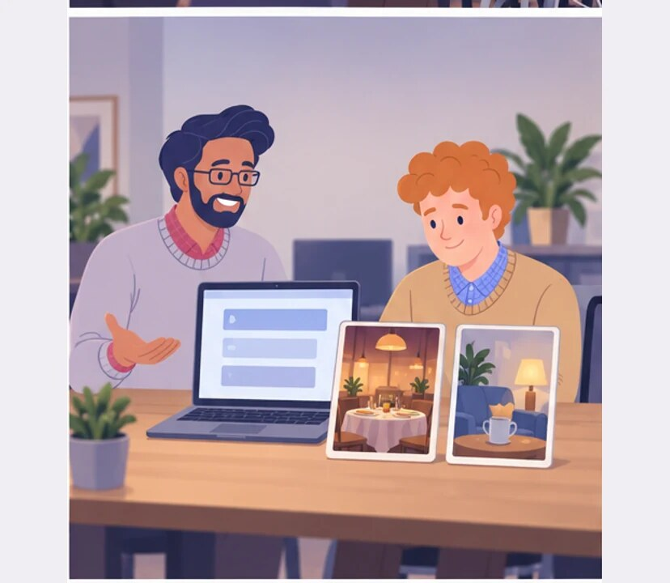
5
If you want to come, great. If not, you genuinely don’t need to explain.
Now that sounds different.
Notes:
A voluntary dinner with the boss. Team bonding and pressure from hierarchy.
Karim means the invitation to be optional. Olek knows an invitation from the boss can feel like a test.
Karim makes the next invitation genuinely consequence-free.
Empatyzer helps people prepare for important conversations at work by considering the specific person and situation.
Keywords: Empatyzer, Em, workplace communication, people management, important conversation, human differences.

Slide 7

6
Karim sees the company dinner as a gift and a way to
build connection. Olek hears an invitation from the
person who evaluates his work, so declining can look
like a lack of commitment. With a power difference,
the word optional is not enough. It must also be
clear that absence needs no explanation and carries
no consequences.
EMPATYZER · BEFORE AN IMPORTANT CONVERSATION
Notes:
A voluntary dinner with the boss. Team bonding and pressure from hierarchy.
Karim means the invitation to be optional. Olek knows an invitation from the boss can feel like a test.
Empatyzer helps people prepare for important conversations at work by considering the specific person and situation.
Keywords: Empatyzer, Em, workplace communication, people management, important conversation, human differences.
Karim sees the company dinner as a gift and a way to build connection. Olek hears an invitation from the person who evaluates his work, so declining can look like a lack of commitment. With a power difference, the word optional is not enough. It must also be clear that absence needs no explanation and carries no consequences.

