Slide 1
09
A country is not an instruction manual
Cultural knowledge and stereotyping
Anna wants to account for Amira’s culture. The map starts answering for the person.
EMPATYZER · BEFORE AN IMPORTANT CONVERSATION
Notes:
A country is not an instruction manual. Cultural knowledge and stereotyping.
Anna wants to account for Amira’s culture. The map starts answering for the person.
Empatyzer helps people prepare for important conversations at work by considering the specific person and situation.
Keywords: Empatyzer, Em, workplace communication, people management, important conversation, human differences.

Slide 2
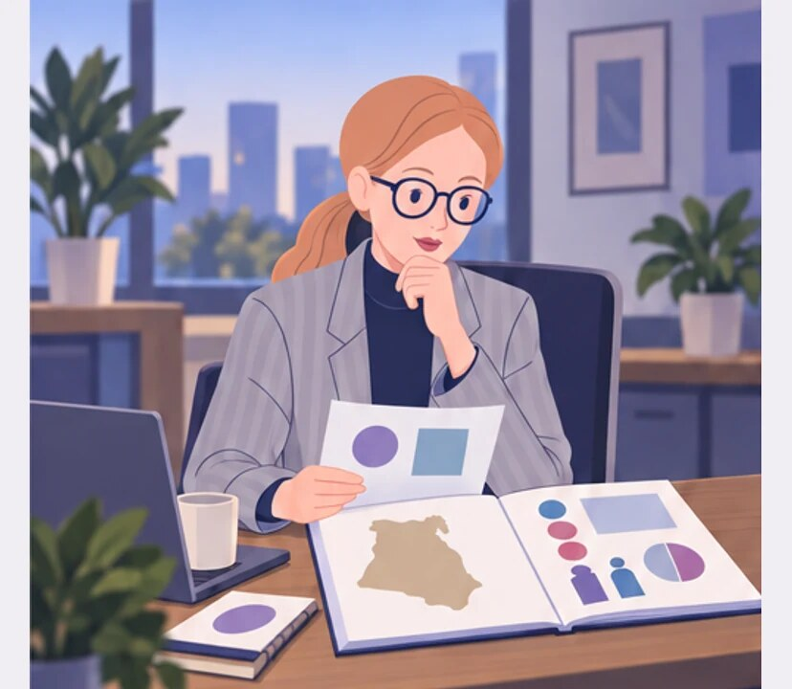
1
In Egypt, people may challenge leaders less openly. Good to know.
Notes:
A country is not an instruction manual. Cultural knowledge and stereotyping.
Anna wants to account for Amira’s culture. The map starts answering for the person.
Anna reads a short cultural profile of Egypt before a meeting.
Empatyzer helps people prepare for important conversations at work by considering the specific person and situation.
Keywords: Empatyzer, Em, workplace communication, people management, important conversation, human differences.

Slide 3

2
I won’t put Amira in a position where she has to challenge her boss in public.
Notes:
A country is not an instruction manual. Cultural knowledge and stereotyping.
Anna wants to account for Amira’s culture. The map starts answering for the person.
Anna plans a debate and leaves Amira out of the critical role.
Empatyzer helps people prepare for important conversations at work by considering the specific person and situation.
Keywords: Empatyzer, Em, workplace communication, people management, important conversation, human differences.

Slide 4
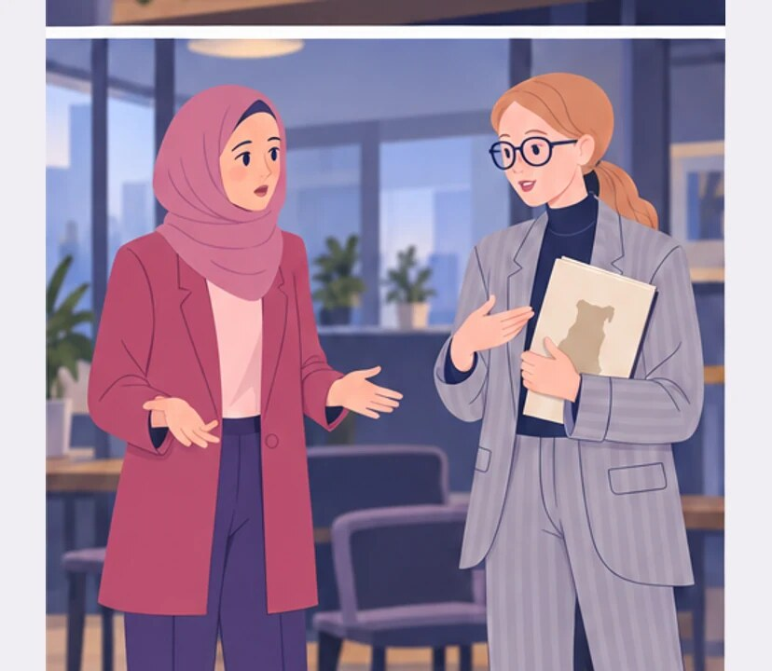
3
AFTER THE MEETING
I thought disagreeing with your boss in public would be uncomfortable for you.
Anna, why didn’t you ask me to assess the solution?
Notes:
A country is not an instruction manual. Cultural knowledge and stereotyping.
Anna wants to account for Amira’s culture. The map starts answering for the person.
After the meeting Amira asks Anna why she was excluded.
Empatyzer helps people prepare for important conversations at work by considering the specific person and situation.
Keywords: Empatyzer, Em, workplace communication, people management, important conversation, human differences.

Slide 5

4
I studied and work here, and I’m on this project precisely to challenge solutions.
Notes:
A country is not an instruction manual. Cultural knowledge and stereotyping.
Anna wants to account for Amira’s culture. The map starts answering for the person.
Amira explains her experience and role in the project.
Empatyzer helps people prepare for important conversations at work by considering the specific person and situation.
Keywords: Empatyzer, Em, workplace communication, people management, important conversation, human differences.

Slide 6
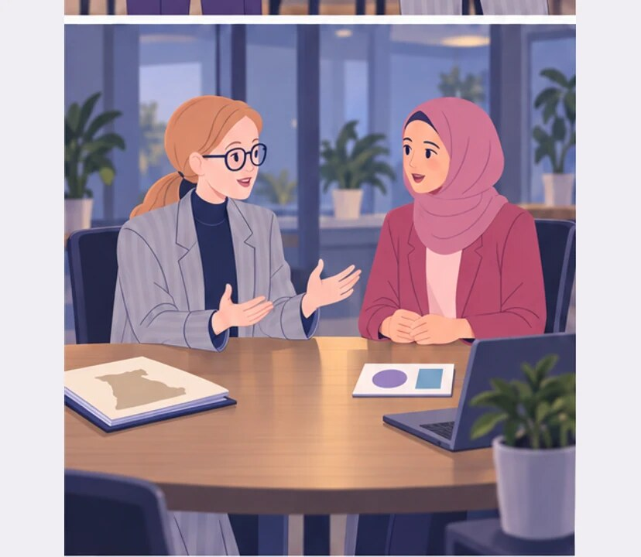
5
I should have asked you instead of answering for you.
A map can suggest questions. It cannot answer for me.
Notes:
A country is not an instruction manual. Cultural knowledge and stereotyping.
Anna wants to account for Amira’s culture. The map starts answering for the person.
Anna sets the country map aside and asks Amira about her own preferences.
Empatyzer helps people prepare for important conversations at work by considering the specific person and situation.
Keywords: Empatyzer, Em, workplace communication, people management, important conversation, human differences.

Slide 7

6
Anna wants to account for cultural differences, but
treats a statistical country profile as a ready-made
description of Amira and makes a decision without
her. Knowledge meant to increase empathy then takes
away the individual’s chance to show who she is. A
map helps when it suggests what to ask. It harms
when it answers for the person in advance.
EMPATYZER · BEFORE AN IMPORTANT CONVERSATION
Notes:
A country is not an instruction manual. Cultural knowledge and stereotyping.
Anna wants to account for Amira’s culture. The map starts answering for the person.
Empatyzer helps people prepare for important conversations at work by considering the specific person and situation.
Keywords: Empatyzer, Em, workplace communication, people management, important conversation, human differences.
Anna wants to account for cultural differences, but treats a statistical country profile as a ready-made description of Amira and makes a decision without her. Knowledge meant to increase empathy then takes away the individual’s chance to show who she is. A map helps when it suggests what to ask. It harms when it answers for the person in advance.

