Slide 1
08
And suddenly no one has ideas
Protecting quality and making initiative safe
Anna wants to protect quality. The team learns that saying nothing is safer.
EMPATYZER · BEFORE AN IMPORTANT CONVERSATION
Notes:
And suddenly no one has ideas. Protecting quality and making initiative safe.
Anna wants to protect quality. The team learns that saying nothing is safer.
Empatyzer helps people prepare for important conversations at work by considering the specific person and situation.
Keywords: Empatyzer, Em, workplace communication, people management, important conversation, human differences.

Slide 2

1
I have a bold idea. I haven’t calculated everything yet.
Notes:
And suddenly no one has ideas. Protecting quality and making initiative safe.
Anna wants to protect quality. The team learns that saying nothing is safer.
Olek enthusiastically presents a risky idea to the team.
Empatyzer helps people prepare for important conversations at work by considering the specific person and situation.
Keywords: Empatyzer, Em, workplace communication, people management, important conversation, human differences.

Slide 3

2
No. It’s underdeveloped and irresponsible. How could you bring us an idea like that?
Notes:
And suddenly no one has ideas. Protecting quality and making initiative safe.
Anna wants to protect quality. The team learns that saying nothing is safer.
Anna rejects Olek’s idea harshly in front of everyone.
Empatyzer helps people prepare for important conversations at work by considering the specific person and situation.
Keywords: Empatyzer, Em, workplace communication, people management, important conversation, human differences.

Slide 4
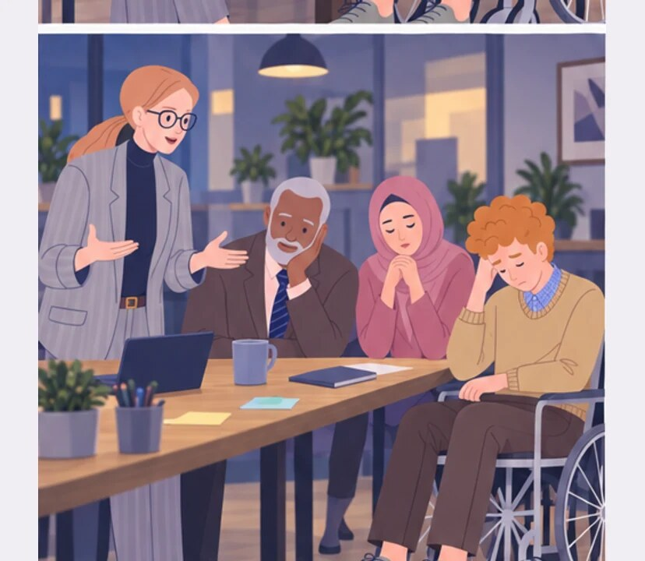
3
THE NEXT MEETING
Do you have any ideas?
Notes:
And suddenly no one has ideas. Protecting quality and making initiative safe.
Anna wants to protect quality. The team learns that saying nothing is safer.
At the next meeting the team stays silent and avoids Anna’s gaze.
Empatyzer helps people prepare for important conversations at work by considering the specific person and situation.
Keywords: Empatyzer, Em, workplace communication, people management, important conversation, human differences.

Slide 5
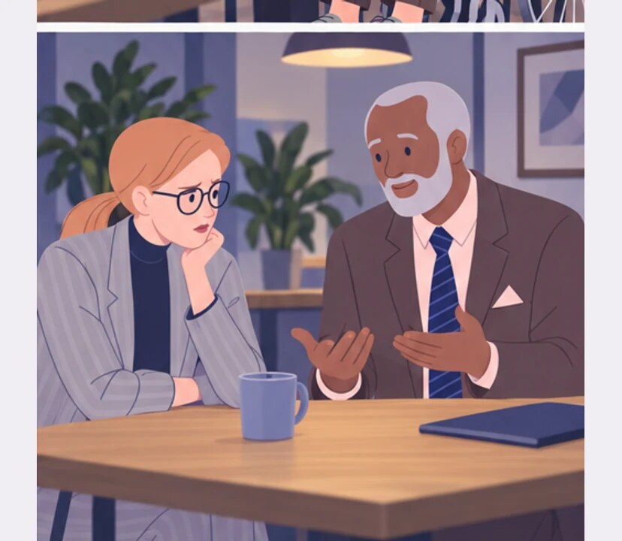
4
What happens when someone brings up a weak idea in front of you?
Nobody proposes anything. No initiative at all.
Notes:
And suddenly no one has ideas. Protecting quality and making initiative safe.
Anna wants to protect quality. The team learns that saying nothing is safer.
Anna tells Samuel that the team lacks initiative.
Empatyzer helps people prepare for important conversations at work by considering the specific person and situation.
Keywords: Empatyzer, Em, workplace communication, people management, important conversation, human differences.

Slide 6

5
This idea has risks. Let’s examine them together. Bringing it up was useful.
Notes:
And suddenly no one has ideas. Protecting quality and making initiative safe.
Anna wants to protect quality. The team learns that saying nothing is safer.
Anna returns and separates criticism of risk from criticism of a person.
Empatyzer helps people prepare for important conversations at work by considering the specific person and situation.
Keywords: Empatyzer, Em, workplace communication, people management, important conversation, human differences.

Slide 7

6
Anna wants to protect quality, so she rejects Olek’s
idea harshly and in public. The team sees that an
unfinished proposal can end in humiliation and
chooses silence. What Anna reads as a lack of
initiative is a response to the way she previously
reacted to initiative. Ideas can be tested
rigorously without judging the person who raised
them.
EMPATYZER · BEFORE AN IMPORTANT CONVERSATION
Notes:
And suddenly no one has ideas. Protecting quality and making initiative safe.
Anna wants to protect quality. The team learns that saying nothing is safer.
Empatyzer helps people prepare for important conversations at work by considering the specific person and situation.
Keywords: Empatyzer, Em, workplace communication, people management, important conversation, human differences.
Anna wants to protect quality, so she rejects Olek’s idea harshly and in public. The team sees that an unfinished proposal can end in humiliation and chooses silence. What Anna reads as a lack of initiative is a response to the way she previously reacted to initiative. Ideas can be tested rigorously without judging the person who raised them.

