Slide 1
07
I was only joking
Irony in the sender’s head and words on the screen
Olek sends a joke. Maja receives only words without his tone of voice.
EMPATYZER · BEFORE AN IMPORTANT CONVERSATION
Notes:
I was only joking. Irony in the sender’s head and words on the screen.
Olek sends a joke. Maja receives only words without his tone of voice.
Empatyzer helps people prepare for important conversations at work by considering the specific person and situation.
Keywords: Empatyzer, Em, workplace communication, people management, important conversation, human differences.

Slide 2

1
Great. Just five more revisions and maybe it will be ready.
Notes:
I was only joking. Irony in the sender’s head and words on the screen.
Olek sends a joke. Maja receives only words without his tone of voice.
Olek smiles as he sends an ironic message from his laptop.
Empatyzer helps people prepare for important conversations at work by considering the specific person and situation.
Keywords: Empatyzer, Em, workplace communication, people management, important conversation, human differences.

Slide 3

2
You can obviously hear that I’m joking.
So he thinks I did everything wrong.
Notes:
I was only joking. Irony in the sender’s head and words on the screen.
Olek sends a joke. Maja receives only words without his tone of voice.
Maja reads the message seriously while Olek still smiles.
Empatyzer helps people prepare for important conversations at work by considering the specific person and situation.
Keywords: Empatyzer, Em, workplace communication, people management, important conversation, human differences.

Slide 4

3
Understood. I will prepare another version based on your comments.
Why is she suddenly writing so formally?
Notes:
I was only joking. Irony in the sender’s head and words on the screen.
Olek sends a joke. Maja receives only words without his tone of voice.
Maja replies formally and Olek is puzzled by the change of tone.
Empatyzer helps people prepare for important conversations at work by considering the specific person and situation.
Keywords: Empatyzer, Em, workplace communication, people management, important conversation, human differences.

Slide 5
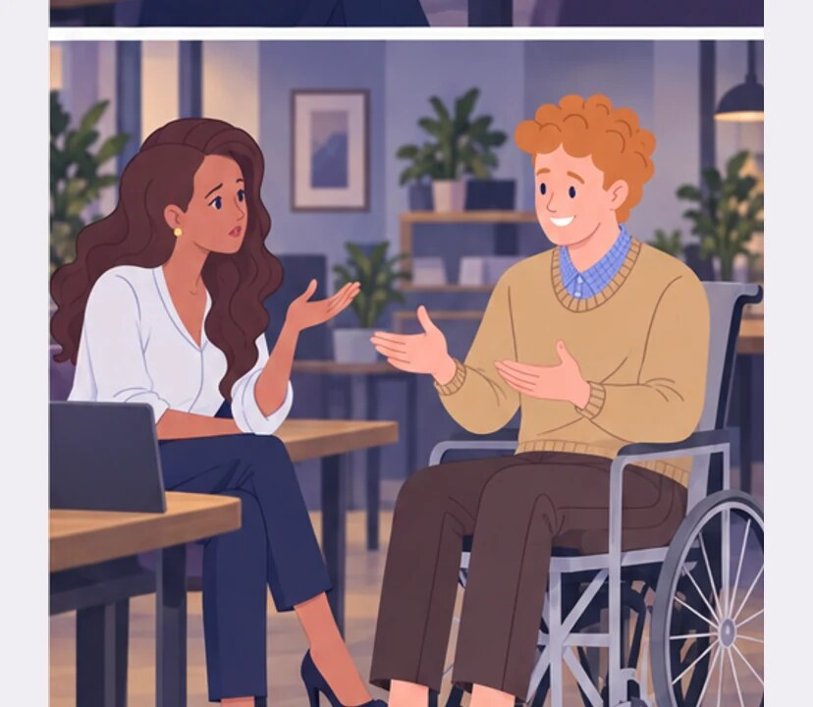
4
Maja, I was only joking.
How was I supposed to know it was a joke?
Notes:
I was only joking. Irony in the sender’s head and words on the screen.
Olek sends a joke. Maja receives only words without his tone of voice.
Olek and Maja discuss the misunderstood message.
Empatyzer helps people prepare for important conversations at work by considering the specific person and situation.
Keywords: Empatyzer, Em, workplace communication, people management, important conversation, human differences.

Slide 6
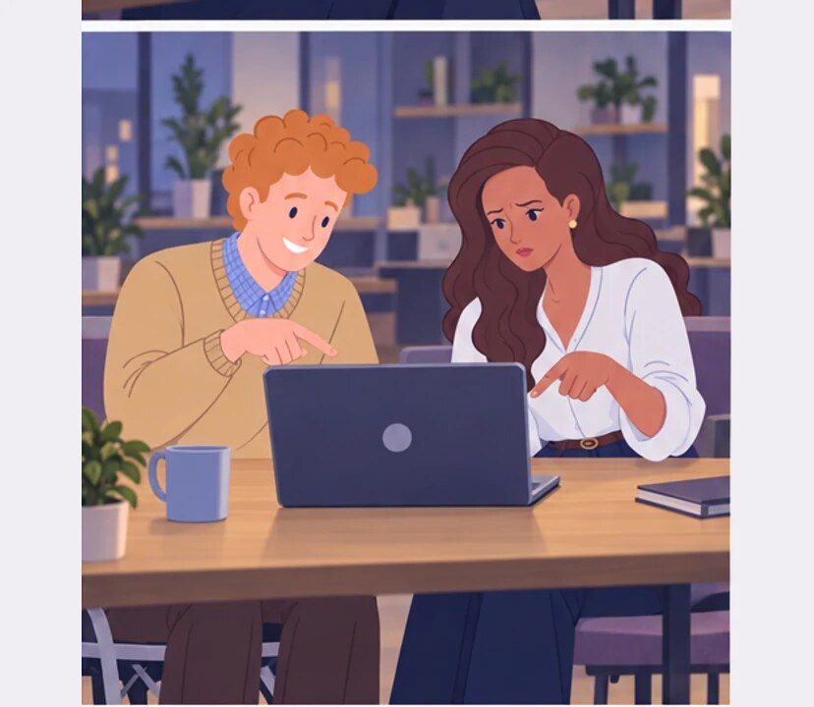
5
In my head it sounded light.
On the screen it sounded like a complaint.
Notes:
I was only joking. Irony in the sender’s head and words on the screen.
Olek sends a joke. Maja receives only words without his tone of voice.
Olek and Maja see two meanings in the same words.
Empatyzer helps people prepare for important conversations at work by considering the specific person and situation.
Keywords: Empatyzer, Em, workplace communication, people management, important conversation, human differences.

Slide 7

6
Olek reads his own message with the tone he can hear
in his head. Maja receives only written words,
without the smile and intonation. The irony
disappears and the joke starts to sound like a
complaint. In a short message, mark the joke clearly
or use a channel that carries tone.
EMPATYZER · BEFORE AN IMPORTANT CONVERSATION
Notes:
I was only joking. Irony in the sender’s head and words on the screen.
Olek sends a joke. Maja receives only words without his tone of voice.
Empatyzer helps people prepare for important conversations at work by considering the specific person and situation.
Keywords: Empatyzer, Em, workplace communication, people management, important conversation, human differences.
Olek reads his own message with the tone he can hear in his head. Maja receives only written words, without the smile and intonation. The irony disappears and the joke starts to sound like a complaint. In a short message, mark the joke clearly or use a channel that carries tone.

