Slide 1
04
Say something!
Speaking immediately and needing a pause
Zofia reads silence as indifference. Olek goes quiet because he is trying to answer carefully.
EMPATYZER · BEFORE AN IMPORTANT CONVERSATION
Notes:
Say something!. Speaking immediately and needing a pause.
Zofia reads silence as indifference. Olek goes quiet because he is trying to answer carefully.
Empatyzer helps people prepare for important conversations at work by considering the specific person and situation.
Keywords: Empatyzer, Em, workplace communication, people management, important conversation, human differences.

Slide 2

1
EVENING
Olek, once again I’m the last to know. Why didn’t you tell me?
Notes:
Say something!. Speaking immediately and needing a pause.
Zofia reads silence as indifference. Olek goes quiet because he is trying to answer carefully.
Zofia asks Olek why he did not tell her something important.
Empatyzer helps people prepare for important conversations at work by considering the specific person and situation.
Keywords: Empatyzer, Em, workplace communication, people management, important conversation, human differences.

Slide 3

2
I need to sort this out so I don’t say something stupid.
Olek, say something!
Notes:
Say something!. Speaking immediately and needing a pause.
Zofia reads silence as indifference. Olek goes quiet because he is trying to answer carefully.
Zofia pushes for an answer while Olek needs a moment to collect his thoughts.
Empatyzer helps people prepare for important conversations at work by considering the specific person and situation.
Keywords: Empatyzer, Em, workplace communication, people management, important conversation, human differences.

Slide 4

3
Notes:
Say something!. Speaking immediately and needing a pause.
Zofia reads silence as indifference. Olek goes quiet because he is trying to answer carefully.
Zofia raises her voice and Olek withdraws further.
Empatyzer helps people prepare for important conversations at work by considering the specific person and situation.
Keywords: Empatyzer, Em, workplace communication, people management, important conversation, human differences.

Slide 5
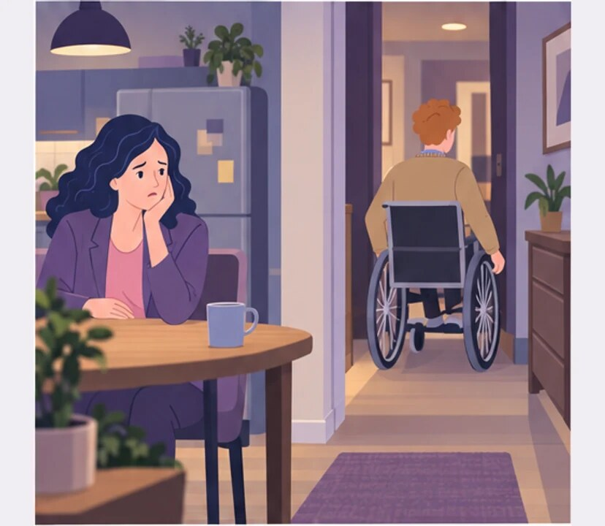
4
He doesn’t even care.
Notes:
Say something!. Speaking immediately and needing a pause.
Zofia reads silence as indifference. Olek goes quiet because he is trying to answer carefully.
Olek leaves and Zofia remains alone at the table.
Empatyzer helps people prepare for important conversations at work by considering the specific person and situation.
Keywords: Empatyzer, Em, workplace communication, people management, important conversation, human differences.

Slide 6
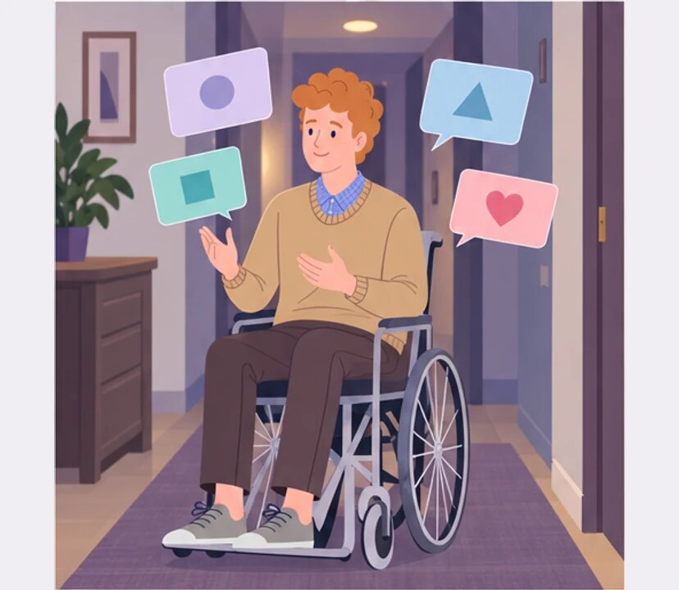
5
40 MINUTES LATER
Now I know what to tell her.
Notes:
Say something!. Speaking immediately and needing a pause.
Zofia reads silence as indifference. Olek goes quiet because he is trying to answer carefully.
After some time alone, Olek is ready to return to the conversation.
Empatyzer helps people prepare for important conversations at work by considering the specific person and situation.
Keywords: Empatyzer, Em, workplace communication, people management, important conversation, human differences.

Slide 7

6
Zofia treats an immediate reaction as proof of
engagement. Olek goes quiet precisely because he
cares and does not want to answer rashly. The harder
she pushes, the more he withdraws, which she
mistakes for indifference. One simple sentence
helps: I need twenty minutes, but I will come back
and finish this conversation.
EMPATYZER · BEFORE AN IMPORTANT CONVERSATION
Notes:
Say something!. Speaking immediately and needing a pause.
Zofia reads silence as indifference. Olek goes quiet because he is trying to answer carefully.
Empatyzer helps people prepare for important conversations at work by considering the specific person and situation.
Keywords: Empatyzer, Em, workplace communication, people management, important conversation, human differences.
Zofia treats an immediate reaction as proof of engagement. Olek goes quiet precisely because he cares and does not want to answer rashly. The harder she pushes, the more he withdraws, which she mistakes for indifference. One simple sentence helps: I need twenty minutes, but I will come back and finish this conversation.

